Slide 1
Workstation Ergonomics & Injury Prevention
Mark Gugliotti
Associate Professor, Physical Therapy

Slide 2
Work-related Injury
Every 7 seconds a worker is injured on the job. (immediate/over time)
Neck pain and/or headache
Low back pain
Shoulder pain
Wrist pain
Nerve compression

Slide 3
Neck pain and Headaches
Results of long term strain placed upon joints, ligaments, and muscles due to poor posture, stress, and working habits

Slide 4
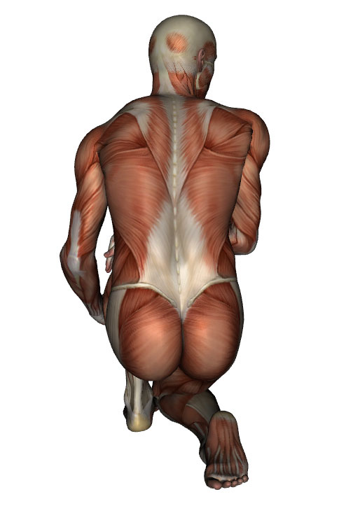
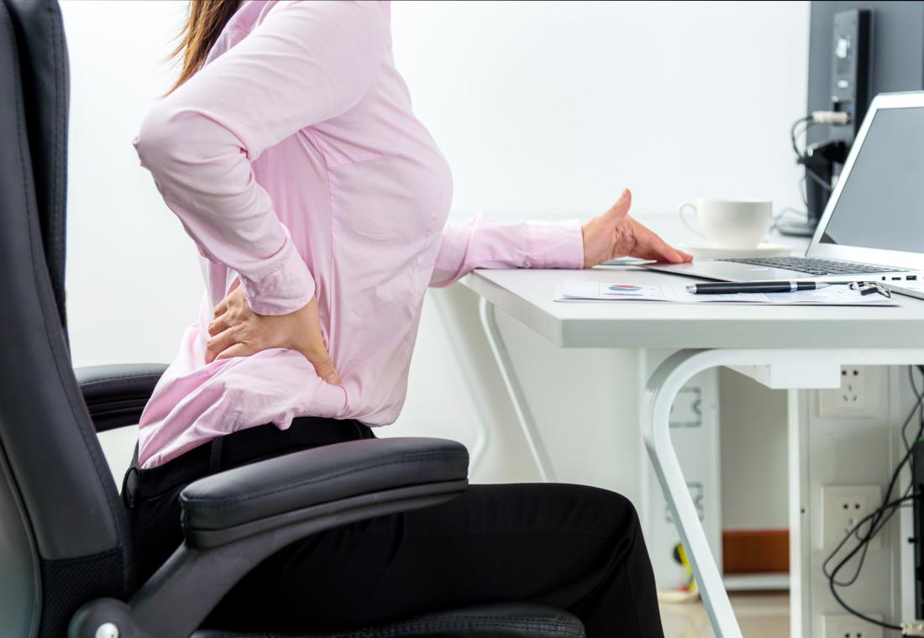
Low Back Pain
Results of long term strain placed upon joints, ligaments, and muscles due to poor posture, stress, and working habits

Slide 5
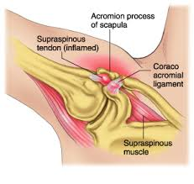
Shoulder pain
Results from long term strain most often from improper table height and mouse use.

Slide 6
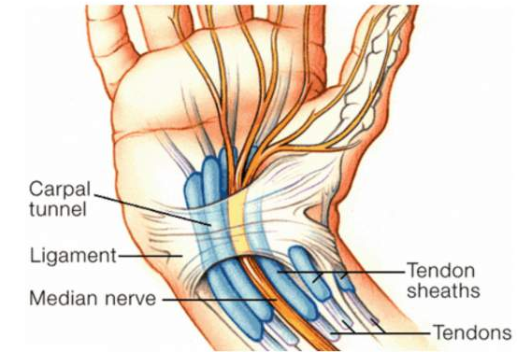
Wrist Pain
Results from long term strain most often from improper hand use, table height, and mouse use.

Slide 7
Common Causes
Poor posture
Faulty body mechanics
Loss of strength and flexibility
Stressful living and work habits
General decline of physical fitness

Slide 8
The Pain Cycle
Pain
Anger, Frustration,
Helplessness
Muscle Guarding
Function Loss
Spasm and Inflammation
Muscle Weakness
Restricted Mobility

Slide 9
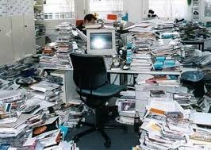
Workstation Contributing Factors
Crowded space
Chair type
Desk height
Monitor position
Keyboard and mouse

Slide 10
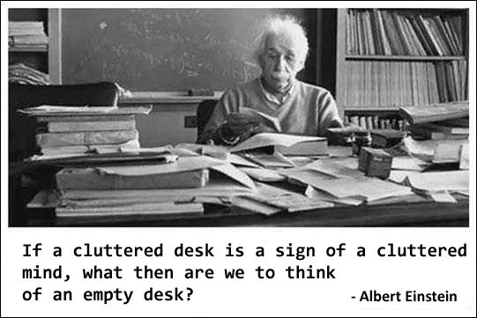
Maybe just more ergonomic. Hmm?

Slide 11
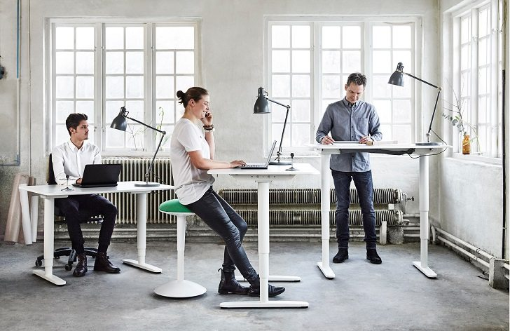
Ergonomics
An applied science concerned with designing and arranging things for people use so that the people and things interact most efficiently and safely.

Slide 12
Sit or Stand?
Sitting
Standing
Unloads hips, knees, and feet
Provides support to neck and back
Provides support to arms
Provides easy access to drawers
May ↓ risk of weight gain/obesity
May ↓ risk of heart disease
May ↓ blood sugar levels
Appears to ↓ low back pain
May improve mood/energy levels

Slide 13
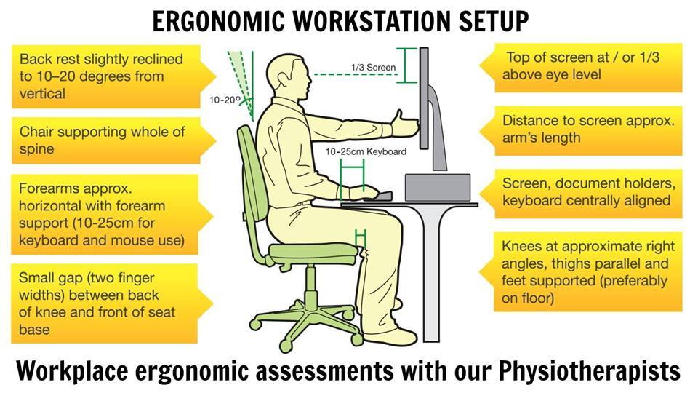
Sitting
https://flexispot.com/ergonomic-calculator

Slide 14
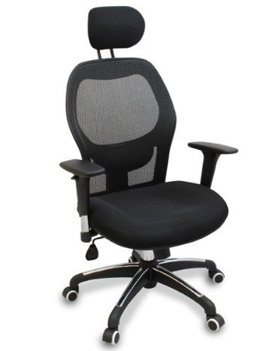
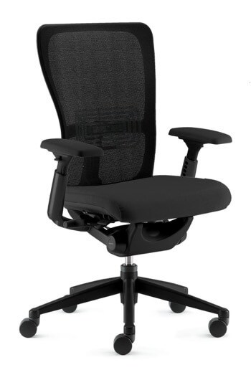
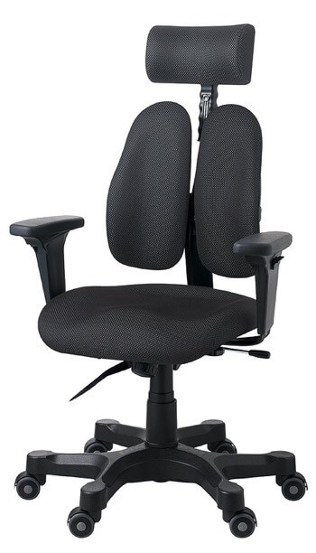
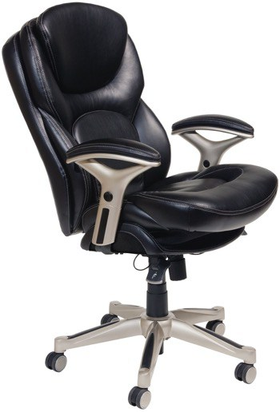
Chairs

Slide 15
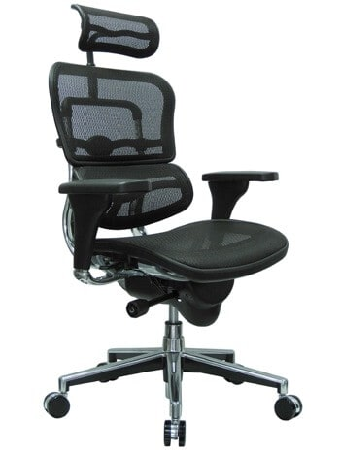
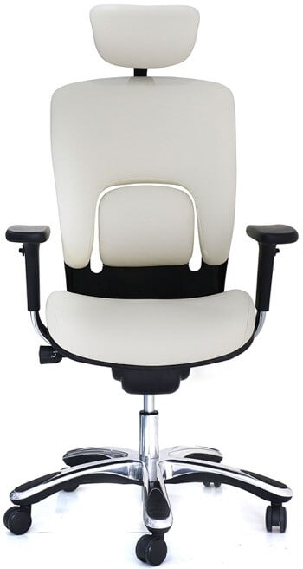
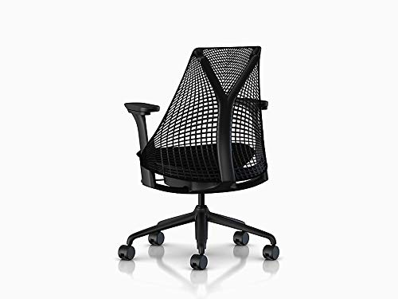
Chairs

Slide 16
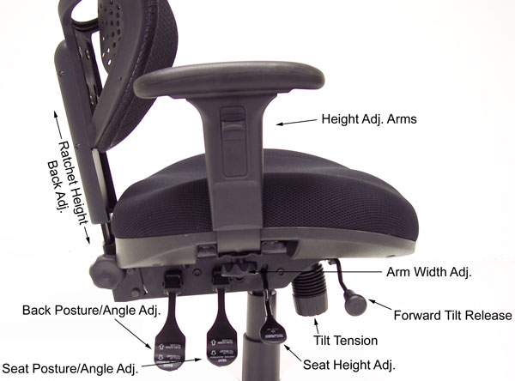
Chair Adjustment Knobs

Slide 17
Healthy Sitting
Chair Considerations
Seat height adjustment
Caster rollers
Pan tilts
Seat set back adjusts
Lumbar support
Seat back pivots forward and back
Waterfall seat front
Good Sitting Practice
Use sitting bones
Use least amount of energy (balanced) and supported
Need to use proper workplace layout
Change position often every 20 min. quick stretch

Slide 18
Posture Do’s & Don’ts: Sitting
Sitting Do’s
Sit close to you work
Have a chair that supports your back
Do maintain your low back arch
Maintain proper posture while at your workstation
Do sit in a chair that you can rest your feet on the ground or use foot rest
Sitting don'ts
Don’t slump sit
Don’t reach forward for your work
Don’t sit for long periods of time
Don’t stay seated if your in pain
Don’t forget to adjust your seat for you!

Slide 19
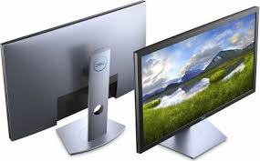
Monitors
Placement that eliminates glare
Minimize direct light around screen
Place directly in front of you
Top line of screen at or slightly below eye level
Monitor at least arm length away
Ability to read the screen without bending head, neck, or trunk

Slide 20
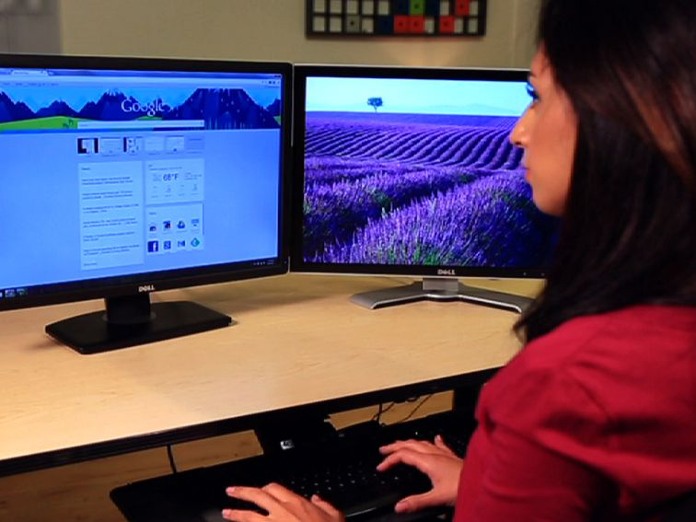
Monitors-Dual Screens
Place in a semi-circle around you
Keep screens close together
Sit more in line with your primary

Slide 21
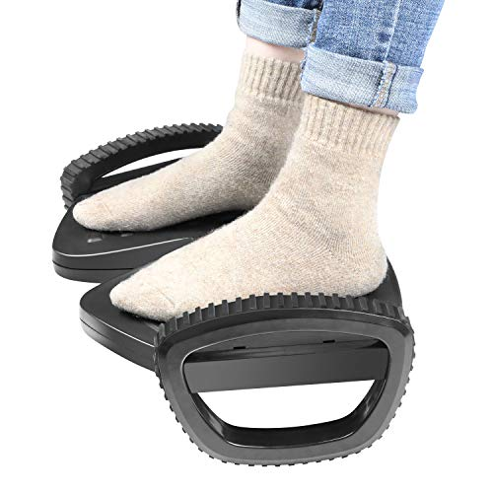
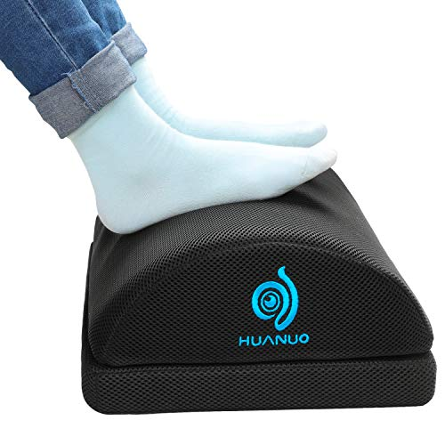
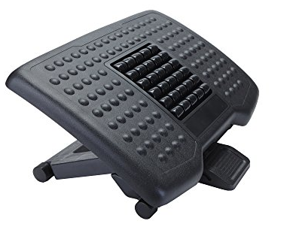
Foot Rests

Slide 22
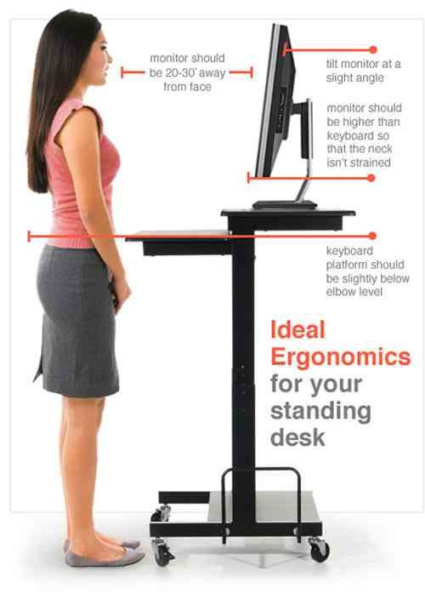
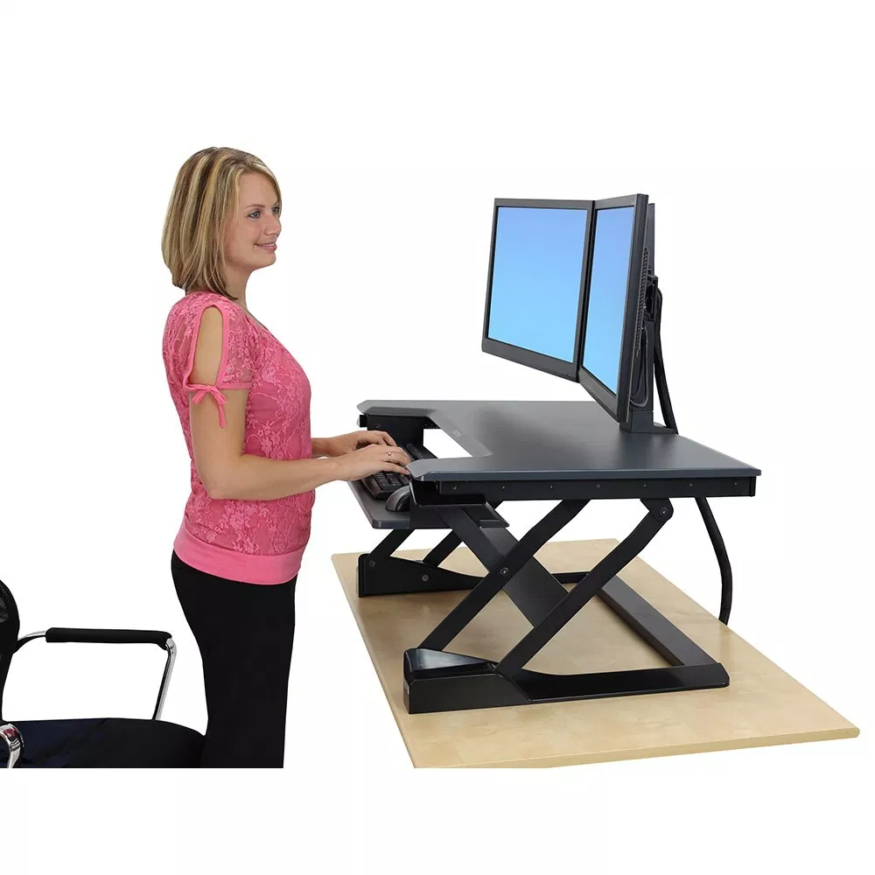
Standing
https://flexispot.com/ergonomic-calculator

Slide 23
Poor vs Good Standing

Slide 24
Posture Do’s & Don’ts: Standing
Standing Do’s
Distribute weight evenly on both feet or use a foot rest
Stand on cushioned mat
Keep work at a comfortable height
Work should be close to you
Change positions often (every 20 minutes)
Standing Don’ts
Don’t stand in Same position for too long
Don’t wear high heals
Don’t stand with knees locked
Don’t stand bent forward at neck or waist

Slide 25
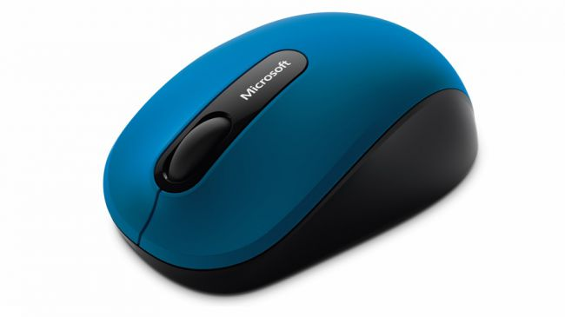
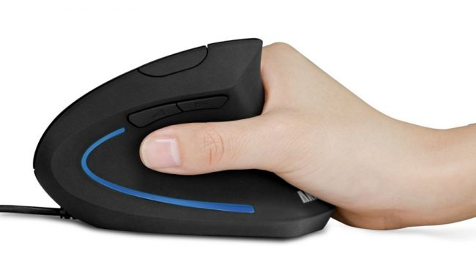
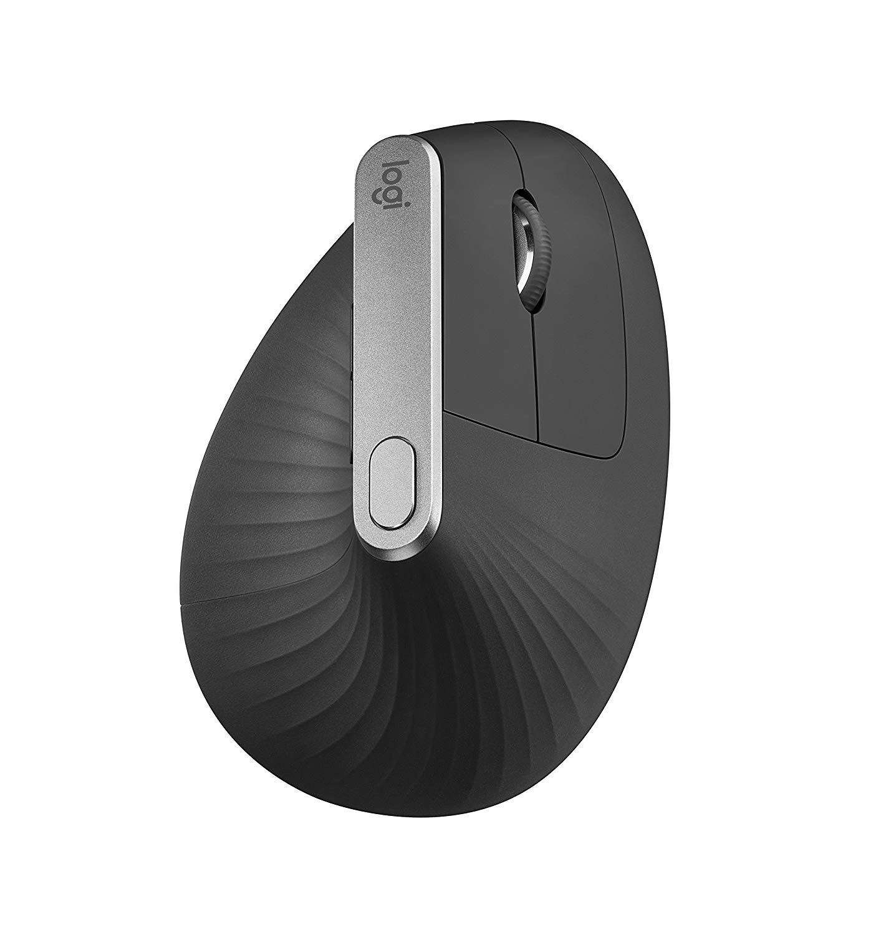
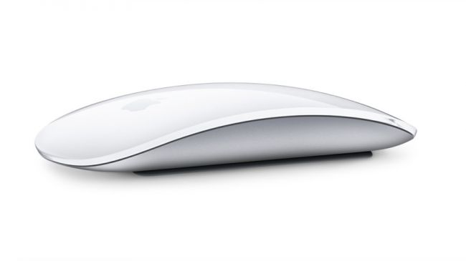
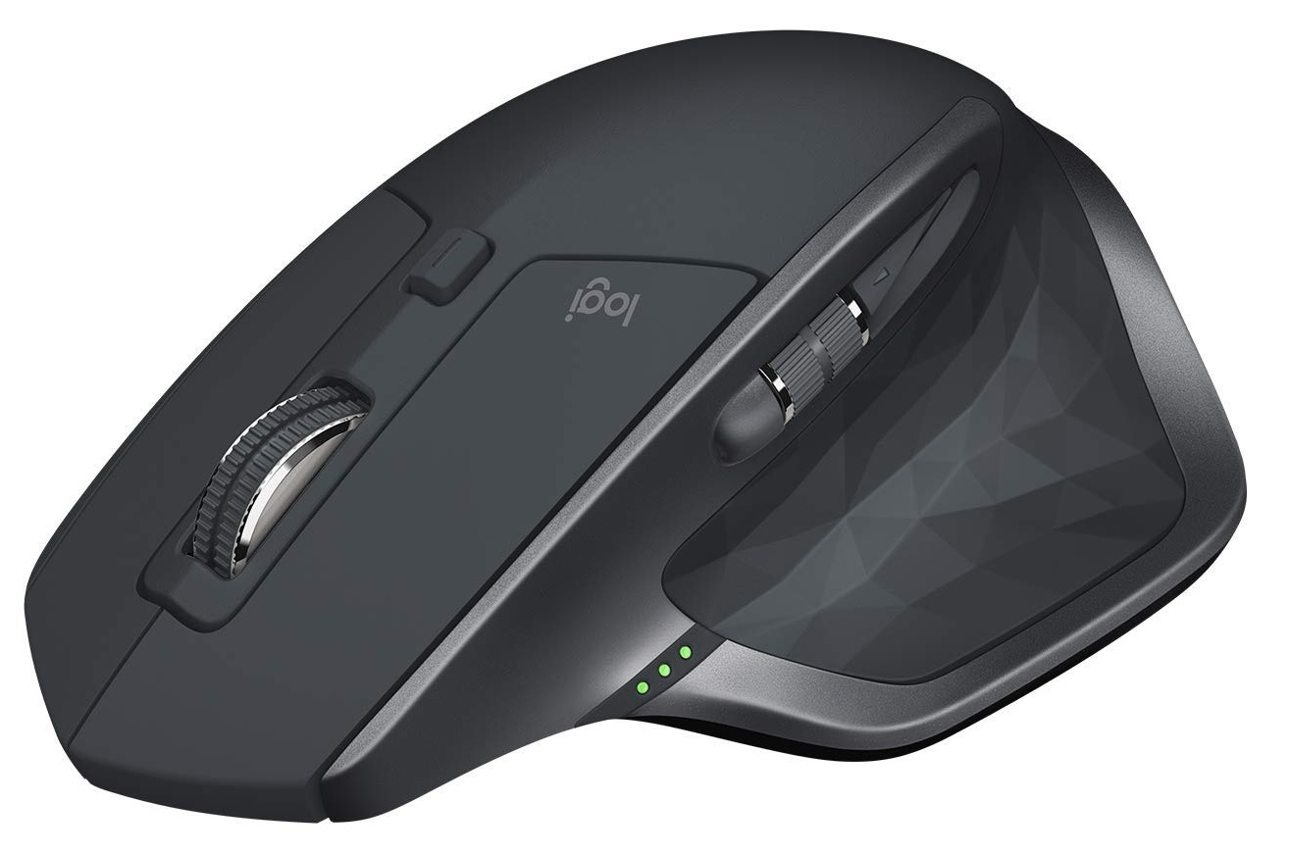
Mice

Slide 26
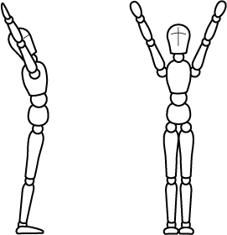
Healthy Lifestyle Tips
Walk 25-30 minutes a day
Stay hydrated
Stop-Stand-Stretch (every 30-40 minutes)
Log off and power down
Keep a balance

Slide 27
Helpful Websites
Chairs
https://www.republiclab.com/ergonomic-office-chairs-guide/
Standing Desks
https://www.healthline.com/nutrition/7-benefits-of-a-standing-desk?utm_medium=email&utm_source=email-share&utm_campaign=social-sharebar-referred-tablet
Foot Rests
https://www.bestreviews.guide/foot-rests-for-desks#.XRdTv9O6bWc.email
Mice
https://www.techradar.com/news/computing-components/peripherals/what-mouse-10-best-mice-compared-1027809
Ergonomic-calculator
https://flexispot.com/ergonomic-calculator

Slide 28
The End
THANKS

