Slide 2
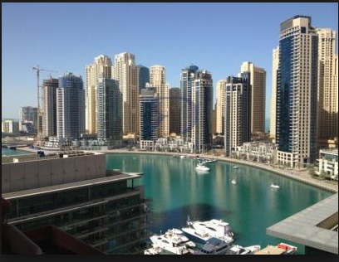
When the Gulf States are more than high rise buildings
Paul Anid, Dr. Sc.
Vice President, HDR, Inc
Mahwah, New Jersey, USA

Slide 3
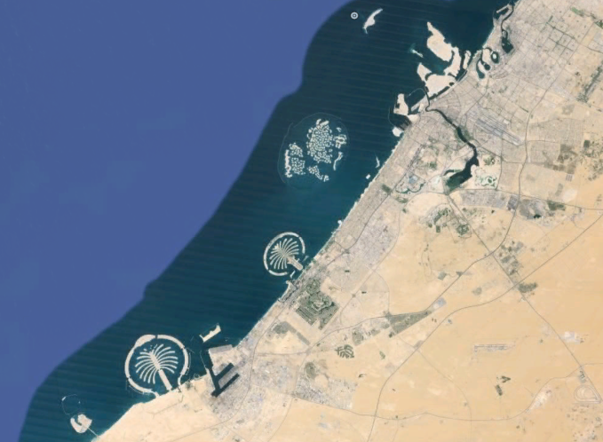
DUBAI
Dubai one of 7 emirates of the United Arab Emirates

Slide 4
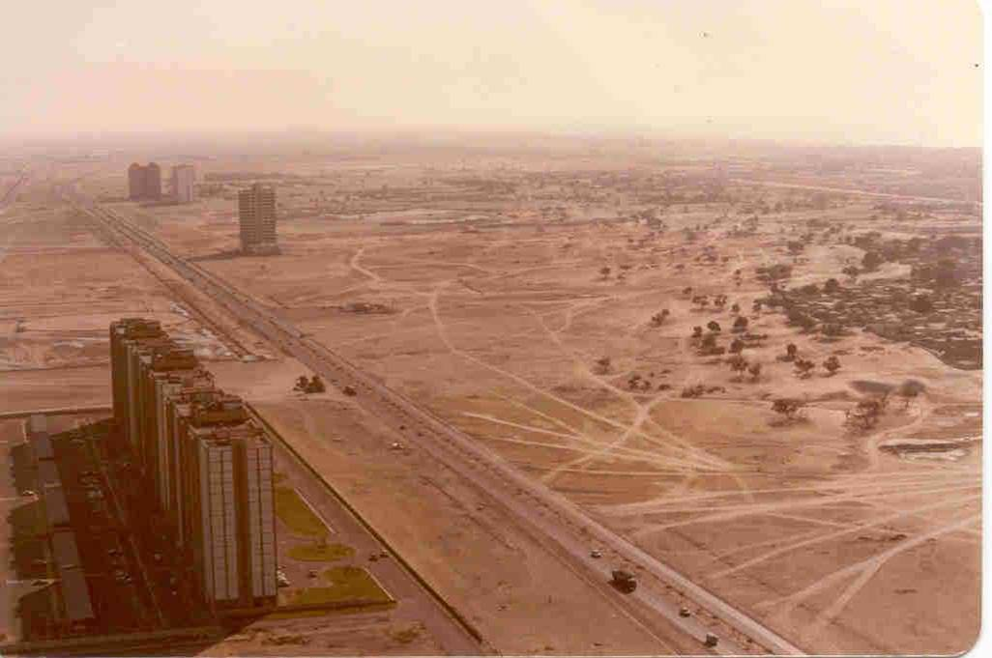
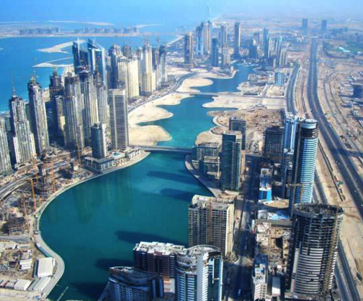
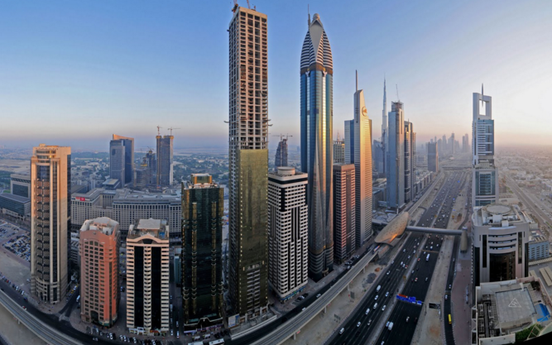
Urban transformation
1990’s
Today

Slide 5
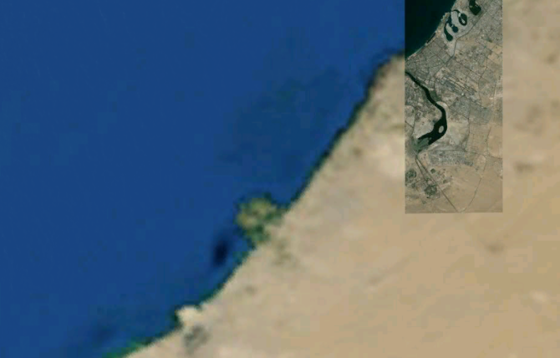
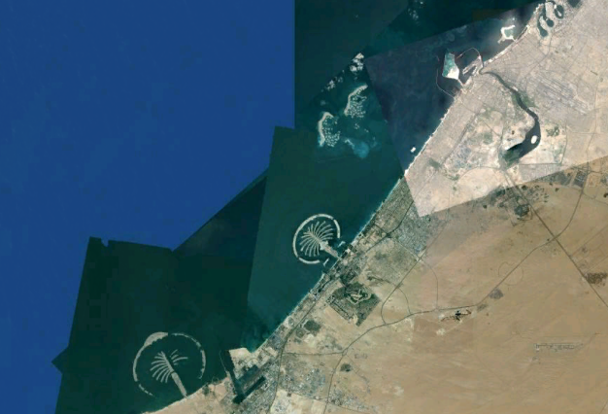
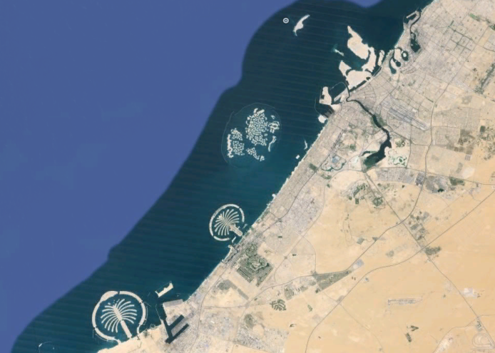
Coastal transformation
1980’s
2000 2005 2015
Population: 1.0M 1.2M 2.416M (12M visitors per year)
Beaches: 80km 120km 300km

Slide 6
Water CONSUMPTION
Largest per capita consumption of ~ 550 Liters per day per person in the world (82% above global average)

Slide 7
ENERGY CONSUMPTION
Largest per capita consumption of ~ 30 KWh per day per person (versus ~ 15 KWh)
Yet a drop of 4.2% compared to 2010

Slide 8
Desalination capacity
UAE is the second largest producer of desalinated water in the world
Dubai has the largest desalinated unit in
the world
YET, A LARGE DEFICIT IS EXPECTED IN THE NEXT 15 YEARS AS CURRENT DESALINATION CAPACITY WILL NOT SUFFICE IF THE SAME CONSUMPTION PATTERN PERSISTS

Slide 9
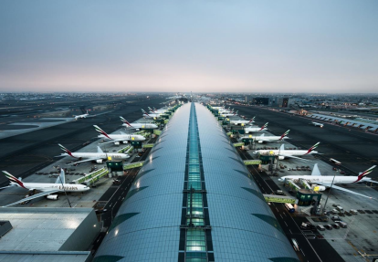
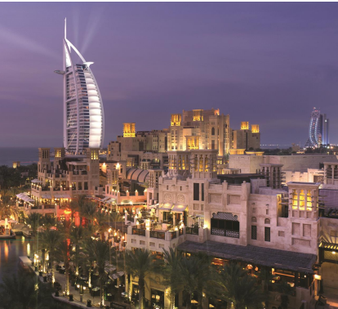
tourism
Dubai has become today the fourth tourist destination in the
world with 20 Million tourists projected for 2020

Slide 10
MORE TO COME
Plans for another tallest building in the World
2020 EXPO (like in Shanghai)
Dubai Canal
More infrastructure needs
Port expansion
75 Million passengers a year through the new Dubai airport
20 Million visitors expected
Higher carbon dioxide footprint from increases in:
Water needs
Energy demand
Transport
Food import
Construction

Slide 11
What has changed?
Land Reclamation had its toll on the marine coastal resources
Natural currents and long-shore sediment transport are altered resulting in new deposition and re-suspension patterns
The quality of coastal waters has dramatically degraded in particular in the islands and near the points of discharge
Red tide events are more likely
Rise in water table affecting infrastructure and foundations
Air Quality already subject to natural sand storms is worsened by rising emissions from fixed (power and industry) and mobile sources (transport sector)
Food security is still largely dependent on imports or on energy and water intensive techniques

Slide 12
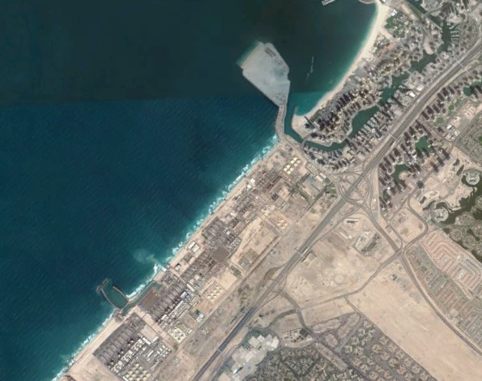
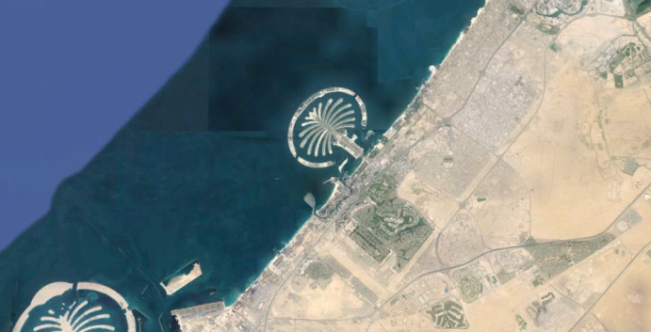
What has changed?
Power Plants and desalination units are now adjacent to urban communities
Cooling water and effluents from desalination plants are discharged along the 80km coastline
DUBAI MARINA: TOP TOURIST DESTINATION
LARGEST DESALINATION PLANT
AND POWER PLANT

Slide 13
Coastal Waters
Air Emissions
Nitrogen Phosphorus
Currents/Sediment transport
Mixturesalt
Marine Life
Heat salt
Heat
Nitrogen Phosphorus
Metals
PAHs
Land reclamation
infiltration
POWER PLANTS
Ground Water Table
DESALINATION PLANTS
City-Wide Landscape irrigation
Treatment Plants
Residences
Commercial
Industry
Other
Storm water
Dewatering
Land
Transport Sector

Slide 14
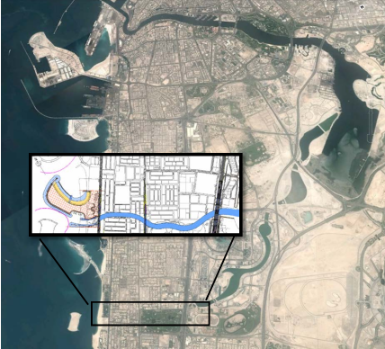
Dubai canal
20 KM Canal linking Dubai Creek to the Arabian Gulf
Will Create a north-south and east-west connection and an “Island” inside Dubai
Will add another 10 KM of “valuable” waterfront

Slide 15
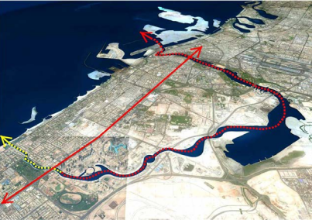
IMPACTS ON CORALS
Dubai Canal
Dead coral affected by sediments
Acropora sp. affected by sediment
Signs of bleaching

Slide 16
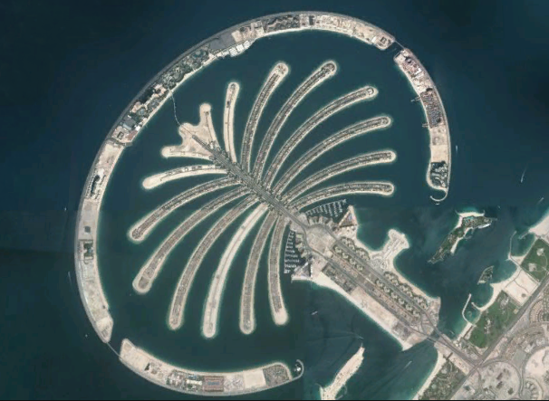
PALM ISLAND

Slide 17
IMPACTS ON BEACHES
Waves
Beach
Waves
Waves
Frond
Frond
Frond
Frond
Waves parallel to beach

Slide 18
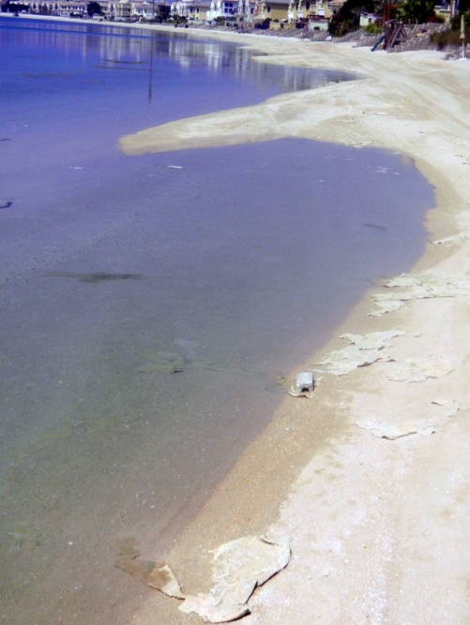
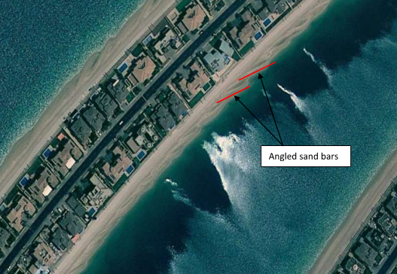
Beach erosion
Beach is not at equilibrium profile
Highly refracted/diffracted waves within frond channels
Waves will cause beaches to “straighten” relative to wave crest orientation
This can happen very quickly (weeks) in a large wave environment.
At Palm Jumeirah this process occurs much slower due to small waves

Slide 19
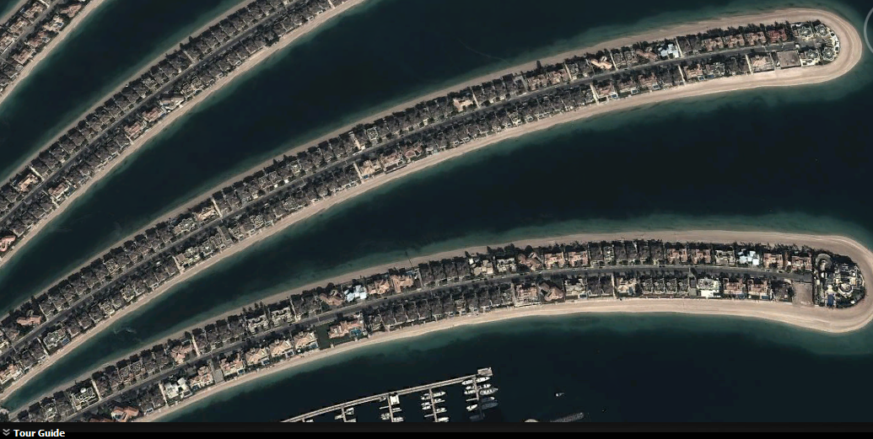
SURFACE Water quality

Slide 20
Phosphate, ammonia

Slide 21
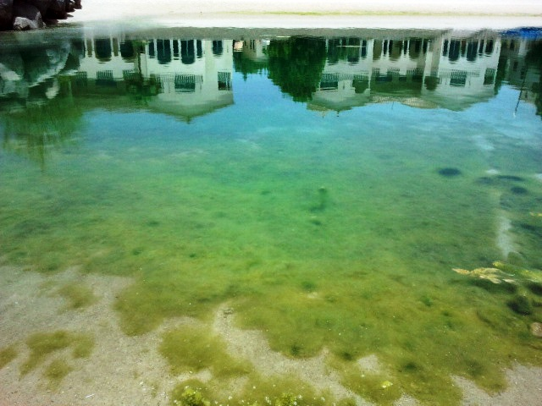
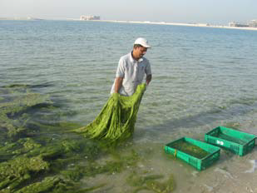
Water quality: proliferation OF MACROALGAE (CHAETOMORPHA_

Slide 22
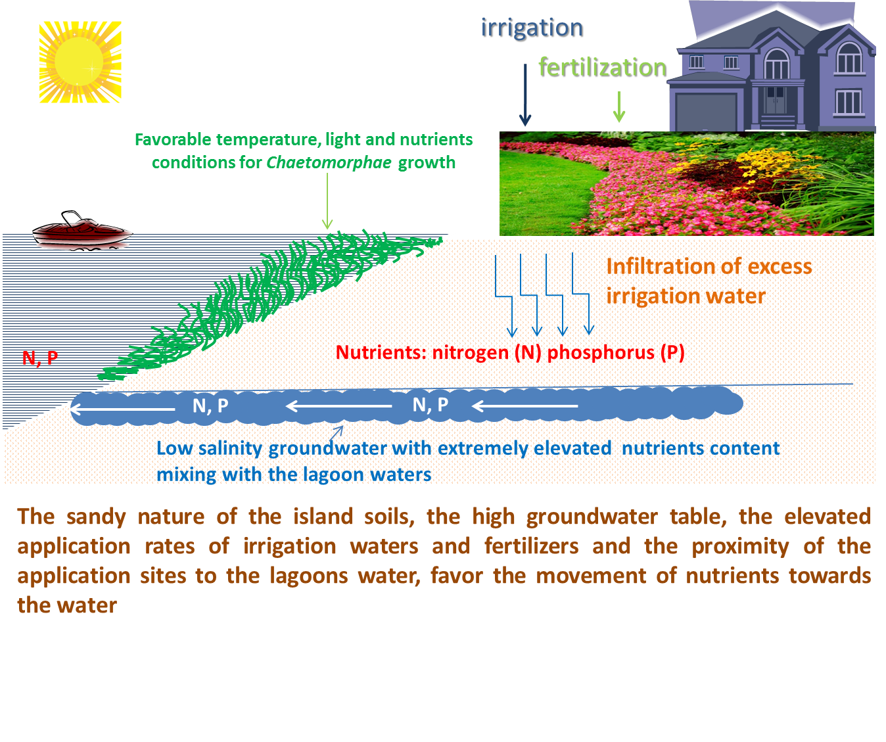

Slide 23
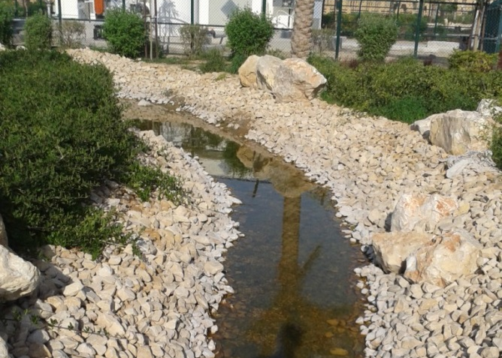
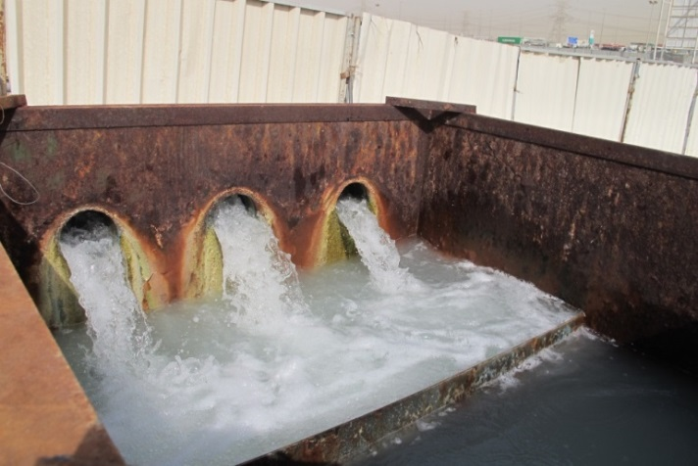
Water table rise
Spreading phenomenon of rising water, reaching the surface in low-lying areas
Continuous need to pump out the
Water
Climate change? Other factors? Sea water rise?

Slide 24
MANAGEMENT APPROACHES TO SUSTAINABILITY
Number 1 challenge: too fast too soon
How to keep up?
Approach as bold as the approach to development

Slide 25
MANAGEMENT APPROACHES TO SUSTAINABILITY
Policy/Regulations:
- Environmental Impact Assessment (EIA) studies are seriously required and enforced even on government sponsored projects
- Locally derived environmental standard
- Empowered environmental authority
- Monitoring programs by both Government and project proponents

Slide 26
MANAGEMENT APPROACHES TO SUSTAINABILITY
Plans:
- 2021 and 2030 plans that include Environmental Protection as main components with numerical achievable targets:
Air emissions by 90% by 2021
30% renewable energy by 2030
100% water recycling
Reduction in per capita water and energy use (removing subsidies and fines – already in place)
- Carbon Foot Print Center to monitor progress – officials held accountable to achieving targets

Slide 27
MANAGEMENT APPROACHES TO SUSTAINABILITY
Food
“Return to the sea”
Replenish fish stocks by creating hatcheries that produce local species fingerlings
Currently 2 large hatcheries in the making to generate up to 10Million fingerlings per year along with strict fishing limitation enforcement

Slide 28
Conclusions
Challenges are great
The will to overcome them is greater
The means to do it are in place
Tangible outcomes in the next 5 years…
Stayed tuned!!

