Slide 1
A Framework for Wireless Sensor Network Security
Babak D. Beheshti
Professor & Associate Dean,
School of Engineering & Computing Sciences, New York Institute of Technology
Old Westbury, NY, USA
Presenter and Date

Slide 2
Agenda
Abstract
Context
The I-TRM
New Security Face of I-TRM
Future Work

Slide 3
Agenda
Abstract
Context
The I-TRM
New Security Face of I-TRM
Future Work

Slide 4
Abstract
Wireless Sensor Networks (WSNs) have become prolific in the past few years as low cost and easily deployable means to collect environmental data.
With the increased scope of applications of WSNs it is imperative to assure security of the network itself against attacks, as well as to assure privacy and integrity of the data that is being collected and transmitted through the network. The I-TRM (Integrated Technical Reference Model) of a WSN has been proposed to standardize these network models in a three faced pyramid, where the three faces are Control, Information and Behavior protocol stacks.
We expand the I-TRM into a four faced pyramid, where the fourth face is the Security Centric face. This presentation introduces the proposed expansion at a high level, with system level requirements of the newly expanded I-TRM. Future work will present more detailed specifications of the new I-TRM.

Slide 5
Agenda
Abstract
Context
The I-TRM
New Security Face of I-TRM
Future Work

Slide 6
How Does This Research Fit into the Sustainable FEW Systems Domain?
A unified and comprehensive reference model for Wireless Sensor Networks (WSN) is needed to cover limitless & diverse applications of WSNs
A reusable and flexible framework to allow code reuse and rapid reconfiguration of a WSN for evolving needs and requirements

Slide 7
Infrastructure-based wireless networks
Typical wireless network: Based on infrastructure
  E.g., GSM, UMTS, …
  Base stations connected to a wired backbone network
  Mobile entities communicate wirelessly to these base stations
  Traffic between different mobile entities is relayed by base stations and wired backbone
  Mobility is supported by switching from one base station to another
  Backbone infrastructure required for administrative tasks
IP backbone
Further networks
Gateways
Server
Router

Slide 8
Infrastructure-based wireless networks – Limits?
What if …
  No infrastructure is available? – E.g., in disaster areas
  It is too expensive/inconvenient to set up? – E.g., in bridges, tunnels, other smart city infrastructure.
  There is no time to set it up? – E.g., in military operations

Slide 9
Wireless Sensor Network (WSN) Application Examples
Wireless Sensor Network consists of spatially distributed autonomous sensors to monitor physical or environmental conditions, such as temperature, sound, vibration, pressure, motion or pollutants and to cooperatively pass their data through the network to a main location.
Intelligent buildings (or bridges)
  Reduce energy wastage by proper humidity, ventilation, air conditioning (HVAC) control
    Needs measurements about room occupancy, temperature, air flow, …
  Monitor mechanical stress on bridges and overpasses
  Monitor stress and torsion on buildings after earthquakes

Slide 10
Battery-operated devices – energy-efficient operation
Often (not always!), participants in an ad hoc network draw energy from batteries
Desirable: long run time for
  Individual devices
  Network as a whole
Energy-efficient networking protocols
  E.g., use multi-hop routes with low energy consumption (energy/bit)
  E.g., take available battery capacity of devices into account
  How to resolve conflicts between different optimizations?

Slide 11
Structuring WSN application types
Interaction patterns between sources and sinks classify application types
  Event detection: Nodes locally detect events (maybe jointly with nearby neighbors), report these events to interested sinks
    Event classification additional option
  Periodic measurement
  Function approximation: Use sensor network to approximate a function of space and/or time (e.g., temperature map)
  Edge detection: Find edges (or other structures) in such a function
  Tracking: Report (or at least, know) position of an observed intruder (“pink elephant”)

Slide 12
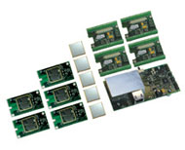
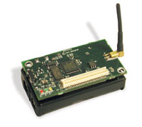
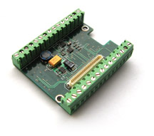
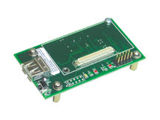

Hardware Platform
Design Engineering Services
Evaluation &
Development Kits
Processor/
Radio Boards
OEM Modules
Sensor Boards
Gateway Boards

Slide 13
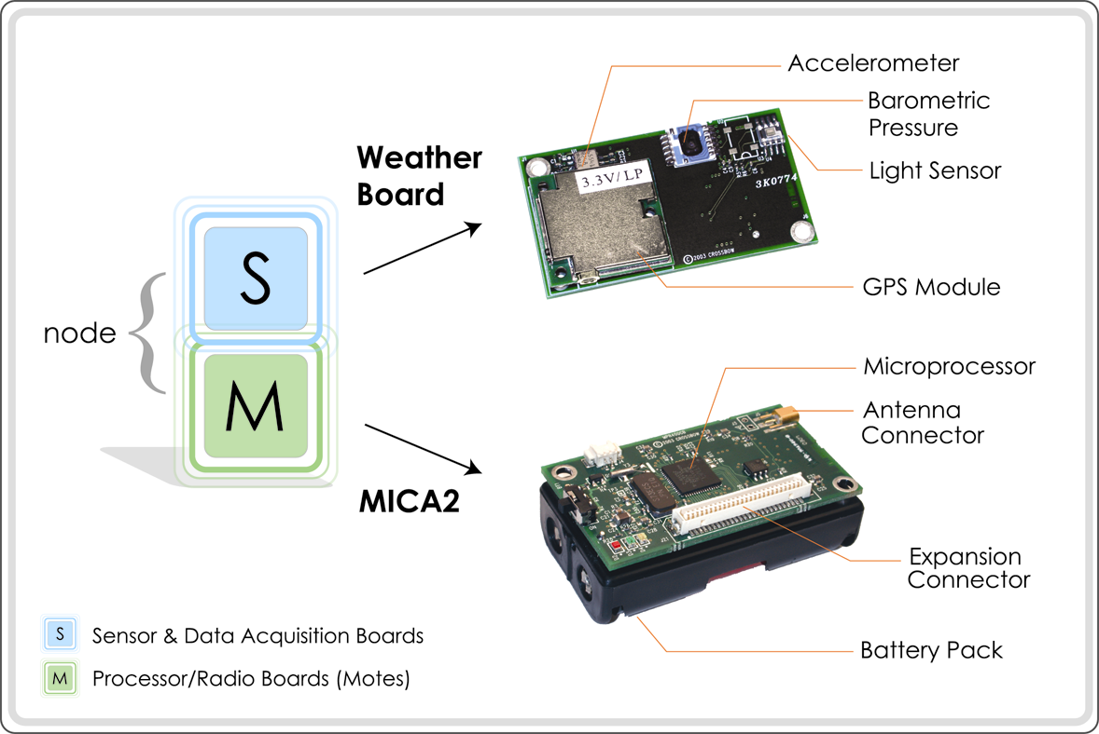
Basic Anatomy of a Sensor Node

Slide 14
Standards and Specifications
Predominant standards commonly used in WSN communications include:
    WirelessHART (The wireless standard for process automation)
    ISA100 (WirelessHART and ISA100.11a convered in a recent Control Engineering article
    IEEE 1451 (IEEE 1451 is a set of Smart transducer interface standards developed by the IEEE Instrumentation and Measurement Society’s Sensor Technology Technical Committee that describe a set of open, common, network-independent communication interfaces for connecting transducers (sensors or actuators) to microprocessors, instrumentation systems, and control/field networks.)
    ZigBee / 802.15.4 (IEEE 802.15.4/ZigBee is intended as a specification for low-powered networks for such uses as wireless monitoring and control of lights, security alarms, motion sensors, thermostats and smoke detectors.)
    IEEE 802.11 (IEEE 802.11p-2010 IEEE Standard for Information technology—
    Telecommunications and information exchange between systems--Local and metropolitan area networks--Specific requirements Part 11: Wireless LAN Medium Access Control (MAC) and Physical Layer (PHY) Specifications Amendment 6: Wireless Access in Vehicular Environments)
    The IEEE focuses on the physical and MAC layers;
    The Internet Engineering Task Force works on layers 3 and above; In addition to these, bodies such as the International Society of Automation provide vertical solutions, covering all protocol layers.

Slide 15
Agenda
Abstract
Context
The I-TRM
New Security Face of I-TRM
Future Work

Slide 16
What is this Research all about?
To develop an architecture for an
  Autonomous Sensor Network
  which is self-aware and adaptable to changes
Three Integral Aspects of Autonomous Systems
  Information Processing
  Control Distribution and Implementation
  Working (Behavior) of System, Sub-Systems and Components

Slide 17
SWE & SensorML

Slide 18
The Sensor Web Enablement (SWE) Family of Standards
The OGC’s SWE initiative was intended to develop standards to enable the discovery, exchange, and processing of sensor observations, as well as the tasking of sensor systems.
Functionalities :
  Discovery of sensor systems, observations, and observation processes that meet an application or users immediate needs;
  Determination of a sensor’s capabilities and quality of measurements;
  Access to sensor parameters that automatically allow software to process and geo-locate observations;
  Retrieval of real-time or time-series observations and coverage in standard encodings
  Tasking of sensors to acquire observations of interest;
  Subscription to and publishing of alerts to be issued by sensors or sensor services based upon certain criteria.

Slide 19
SWE standards include the following OpenGIS® Specifications
Observations & Measurements Schema (O&M)
Sensor Model Language (SensorML)
Transducer Markup Language (TransducerML or TML)
Sensor Observations Service (SOS)
Sensor Planning Service (SPS)
Sensor Alert Service (SAS)
Web Notification Services (WNS)

Slide 20
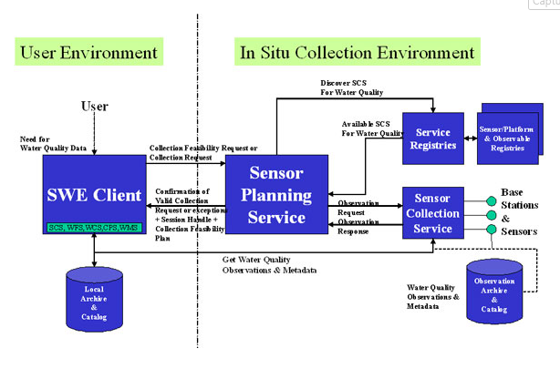
A Complex System

Slide 21
Sensor Model Language
(SensorML)
The role of the SensorML is to provide characteristics required for processing, geo-registering, and assessing the quality of measurements from sensor systems.
Two possible roles:
  To describe the procedure by which an existing observation was obtained. This would include the sensor measurement process, as well as any post processing of the raw observations;
  To provide processing chains with which SensorML-enabled software could derive new data from existing observations on-demand. SensorML calls this a “Derivable Observation”, since the values do not exist prior to execution of the processing chain

Slide 22
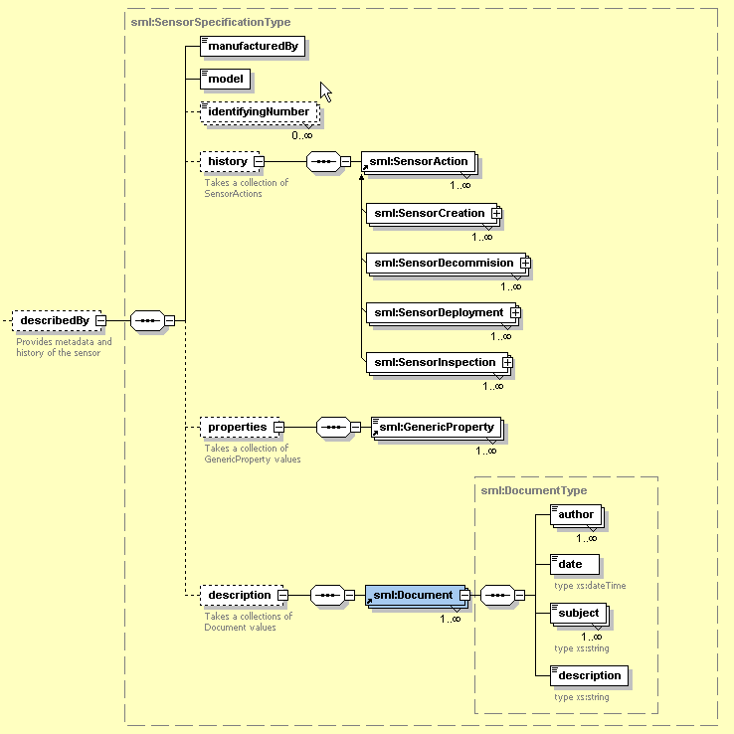
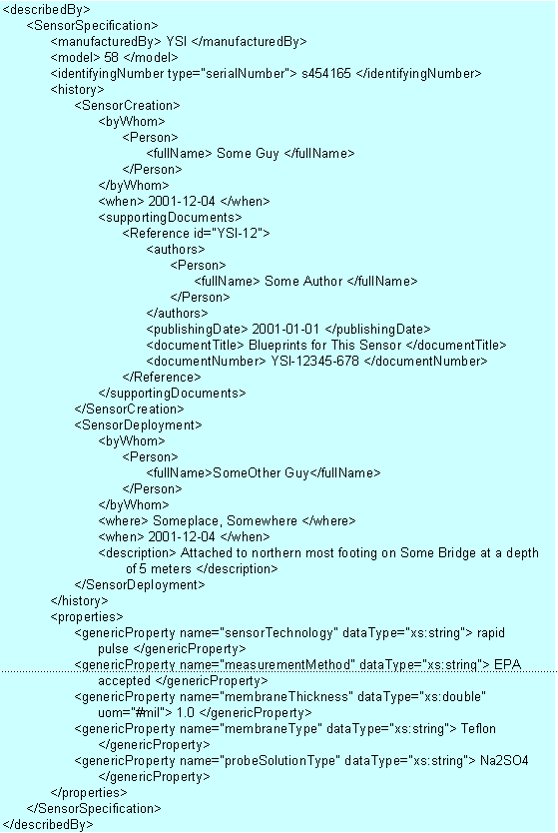
Mike Botts, "SensorML and Sensor Web Enablement," Earth System Science Center, UAB Huntsville

Slide 23
Integrated Technical Reference Model (I-TRM)
Defines a layered architecture with a high-level goal definition to task execution.
Manages how and where the data is collected.
The I-TRM combines
                An Information-Centric Technical Reference Model (IC-TRM),
          A Control Technical Reference Model (C-TRM)
          A Behavioral (intelligence-based) Technical Reference Model (B-TRM) to provide a complete system technical reference model.

Slide 24
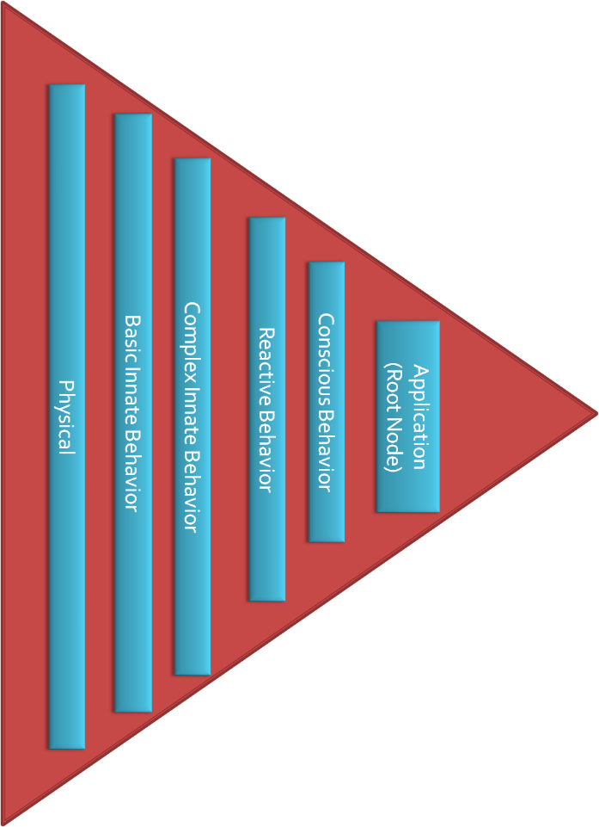
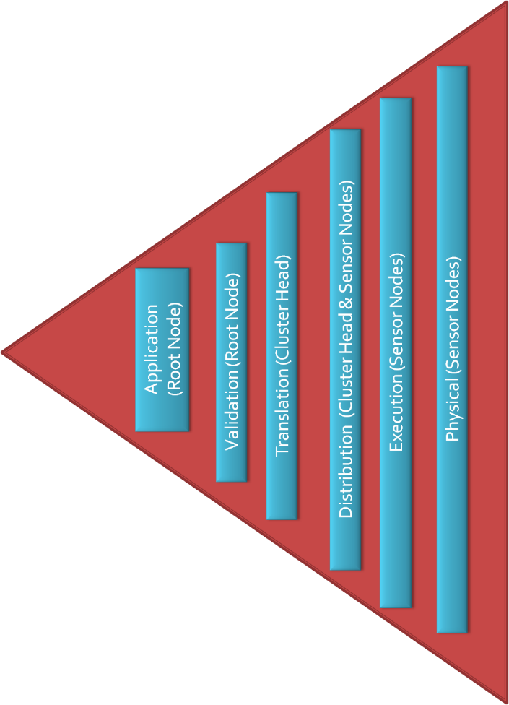
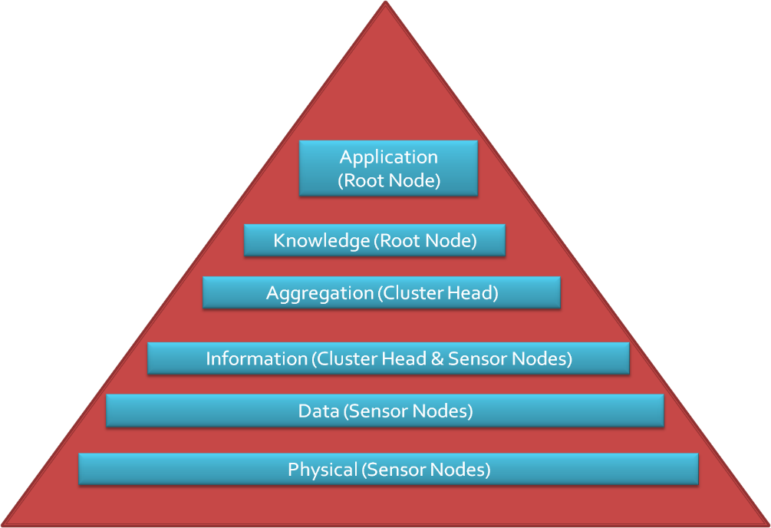
Behavior Face
Control Face
Information Centric Face

Slide 25
An Adaptive Feedback System
Information Centric Face
Control Face
+
Behavior Face

Slide 26
Control
Technical Reference Model (C-TRM)
The Control Plane is responsible for the goal setting and control of the system.
This closely follows the work done in the field of control architecture, authentication of the semantic correctness of the goal, and decomposition of valid goals into functional tasks based on knowledge about the lower layers.
The control plane of the I-TRM is responsible for the control data that flows downstream in a WSN.
The control face provides details about the control organization of the system. The layers starting from layer 6 down are described from the top layer down, in the natural direction of control message flow.

Slide 27
Control
Technical Reference Model (C-TRM)
Application
Validation
Translation
Distribution
Execution
Physical
Notes:
27

Slide 28
Information-Centric
Technical Reference Model (IC-TRM)
Defines a layered architecture
  data collection
  information aggregation
  presentation
Not how and where the data is collected.

Slide 29
Information-Centric
Technical Reference Model (IC-TRM)
Application
Knowledge
Aggregation
Information
Data
Physical
Notes:
29

Slide 30
Behavior
Technical Reference Model (B-TRM)
Behavior is:
A mapping of sensory inputs to a pattern of motor/component actions which then are used to perform a task.
The action or reaction of something under specified circumstances.
A series of events resulting from the execution of the operating rules of that system, as defined within rule-clusters.

Slide 31
Behavior
Technical Reference Model (B-TRM)
Application
Conscious Behavior
Reactive Behavior
Complex Innate Behavior
Basic Innate Behavior
Physical
Notes:
31

Slide 33
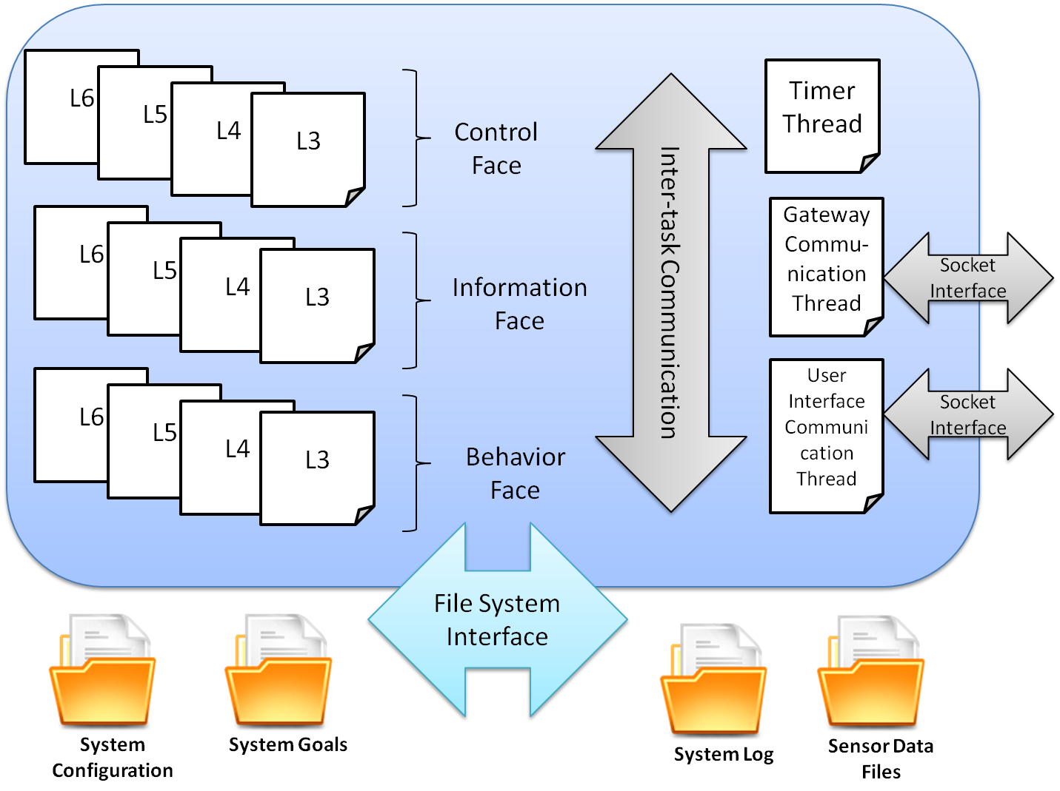
Implementation Software Architecture

Slide 34
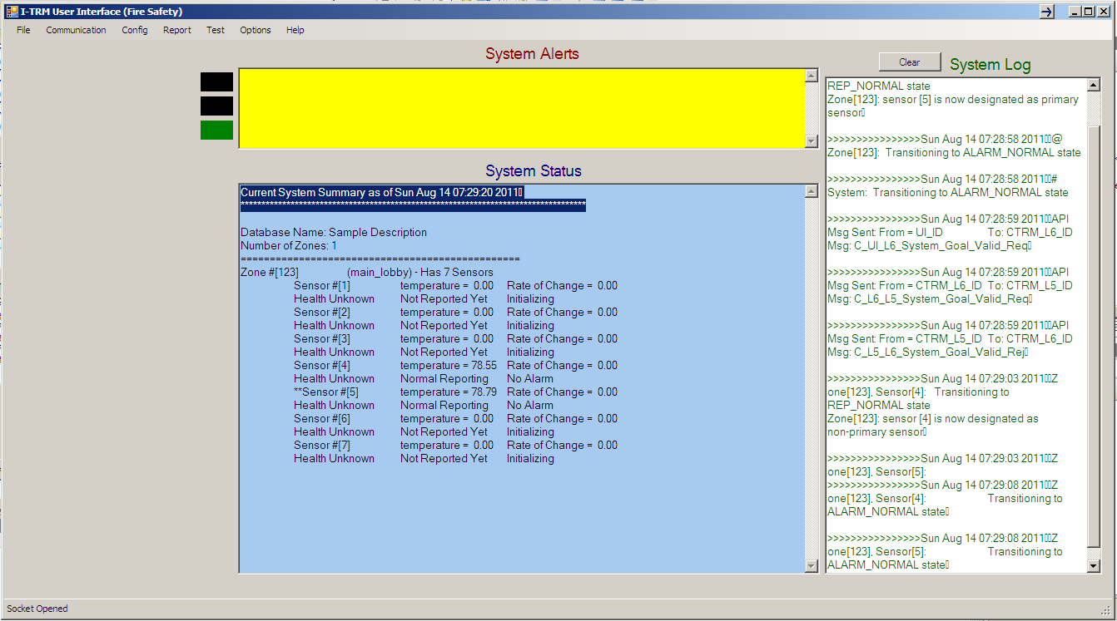
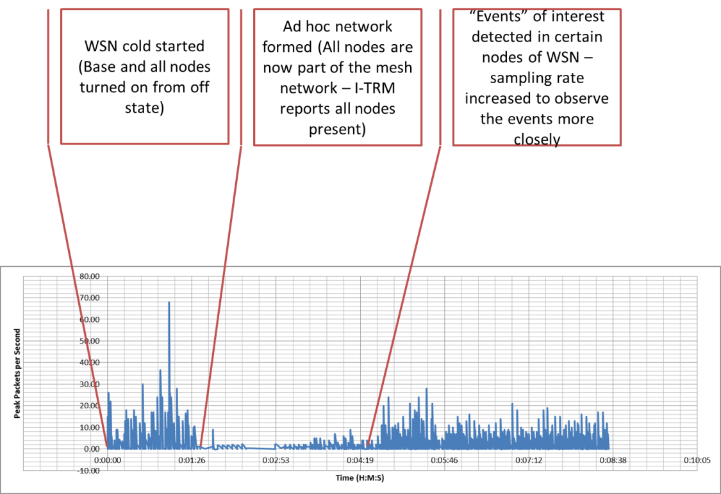
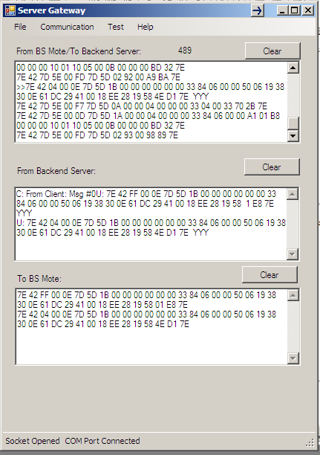

Slide 35
Agenda
Abstract
Context
The I-TRM
New Security Face of I-TRM (S-TRM)
Future Work

Slide 36
Security
Technical Reference Model (S-TRM)
Important security issues include
  key establishment
  secrecy
  authentication
  privacy
  denial-of-service attacks
  secure routing
  node capture
  …
We need special security models in WSN that are power and resource efficient

Slide 37
Security
Technical Reference Model (S-TRM)
Application
(Security Coordinator)
Trust Management
Transport (Flooding, Desynch)
Network (Spoofed Info, Sinkhole, Sybil, Wormholes…)
Link (Cipher, Collisions, Unfairness & Exhaustion)
Physical (Communication Link, Tampering)
Notes:
37

Slide 38
Physical Layer
The physical layer attack includes jamming (interferences with radio frequencies) and physical tampering of nodes. (e.g. in frequency hopping: hopping set (available frequencies for hopping), dwell time (time interval per hop), and hopping pattern (the sequence in which the frequencies from the available hopping set is used)
The specifications in this layer include:
  Modulation Scheme
  Configurable parameters for coding and modulation
  Tamper-proofing API and configurations

Slide 39
Link Layer
The data link layer attacks include
  Collision (link layer jamming)
  Abuse of MAC priority schemes
  Exhaustion of battery resources

Slide 40
Link Layer
Cryptographic methods used in WSNs should meet the constraints of sensor nodes and be evaluated by code size, data size, processing time, and power consumption.
Specification of WSN specific cipher related issues such as:
  How the keys are generated or disseminated
  How the keys are managed, revoked, assigned to a new sensor added to the network or renewed for ensuring robust security

Slide 41
Link Layer
Countermeasures that would be included in this layer include:
Source: Y. Wang, G. Attebury, and B. Ramamurthy, IEEE Communications
Surveys and Tutorials, Vol. 8, No. 2, pp. 2-23, 2006
Attack | Countermeasure
Collision | Error-correction code
Exhaustion | Rate Limitation
Unfairness | Small Frame Size

Slide 42
Network Layer
The network layer attacks include
  Spoofed, altered or replaying information,
  Selective forwarding,
  Sinkhole attacks,
  Sybil attack,
  Wormholes,
  Hello flood attacks, and
  Acknowledgement spoofing.

Slide 43
Network Layer
Countermeasures that would be included in this layer include: (Source: Y. Wang, G. Attebury, and B. Ramamurthy, IEEE Communications Surveys and Tutorials, Vol. 8, No. 2, pp. 2-23, 2006)
Attack | Countermeasure
Spoofed routing info & selective forwarding | Egress filtering, authentication, monitoring
Sinkhole | Redundancy checking
Sybil | Authentication, monitoring, Redundancy
Wormhole | Authentication, probing
Hello Flood | Authentication, packet leashes by using geographic and temporal info
Ack. flooding | Authentication, bi-directional link authentication verification

Slide 44
Transport Layer
The transport layer can be attacked via flooding or de-synchronization
The DoS (denial of service) vulnerabilities are normally for the last four layers of the stack (except application layer).

Slide 45
Transport Layer
Countermeasures that would be included in this layer include:
Source: Y. Wang, G. Attebury, and B. Ramamurthy, IEEE Communications
Surveys and Tutorials, Vol. 8, No. 2, pp. 2-23, 2006
Attack | Countermeasure
Flooding | Client puzzles
De-synchronization | Authentication

Slide 46
Trust Management Layer
A holistic approach aims at improving the performance of wireless sensor networks with respect to security, longevity and connectivity under changing environmental conditions.
The holistic approach of security concerns is about involving all the layers for ensuring overall security in a network. [14]
For such a network, a single security solution for a single layer might not be an efficient solution rather employing a holistic approach could be the best option.

Slide 47
Trust Management Layer
Anomaly Detection:
  Analyze the network flow and infer the status
  Apply statistical or heuristic measures to determine the status
  If the events are not normal generate alert
Abnormal Node Detection:
  Useful for detecting a node which is not behaving as expected (either faulty or malicious)
  Attach trust value for each node based on:
    statistics,
    data value,
    intrusion detection
    …

Slide 48
Trust Management Layer
Trust between the nodes can be based on the sensed events (sensed continuous data of temperature).
Use Bayesian probabilistic approach for mixing second hand information from neighboring nodes with directly observed information to calculate trust¹
Trust-based models usually involve high computational overhead, and building an efficient scheme for resource-constrained WSNs is a very challenging task.
1. Trust Management in Wireless sensor Networks – Mohammad Momani and Subhash Challa

Slide 49
Application Layer
The uppermost layer provides a means for the user to access and use the security based information from the system in a consistent format.
It also allows for configuration of the security layers at any time.
All event reports of lower layers are made available to the applications via this layer.
This layer provides a universal and standard interface to all applications utilizing the I-TRM.

Slide 50
Agenda
Abstract
Context
The I-TRM
New Security Face of I-TRM
Future Work

Slide 51
Future Work
Development of an API and meta-data for all S-TRM layers
The mobility of sensor nodes has a great influence on sensor network topology and thus raises many issues in secure routing protocols
Current work on security in sensor networks focuses on discrete events such as temperature and humidity. Continuous stream events such as video and images are not discussed.

Slide 52
References
Joshi, H., & Michel, H. (2008). Integrated Technical Reference Model and Sensor Network Architecture. International Conference on Wireless Networks. Las Vegas, NV.
Michel, H., & Joshi, H. (2008). A Sensor Network Architecture: Information, Control and Behavior Definitions for Large-Scale or Systems-of-Systems Testing. Journal of the International Test and Evaluation Association , 29 (4).
Joshi, H. (2008). Autonomous Mobile Sensor Networks Architecture for Hazard Detection and Surveillance. Dartmouth, MA: M.S.,University of Massachusetts Dartmouth.
Dipple, H., & Michel, H. (2006). The Control Technical Reference Manual. International Conference on Artificial Intelligence. Las Vegas, NV.
Joshi, H., & Michel, H. (2007). Integrating Information-Centric, Control-Centric and Behavior-Centric Technical Reference Models for Autonomous Sensor Networks. Proceedings of the 2007 International Conference on Wireless Networks ICWN, (pp. 319-324). Las Vegas, NV.
Fortier, P., & Michel, H. (2005). Comparison of the EI TRM versus TENA. ITEA Technology Review Workshop. Atlanta, GA.
Sophia Kaplantzis, “Security Models for Wireless Sensor Networks”, March 2006
John Paul Walters, Zhengqiang Liang, Weisong Shi, and Vipin Chaudhary, “Wireless Sensor Network Security, A survey. Chapter 17, Security in Distributed Grid, and Pervasive Computing (Yang Xiao editors), 2006 CRC press
Jaydip Sen, “A survey on Wireless Sensor Network Security”, Int. Jr. of Communication Networks and Information Security (IJCNIS), Vol 1, No.2 , Aug 2009
Vasyl A. Radzevych and Sunu Mathew, “Security in Wireless Sensor Networks: Key Management Approaches (Power point presentation, available on Internet)
Joshua Backfield, “Network Security Model”, SANS Institute 2008
J. Hill, R. Szewczyk, A. Woo, S. Hollar, D.E. Culler, and K. Pister, “System architecture directions for networked sensors”, In Proceedings of the 9th International Conference on Architectural Support for Programming Languages and Operating Systems, New York, ACM Press, 2000, pp. 93-104.
G. Gaubatz, J.P. Kaps, and B. Sunar, “Public key cryptography in sensor networks-Revisited”, In Proceedings1st European Workshop on Security in Ad-Hoc and Sensor Networks (ESAS ‘04), 2004.
Avancha, S, “A Holistic Approach to Secure Sensor Networks”, PhD Dissertition, University of Maryland, 2005.
Sen, J., “A Survey on Wireless Sensor Network Security”, International Journal of Communication Networks and Information Security (IJCNIS) Vol. 1, No. 2, August 2009.

