Slide 1
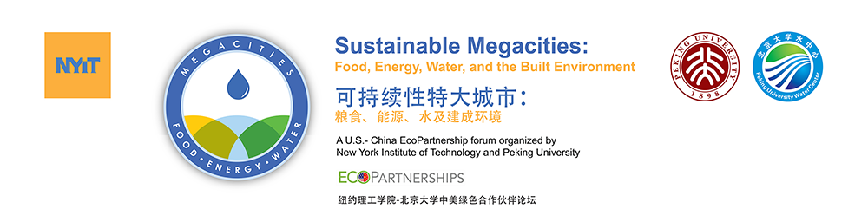


Participatory Modeling of Complex Urban Infrastructure Systems (Model Urban SysTems, MUST)
John C. Crittenden, Ph.D., P.E., NAE (US & China)
Zhongming Lu, Ph.D.
Brook Byers Institute for Sustainable Systems,
Georgia Institute of Technology, Atlanta, GA
E-Mail: john.crittenden@ce.gatech.edu

Slide 2


Conference website:
http://www.icsi2016.org/

Slide 3
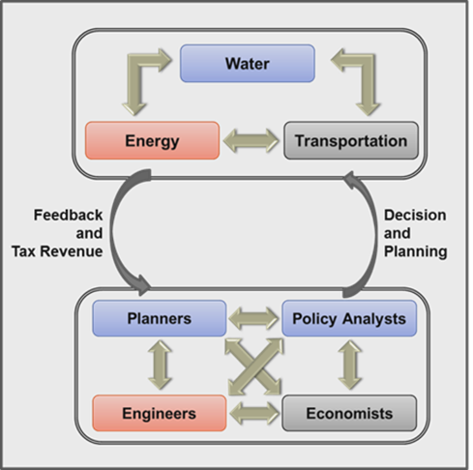

Introduction of MUST
Research Elements:
Food
Systems dynamics modeling of complex urban infrastructure systems (i.e., the Metamodel).
Quantifying the resilience of urban infrastructure systems.
Social, Behavioral, and Economic decision making.
Optimizing between resilience and sustainability.

Slide 4
MUST Investigators
Name | Affiliation
Ashuri, Baabak | Associate Professor, School of Building Construction; Director, Economics of the Sustainable Built Environment (ESBE) Lab
Bras, Bert | Professor, George W. Woodruff School of Mechanical Engineering.
Clark, Jennifer | Associate Professor in the School of Public Policy and Director of the Center for Urban Innovation in the Ivan Allen College
Crittenden, John | Director, Brook Byers Institute for Sustainable Systems, Hightower Chair and Georgia Research Alliance Eminent Scholar in Environmental Technologies; School of Civil and Environmental Engineering
Fujimoto, Richard | Regents’ Professor in the School of Computational Science and Engineering
Grijalva, Santiago | Associate Professor; Associate Director for Electricity Strategic Energy Institute (SEI); Georgia Power Distinguished Professor
Guhathakurta, Subhrajit | Professor, School of City and Regional Planning; Director, Center for Geographic Information Systems
Leigh, Nancey Green | Associate Dean For Research, College of Architecture; Professor, School of City and Regional Planning;
McDermott, Tom | ‎Director of Technology Policy Research, Georgia Tech Research Institute
Thomas, Valerie | Anderson Interface Professor of Natural Systems, School of Industrial and Systems Engineering
Weissburg, Marc | Professor, School of Biology

Slide 5
MUST Investigators: Expertise
Name | Expertise / Role in Project
Ashuri, Baabak | Infrastructure Project Finance & Investment Science, Systems Engineering, Infrastructure project development processes & delivery systems, Risk Management, & Operations Research (Business Analytics & Data Mining)
Bras, Bert | Computer-aided engineering, design and manufacturing; environmentally conscious design, design for recycling and robust design
Clark, Jennifer | Regional economic development, manufacturing, industry clusters and innovation
Crittenden, John | Sustainable systems, pollution prevention
Fujimoto, Richard | Execution of discrete-event simulation programs on parallel and distributed computing platforms
Grijalva, Santiago | Power system and smart grid computation; De-centralized and autonomous power control architectures; Ultra-reliable electricity internetworks; Seamless integration of large-scale renewable energy; Electricity markets design and power system economics
Guhathakurta, Subhrajit | Geographic information systems, planning support systems, sustainability
Leigh, Nancey Green | Economic development planning, sustainable development, urban andregional theory, industrial restructuring, income inequality
McDermott, Tom | Modeling dynamic systems, systems thinking, organizational and team behavior, management of technology
Thomas, Valerie | Energy and materials efficiency, sustainability, industrial ecology, technology assessment, international security, science and technology policy
Weissburg, Marc | Ecology, community ecology, biologically Inspired design methodology and pedagogy

Slide 6
Interdependences of Urban Infrastructure Systems
Water
Land Use
Fresh Surface
Transport
Water Supply
Residential
Carbon Emissions
Fresh Ground
Commercial
Industrial
Saline Surface
Energy for Water
Agriculture
Rain
Water
Oil
Natural Gas
Fuel
Water for Energy
Coal
Electricity
Biomass
Water Evaporation
Geothermal
Water
Hydro
Energy
Waste water Treatment & Discharge
Wind/Solar
Energy for Water
Carbon
Energy

Slide 7



Defining Infrastructure Ecology
Developing a Science of Infrastructure Ecology for Sustainable Urban Systems
Ming Xu, Marc Weissburg, Joshua P. Newell, and John C. Crittenden
(2012, 46 (15), pp 7928–7929)
Infrastructure Ecology is an emerging transdiscipline:
  Infrastructure Ecology alters and reorganizes energy and resource flows and considers the potential synergistic effects arising from infrastructure symbiosis.
“Understanding the city as an ecosystem requires knowledge of how human and natural infrastructure systems interact to create emergent properties.”
These “infrastructures” include physical infrastructure systems and their interactions (e.g., water-transportation−energy nexus), as well as ecological infrastructure, information and communications technology (ICT) infrastructure, socio-economic infrastructure (e.g., banking, finance) and social network infrastructure.”
It is Transdisciplinary. - It creates a body of knowledge distinct from its antecedents (engineering, ecology) that fundamentally changes the questions that are asked, and the tools used to answer them.

Slide 8
Infrastructure Symbiosis: System-based Design Recognizing the Interdependence

Slide 9
Water Resource Withdrawal Profile in the United States
Decentralized
Energy Production
Urban Farming

Slide 10
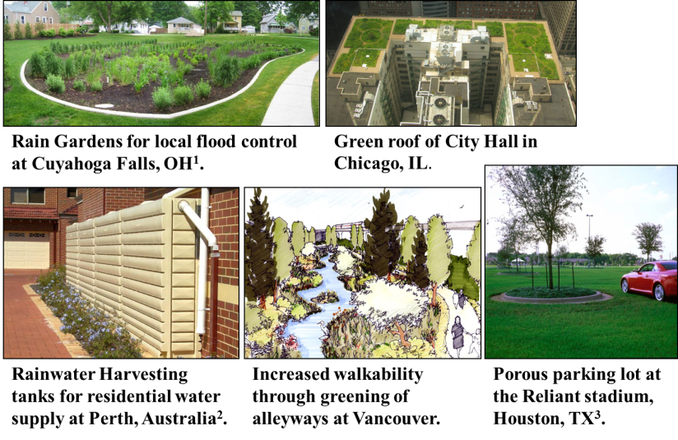
Low Impact Development (Reducing Storm Water Runoff, Erosion and Surface Water Contamination) - LID Best Management Practices (BMPs)

Slide 11
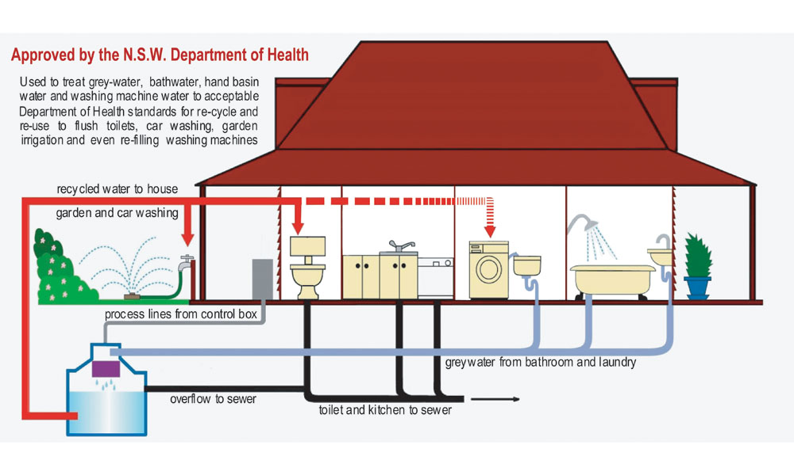
Typical Greywater Reclamation System at the Household Level
Note: N.S.W. denotes New South Wales, Australia
Source: http://www.environmentwriter.com/wp-content/uploads/greywater1.jpg

Slide 12
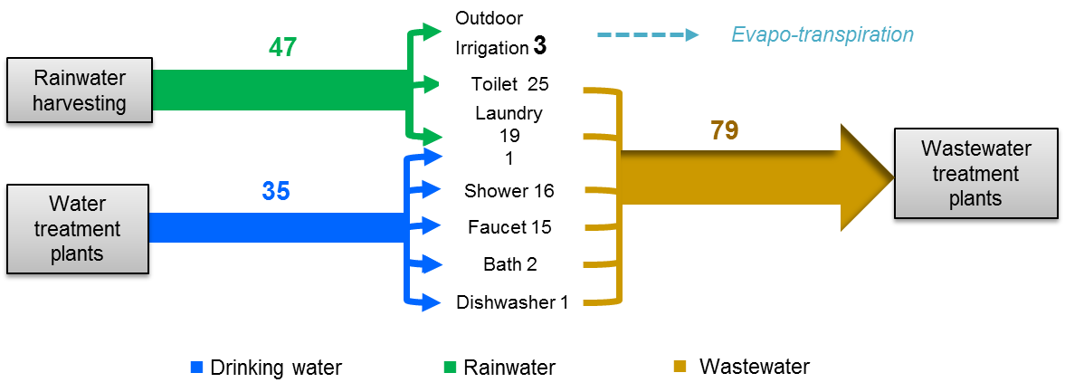
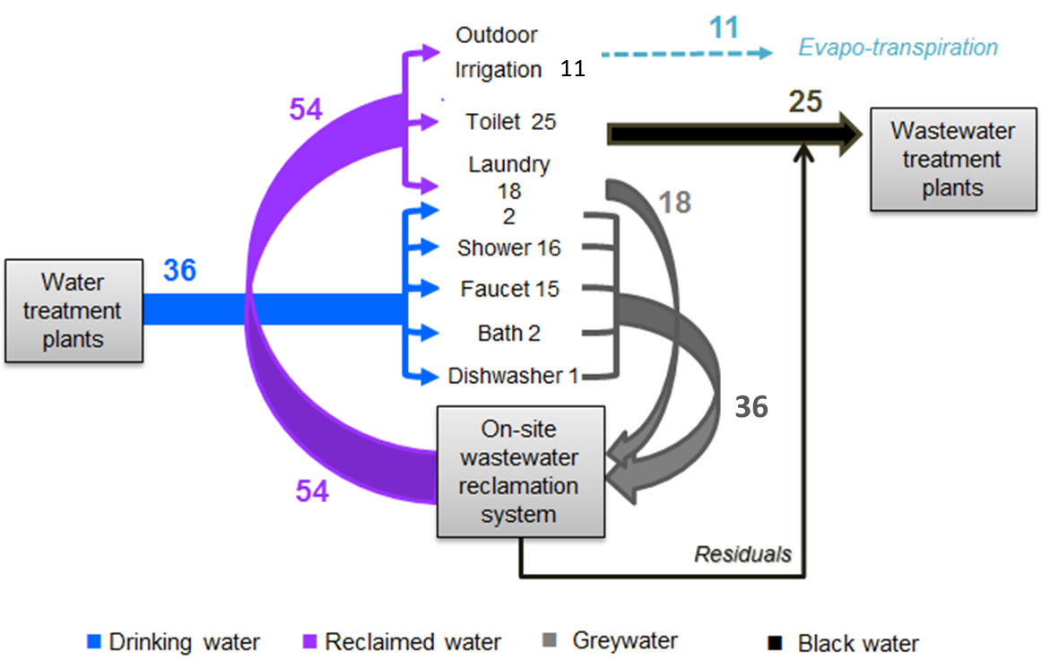
Water Flows with LID and Reclamation a 2-story apartment unit of Atlanta, GA
Same Size Waste Water Treatment Plant
Smaller Water Treatment Plant
Smaller Flow, More Concentrated; Smaller Plant: Better energy and nutrient recovery.
Potential of off-grid water supply

Slide 13
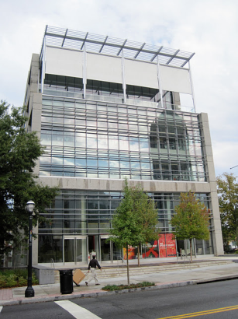
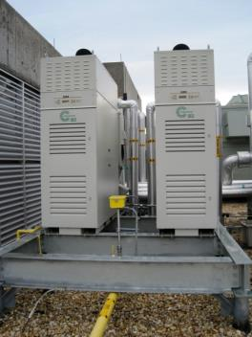
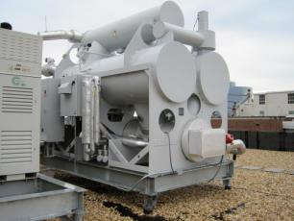
Decentralized Energy Production at Perkins + Will, Atlanta Office
Microturbines are used to for heating and cooling using Absorption Chillers and supply 40% of the total electricity.
Adding Distributed Generation as part of the Grid:
Water Reduction: >50%
CO₂ Reduction: 15 - 40%
NO_{X} Reduction: ~90%
Adsorption Chiller
65 kW Microturbine
Perkins+Will Office Building

Slide 14
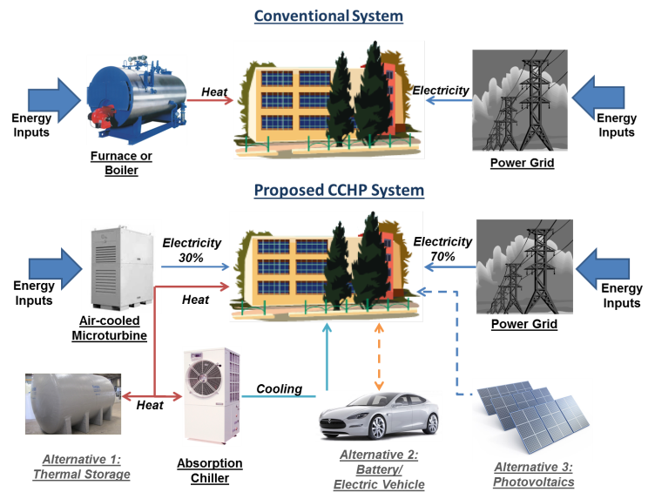
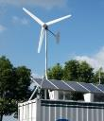
Future Research: Expanding the Current CCHP System 2.0
Wind

Slide 15
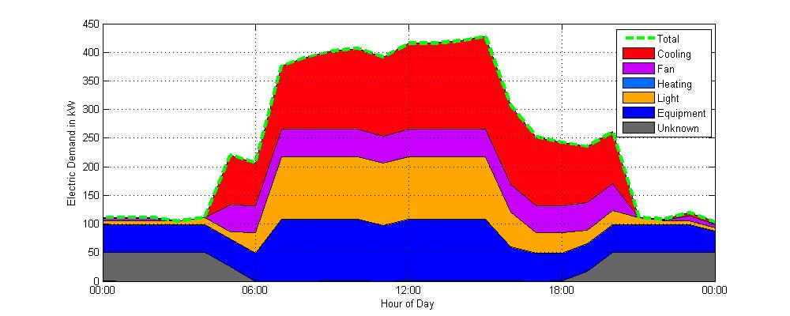
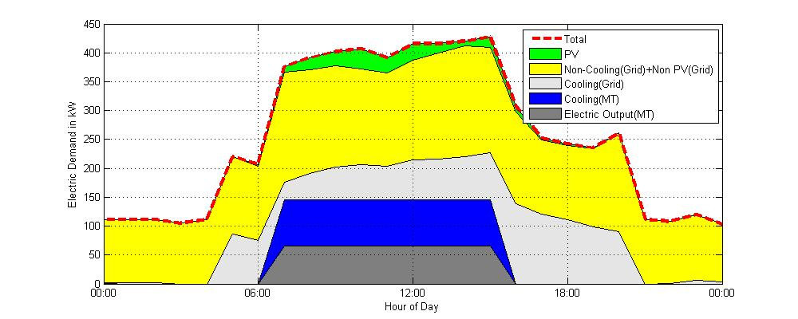
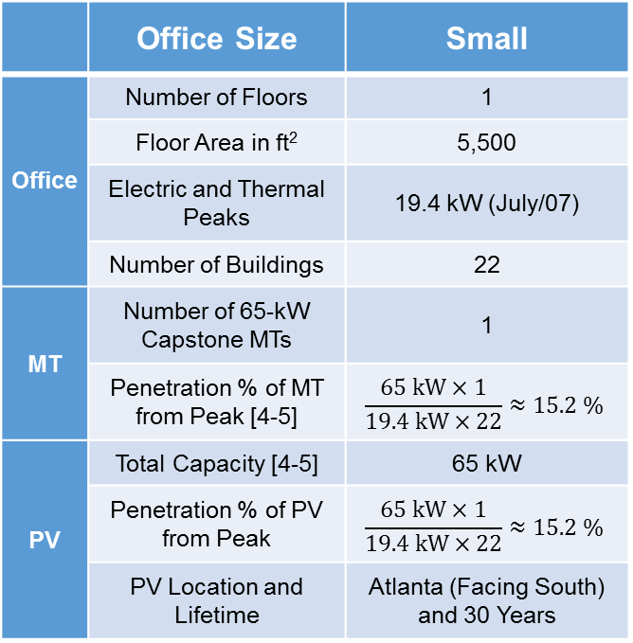
Dispatch Optimization of Electric Energy Output
Minimize the Generation Cost and Maximize the Environmental Benefits
Electric Energy from Grid (No MT and No PV)
 | Office Size | Small
Office | Number of Floors | 1
 | Floor Area in ft² | 5,500
 | Electric and Thermal Peaks | 19.4 kW (July/07)
 | Number of Buildings | 22
MT | Number of 65-kW Capstone MTs | 1
 | Penetration % of MT from Peak [4-5] | $$\frac{65 kW×1}{19.4 kW×22}≈15.2 \%$$
PV | Total Capacity [4-5] | 65 kW
 | Penetration % of PV from Peak | $$\frac{65 kW×1}{19.4 kW×22}≈15.2 \%$$
 | PV Location and Lifetime | Atlanta (Facing South) and 30 Years
Electric Energy from Grid, MT, and PV
Peak reduction by PV and MT
Cooling load (up to 80.7 kW) is covered by chillers of MT
Credit: Insu Kim

Slide 16
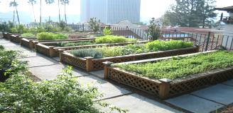
Closing the Urban Water, Nutrient, Energy and Carbon Loops
Stormwater Management with Low-Impact Development
More Concentrated Wastewater
On-site Energy and Nutrient Recovery
Stormwater treated through LID
Natural Gas from Anaerobic Digestion
Source of Fertilizer
Urban Agriculture (Aquaponics,
Urban Farming, Greenhouse Farm)
Harvested Rainwater
Fertilizer for Farms,
Food for Aquaponics
CO2 Injection
Local Composting
Combined Carbon Capture, Cooling, Heating and Power (Air-cooled microturbines)
Heat
Heat and Energy
Natural Gas from Compost
Landfill
Natural Gas from Landfill
Natural Gas
Natural Gas
Heat and Energy
Water
Fertilizer
CO2

Slide 17
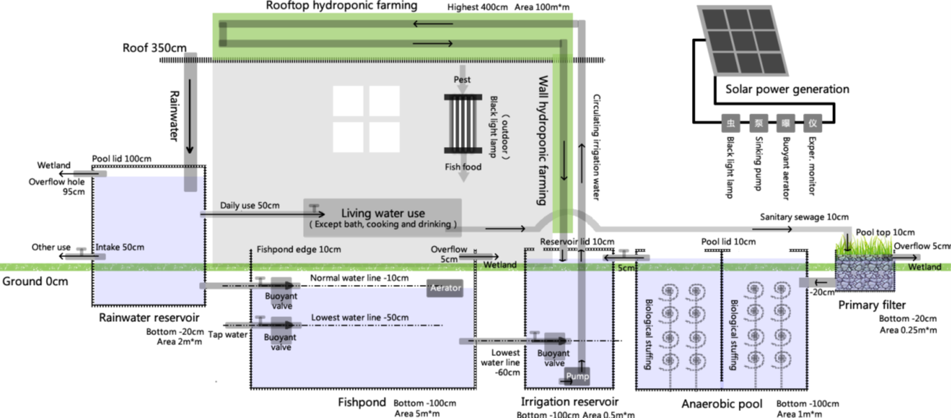
The Design of Decentralized Water, Energy and Food Systems in Rural Baoting, Hainan
The installation cost: ￥50,000 ($8,000)
Credit: Baolong Han, RCEES
One single family with 5 people | Conventional | Decentralized | Change
Land use (including housing and farming) | More than 400 m² | Less than 100 m² | -75%
Water use | More than 200 tones/year | Less than 120 tones/year | -40%
Chemical fertilizer use | More than 40 kg/acre/year | Less than 10 kg/acre/year | -75%
Pesticide use | More than 1kg/acre/year | Less than 0.1 kg/acre/year | -90%
Net household income | Less than ￥40,000/year | More than ￥50,000/year | +20%

Slide 18
The Connection between Autonomous Vehicles and Water
80% penetration of autonomous vehicles
28% of the cars we have today
At least 72% reduction in parking space
Additional 17% of city land for green space and stormwater management
24.7% reduction of impervious area and stormwater runoff
Notes:
https://www.itreetools.org/Canopy/resources/Tree_and_Impervious_Cover_change_in_US_Cities_Nowak_Greenfield.pdf

Slide 19
  The Adoption of Shared Autonomous Vehicles Might Boost the Return on Investment of Transit-oriented Development
¾ mile or 10 minute walking
¾ mile or 10 minute walking
¾ mile or 10 minute walking
¾ mile or 10 minute walking
The radius served by transit can be extended through the enhanced mobility with autonomous vehicles.

Slide 20
The Synergistic Effects of “Infrastructural Symbiosis”
Low-Impact Development
The accumulated synergistic effects :
  reduced water and energy consumption,
  lower dependence on centralized systems,
  larger share of renewables in the electricity mix,
  reduced vehicle-miles travelled, &
  an increase in tax revenue.
  enhanced system resilience
Greywater Reclamation
Decentralized Water Infrastructure
Preferred Neighborhood
Rainwater Harvesting
Air-cooled Microturbine
Decentralized Energy Infrastructure
Residential PV, Wind, etc
Increased
Neighborhood Amenities
Thermal and Energy Storage
Vehicle-to-Grid (V2G)
Compact Growth
Mixed Land Use
Transit – oriented Development
Autonomous Vehicles

Slide 21
Manage the Complexity in Infrastructure Systems

Slide 22
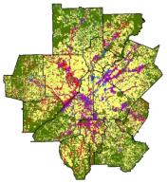
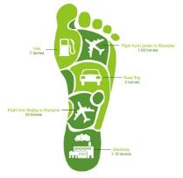





Urban Systems Complexity
Emergence of desirable amenities (high Tax Revenue and Quality of Life) & undesirable amenities (e.g., poor air quality, low tax revenue, traffic congestion, flooding, etc.)
Macro
Infrastructure Systems
Socio-Economic Environment
Micro
Notes:
Infrastructures (pipelines, roads, buildings) serve for human activities in the urban areas. Meanwhile, the increasing wealth and population stimulates the growth and renovation of infrastructures. In the micro level, the interconnection is determined by thousands, millions, even billions of decisions related to geo information, socioeconomic status, and willing pay. That’s what we can observe various land use pattern, water, energy and transportation network in the macro level.

Slide 23

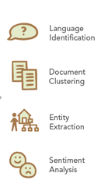
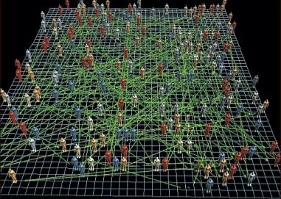
Big Data for Social Decision and Complexity Modeling
Topic Modeling
Collect
Social Media
Analyze
Enrich and prepare social media content with metadata
Modeling
Agent-based urban model and visualization
Blogs
Twitter
News
Product Reviews

Slide 24
Sentiment Analysis on the Topic of “Green Roof”
We synthesized the topics of 1.2 millions sustainability-related tweets collected from April, 2016 to June, 2016. The topic modeling algorithm takes less than 40 minutes.
In 6054 tweets about “green roof” topics:
  4543 tweets are neutral
    “We do green roof systems for today’s homeowners and building owners”
  1422 tweets are positive
    “4 best reason to grow a living roof! Beautiful, beneficial, efficient, green living rooftops”
  89 tweets are negative
    “Green roof garage has been nixed. Too expensive. :(”

Slide 25
Agent-based Housing Market Simulation
Apartment
vs. Single-family
Transaction price
Estate sale
House demand for next period
Prospective homebuyers
Socioeconomic attributes
Preference
Evaluate candidate houses
Decide the biding house
Determine willingness to pay
Bid Price
Housing Market
House inventory:
apartment, single-family
Infrastructure service
Stormwater management(1st yr)
Transportation improvement (5th yr)
Developers
Asking price
New house investment decision
Consider LID options if impact fee exists
Asking Price
New houses
Homeowners
Property value
Living community
Green space
Transportation accessibility
Bid Success
Infrastructure
improvement
Impact fee ?
Government
Collect property tax
Distribute property tax for infrastructure improvement
Property Tax

Slide 26
Agent-based Modeling: Simulating the Adoption Rate for More Sustainable Urban Development
Business As Usual (BAU)
Principal Agents: Prospective Homebuyer, Homeowners, Developers, Government
Implemented Policy Tool
Impact fee for Low Impact Development non-compliance penalty:
  $13,000 per unit for single-family house
  $1,500 per unit for apartment home
Policy Implementation Effect
More Sustainable Development (MSD)
After 30 years:
40% reduction in potable water demand from centralized plant in MSD as compared to BAU
36% increase in net property tax revenue generation in MSD as compared to BAU
Source: Lu. et al., ES&T, 2013

Slide 27
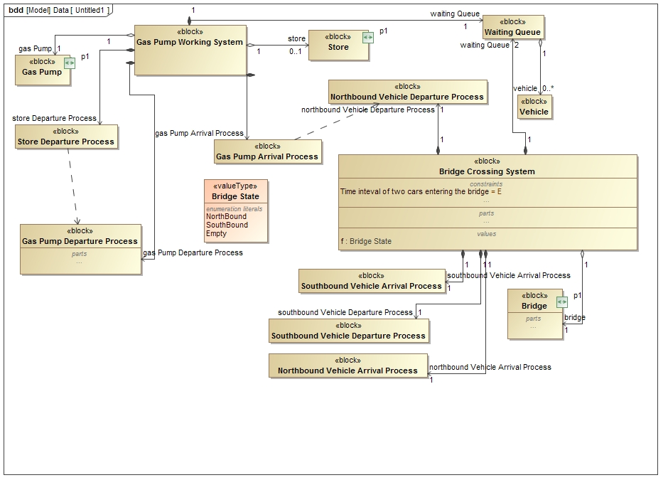
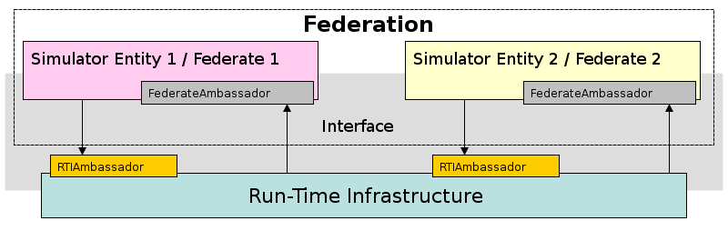
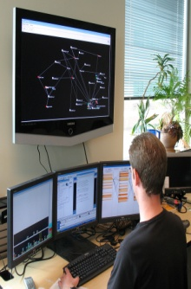
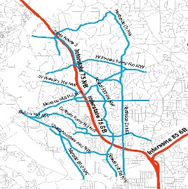
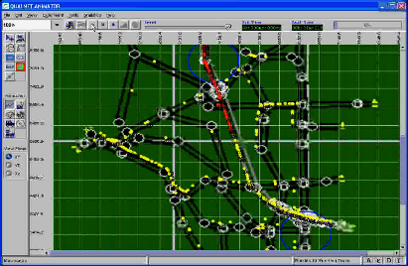
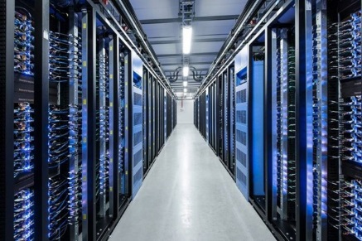
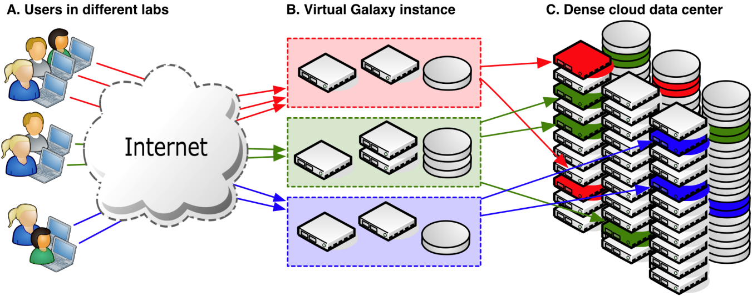
Integrated Simulation Models to Study Infrastructure Dependencies: Approach
Integrated (Federated) Simulations
System Specification
Common Object, Data Models, Simulations
Visualization and Analysis
Cloud-Based Model execution
Specification of common data model in SysML
Automated generation of federated simulations
Fast Runtime Infrastructure (RTI) software to interconnect models
Leverage industry standards, computational tools when available

Slide 28
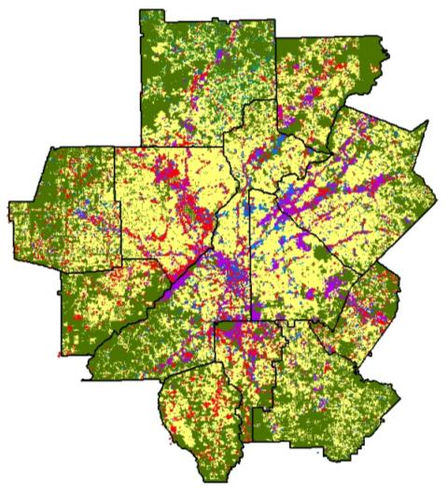
Spatial Databases for Urban Modeling
The SMARTRAQ project
Supports research on land use impact on transportation and air quality
1.3 million parcels in the 13 metropolitan Atlanta non-attainment counties

Slide 29
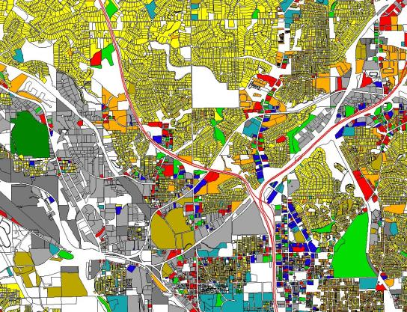
SMARTRAQ Data and Attributes
Address
Road Type
City
Zip Code
Owner Occupied
Commercial/Residential
Zoning
Sale Price
Sale Date
Tax Value
Assessed Value
Improvement Value
Land Value
Year Built
No. of Stories
Bedrooms
Parking
Acreage
Land Use Type
Number of Units
X,Y Coordinate
Estimated Sq Feet
Total Sq Feet

Slide 30
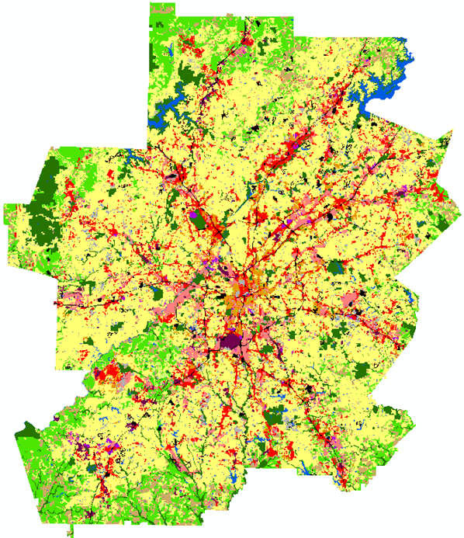
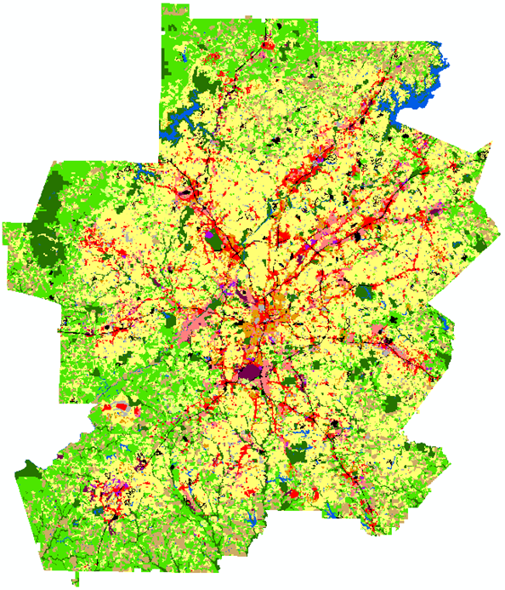





Projected Growth Scenarios for Atlanta
Business As Usual
Year 2030
More Compact Development
Year 2030

Slide 31
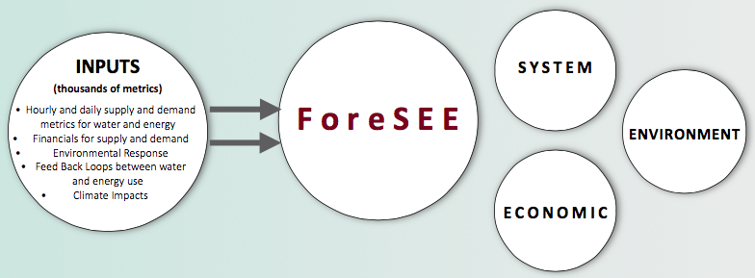
ForeSEE: An Integrated Water-Energy-Cost Modeling Tool with Hourly, Daily, Monthly and Annual Forecasting
Hourly demand data used to project grid electricity and water savings from use of distributed water and energy technologies
Source: C. Golin and M. Cox (Credit: V. Thomas)
Notes:
ForeSEE estimates of energy saved are determined by the productivity of solar panels during a specific hour during the average day and the peak day of a specific month coupled with the reduced energy required to distribute public water equal to the capacity that could be obtained on an average day. By 2020, the annual reduction in grid energy reaches 80,000 MWh, enough energy to avoid building three peaker gas-powered plants. Figure 2 shows the average hourly reduction in grid energy in 2020.

Slide 32
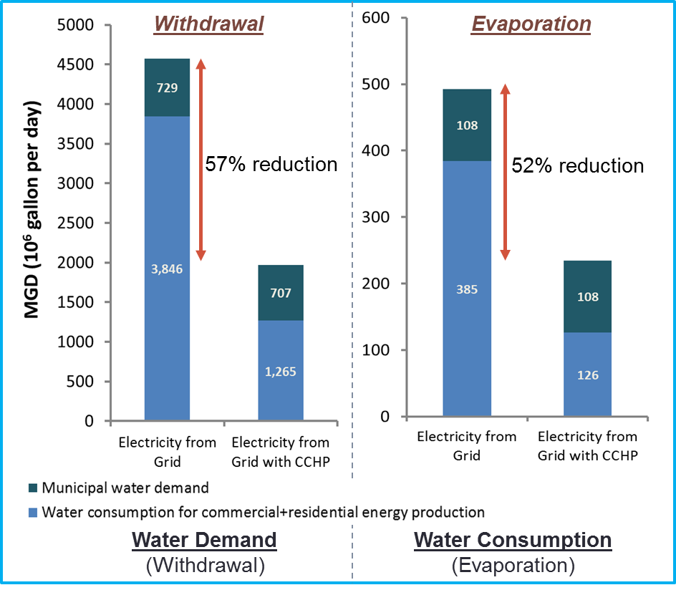
Atlanta Water Demand for New Residential and Commercial Buildings in More Compact Growth Scenario (with low flow fixtures + decentralized CCHP system)
Installation of Air Cooled Microturbines save 2.4 times the amount of water used for domestic consumption

Slide 33
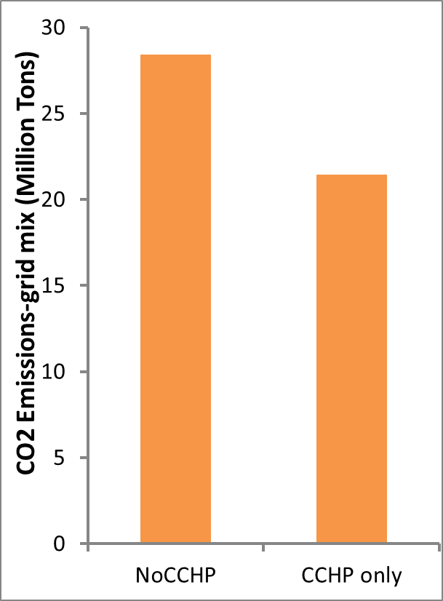
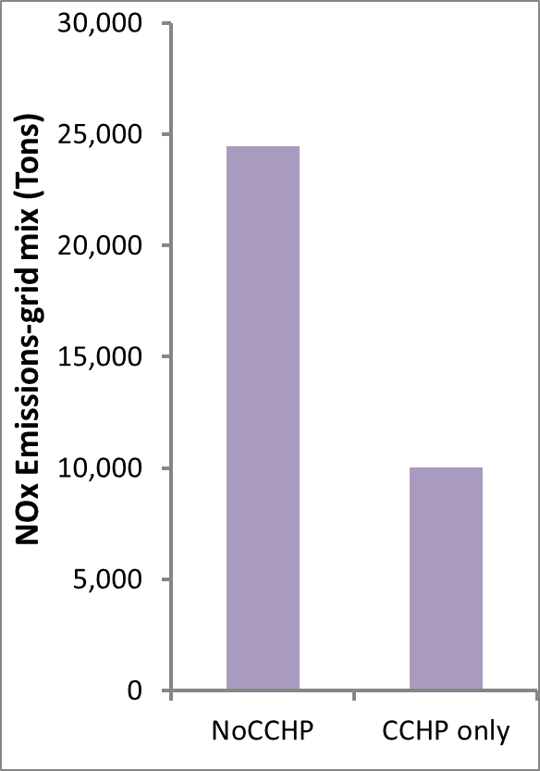
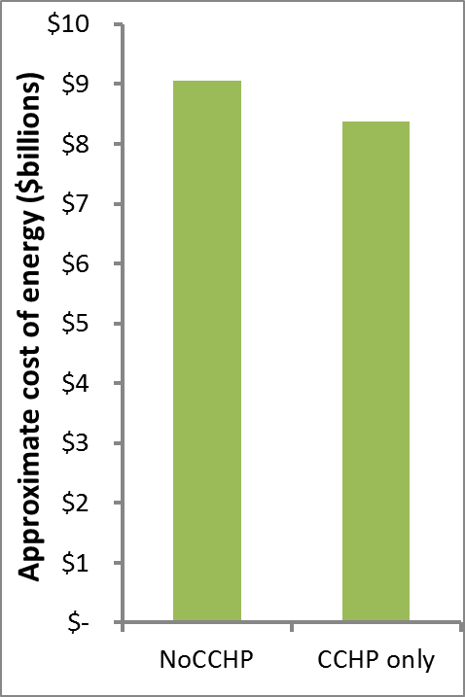
Potential GHG and Cost Reductions in 2030
By 2030, implementation of CHP in all new residential and commercial buildings will reduce the CO₂ emissions by~ 0.007 Gt CO₂, NOx emissions by ~ 15000 Tons ,and the energy costs by $680 million per year for the Metro Atlanta region.
CO₂ Emissions
NO_{X} Emissions
Energy Cost
-25%
-8%
-23%
- 65%

Slide 34
Summary
Infrastructure Systems Are All Connected and Greater Sustainability Gains Can be Achieved by Looking at Their Interactions
Decentralized Water / Low Impact Development Can Save Water, Energy and Money
Decentralized Energy and Combined Heat and Power Can Save Energy, Water and Money
Transportation and Land Use/ Planning Is Vital in Reducing the Impact Of Urban Systems and Examining Their Interactions
Complexity Models May Be Useful to Examine the Adoption Rate of Policy Instruments
Caveat: We need to test the ideas that were presented

Slide 35
Emerging Engineering Solutions for Water and Human Sustainability
Network of Wireless Sensors
Social-Media Data Analytics
Energy Independent
Buildings
Performance Monitoring
Network of Things
Understand Stakeholder Preference
Living Buildings
High Performance Buildings
Transit-oriented Development
Water and Human Sustainability
Bike Friendly Neighborhood
Decentralized Energy Infrastructure
Flow Batteries
Shared Autonomous Vehicles
Efficient Water Use
Grid Scale Energy Storage
Super Capacitors
Decentralized Water Infrastructure
Solar Powered Public transit
Tele-commute to work

Slide 36
Thank You!
John C Crittenden, Ph.D., P.E., U.S. and Chinese N.A.E.
E-Mail: john.crittenden@ce.gatech.edu
Zhongming Lu, Ph.D.
E-Mail: zhongming.lu@gatech.edu
Web Site: http://www.sustainable.gatech.edu/

