Slide 1
Importance of Effective Timing and Synchronizations in Smart Cities
Ziqian (Cecilia) Dong, Ph.D.
Assistant Professor
Electrical and Computer Engineering
New York Institute of Technology, New York, NY 10023

Slide 2
Layer view of time-aware systems
Timing support for applications
Time-aware network and communication systems
Time and frequency transfer systems
Oscillators and clocks
Source: NIST Technical Note 1867

Slide 3
Time Synchronization
Time synchronization is important in networks, wired or wireless. It is the fundamental requirement for communication between nodes on the network.
Sent time
Access time
Propagation time
Receive time

Slide 4
Time synchronization in Wireless Networks
Synchronization nodes can be utilized over a multi-hop wireless network.
Hardware clocks have variations in oscillators, the clocks may drift and result in the durations of time intervals of events not observed the same among nodes.
Applications: location and speed determination, relative proximity determination among nodes and energy saving.
Notes:
What is the project about?
Define the goal of this project
Is it similar to projects in the past or is it a new effort?
Define the scope of this project
Is it an independent project or is it related to other projects?
* Note that this slide is not necessary for weekly status meetings

Slide 5
The challenge
Precise clock synchronization is not always achieved between different hardware.
Protocols from lenient to strict are available to meet different needs.
Reference Broadcast Synchronization (RBS)
Timing-sync Protocol for Sensor Networks (TPSN)
Flooding Time Synchronization Protocol (FTSP)
Notes:
* If any of these issues caused a schedule delay or need to be discussed further, include details in next slide.

Slide 6
A case study - Detecting and Locating Man-in-the-Middle Attacks in Fixed Wireless Networks
Method to detect and locate a Man-in-the-Middle (MITM) attack in a fixed wireless network by analyzing round-trip time (RTTs) and measured received signal strength (RSS) from fixed access points.
Evaluated three machine learning algorithms on the measured RSS dataset to estimate the location of a Man-in-the-Middle attacker.
Notes:
Duplicate this slide as necessary if there is more than one issue.
This and related slides can be moved to the appendix or hidden if necessary.

Slide 7
Man in the Middle Attack
A MITM attack is considered an active eavesdropping attack, often carried out on the media access control (MAC) layer through address resolution protocol (ARP) cache poisoning
The purpose of a MITM attack is to intercept a connection between two legitimate hosts in the network and pretending to be the intended sender or receiver of track between two legitimate nodes. in order to carry out different kinds of attacks such as capturing track between the two nodes
Notes:
The following slides show several examples of timelines using SmartArt graphics.
Include a timeline for the project, clearly marking milestones, important dates, and highlight where the project is now.

Slide 8
B
(Client)
IP: 10.42.0.14
MAC: 64:A3:CB:47:35:66
MITM Attacker
10.42.0.34
00:0f:04:b2:68:ef
A
(Server)
IP: 10.42.0.1
MAC: B4:b6:76:19:2:21
ARP Request: ...0.1?
SRC: 68:ef, DST: 68:ef
ARP Reply: …2:21?
SRC: 2:21, DST: 68:ef
ARP Request: …0.14?
SRC: 68:ef, DST: ff:ff
ARP Reply: …35:36?
SRC: 35:36, DST: 68:ef
ARP Reply: …0.14 is at …68:ef
SRC: 68:ef, DST: 2:21
ARP Reply: …0.1 is at …68:ef
SRC: 68:ef, DST: 35:66
ICMP Echo Request
SRC IP: …0.1, DST IP: …0.14
SRC: 68:ef, DST: 35:66
ICMP Echo Request
SRC IP: …0.14, DST IP: …0.1
SRC: 68:ef, DST: 2:21
ICMP Echo Response
SRC IP: …0.1, DST IP: …0.14
SRC: 2:21, DST: 68:ef
ICMP Echo Response
SRC IP: …0.14, DST IP: …0.1
SRC: 35:66, DST: 68:ef

Slide 9
B
MITM Attacker
A
mBA
r+TA
TA
mBA

Slide 10
(0,4)
(5,4)
Server
6.4 Meter Server to Client
4m
(0,2)
(5,2)
(0,0)
(5,0)
Client
5m

Slide 11
(0,4)
(5,4)
MITM
Server
(0,2)
6.4 meters from Server to Client
4m
(5,2)
Client
(0,0)
(5,0)
5m

Slide 12
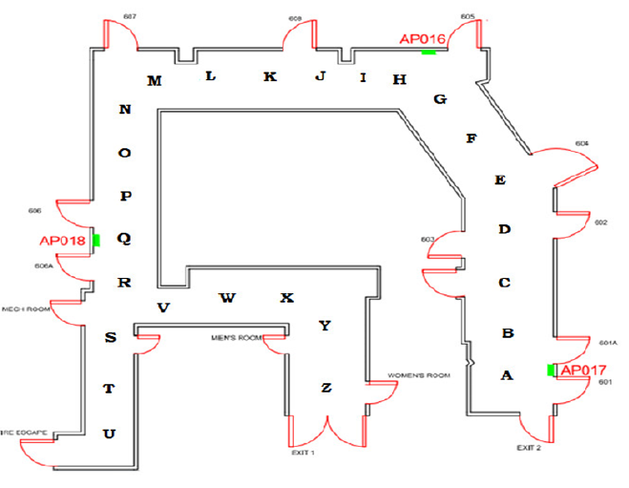
Experiment in EGGC 6th Floor

Slide 13
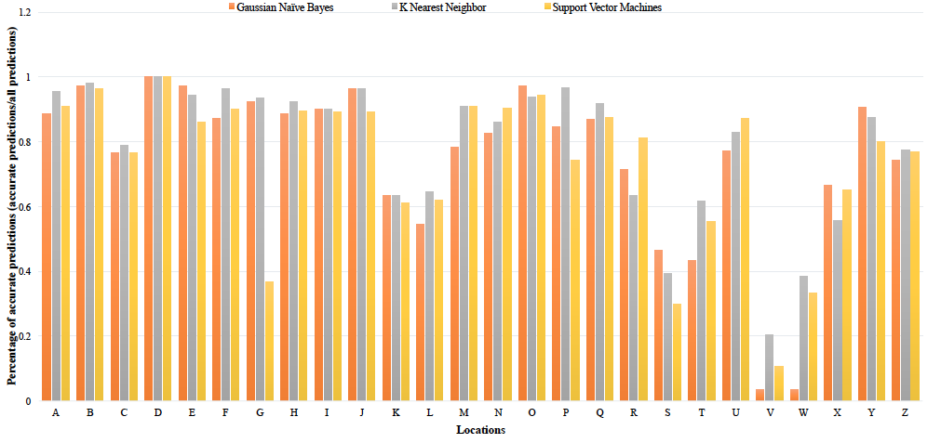
Location estimation accuracy – per point

Slide 14
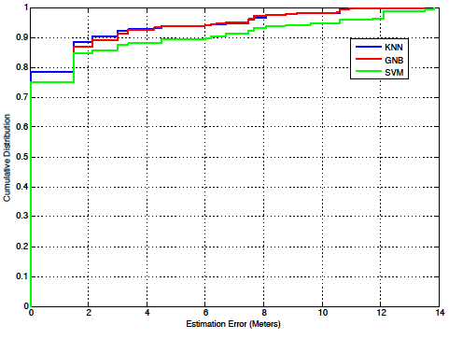
Location prediction accuracy

Slide 15
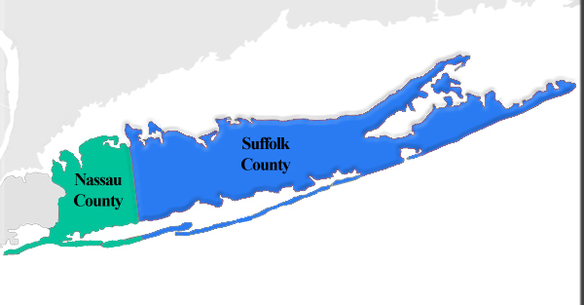
Long Island

Slide 16
Water quality data – New York Suffolk County

Slide 17
References
[1] NIST Technical note 1867
[2] Ziqian Dong, Randolph Espejo#, Yu Wan# and Wenjie Zhuang#, “Detecting and Locating Man-in-the-Middle Attacks in Fixed Wireless Networks,” accepted to CIT. Journal of Computing and Information Technology, Special Issue on Network Security, August 2015.

Slide 18
Thank you Questions
Notes:
Prepare slides for the appendix in the event that more details or supplemental slides are needed. The appendix is also useful if the presentation is distributed later.

