Slide 1
An Ontology-underpinned Emergency Response System for Water Pollution Accidents for NYIT October Conference 2015
Dr. Xiaoliang Meng
Associate Professor and Director
Joint International Center for Resource, Environment Management and Digital Technologies (JIC-REDT)
Wuhan University
www.jicredt.com

Slide 2
Accident News
on April 23th, 2014, two major water suppliers (Baihezui and Yushidun water plants) in Wuhan city had halted production at around 4 p.m. and 7 p.m. The result showed that the water in Wuhan section of Han River contained excessive amount of ammonia and nitrogen which had exceeded the national standard. The suspension of water supply caused a water shortage and affected 300,000 people http://news.xinhuanet.com/english/china/2014-04/24/c_126426298.htm.
The production of Yushidun Water plants restored at 8 a.m. on 24th, however, it was suspended at 9:40 a.m. again. When it was get back to normal around 4 p.m. on 24th, the citizens worried about the safety of drinking water and another suspending.

Slide 3
Drinking Water – After Accident - Safe?
This serious accident alerted the government that it is necessary to have an emergency response system for polluter identification, pollutant tracing, early warning, decision support and public awareness for water pollution accidents.

Slide 4
Study Area

Slide 5
The proposed system used the Han River in China as the study area. Han River is the largest tributary of the Yangtze River, and it has 1577 kilometers in length, out of which 657 km long in Shanxi Province and 920 kilometers in Hubei Province.
There are 19 boundary stations along the Han River in Hubei Province, providing the hydrology and water quality data. The real-time data can be read through the existing Online Water Quality Monitoring Platform maintained by Hubei Environmental Monitoring Central Station.

Slide 6
Project Funder
Collaborating with Hubei Environmental Monitoring Central Station
Funded by Hubei Environmental Protection Bureau.

Slide 7
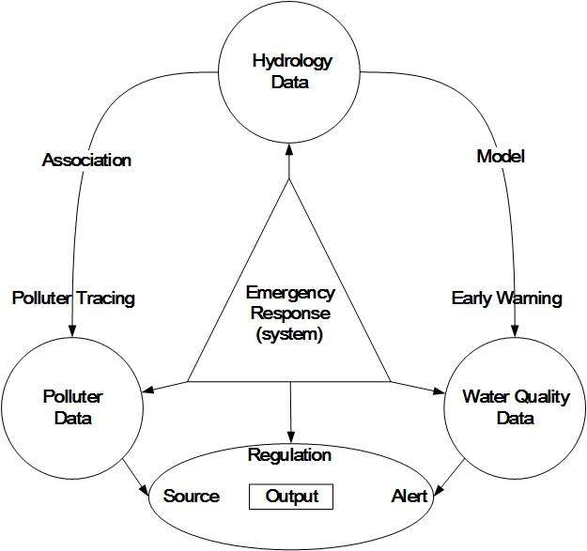
Overall View

Slide 8
System Structure

Slide 9
Semantic Sensor Web
The data of hydrology, water quality and polluter can be achieved automatically through web services. Various sensors are deployed in the water monitoring stations to detect the water quality and hydrology. In order to sharing the observation data from heterogeneous sensor nodes, the Open Geospatial Consortium (OGC) Sensor Web Enablement (SWE), which is a standards-based framework, is involved as the solution . SWE is a Service Oriented Architecture (SOA) approach, and the Sensor Observation Service (SOS) is used as the standard web service interface for requesting, filtering, and retrieving observations and sensor system information from the in-situ stations and mobile monitoring devices. This is the intermediary between the emergency response system and the online water quality monitoring platform which provides the observation repository or near real-time sensor channel.
Each data source is exposed to the system using an RDF interface. This interface generates RDF from the data contained in the data source. Each RDF interface generates ontologically described RDF. This component performs any ontology translation required to get the data into the knowledge models, including the water, polluter and regulation ontology models. Once the data is in RDF and described according to the appropriate ontology, it is stored in the RDF store which is a knowledge base, and is accessible to the system interface.

Slide 10
The Mechanistic Model
two-dimensional
one-dimensional
zero-dimensional
All classic

Slide 11
The Ontology Model
The Water Ontology
The Regulations Ontology
The Pollutants Ontology
Based on existing ontologies

Slide 12
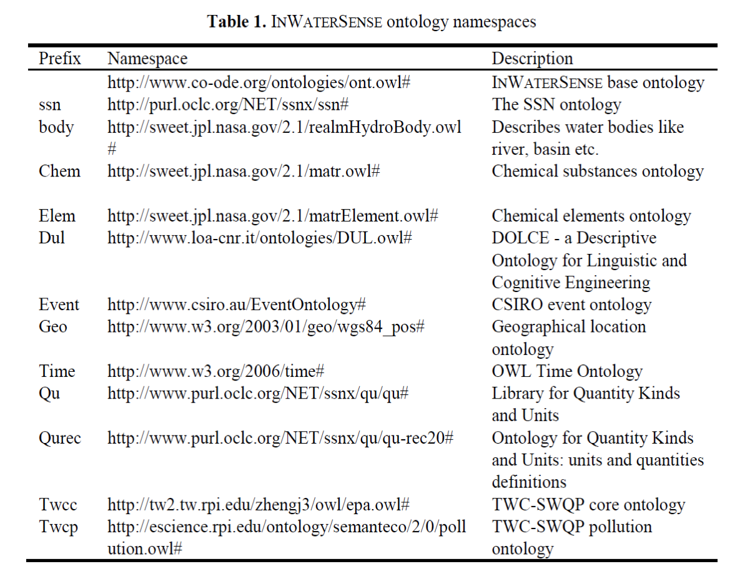
Examples

Slide 13
Water Quality Observation Ontology

Slide 14
As for the instance data (ABox), we have used an example of observation stream datanamely the observation instance O15041218 depicted in Fig. 5. That instance represents a measurement of the concentration of Ammonia Nitrogen, which is in turn a river feature (O15041218 ssn:observedProperty AmmoniaNitrogen, AmmoniaNitrogen ssn:isPropertyOf RiverFeature); it is produced by a device named d1 (oo11724 ssn:observedBy d1); it is sampled on 2015-04-12 at 18:00:00, which is same as the entry system time since there is no latencies, i.e., data are already in machine (O15041218 ssn:observationResultTime T15041218, T15041218 time:isXSDDateTime "2015-04-12T18:00:00"^^<xsd:dateTime>); it’s measured value is 1.98 (O15041218 ssn:observationResult R15041218, R15041218 ssn:hasValue V15041218, V15041218 dul:hasDataValue "1.98"^^<xsd:double>); it is measured by the s2 sensing node (hasSensingNode sn2), at the sample position of 112.4386 for longitude, and 31.46944 for latitude (O15041218 observationResultLocation L15041218, L15041218 geo:lat "31.46944"^^<xsd:double>, L15041218 geo:long "112.4386"^^<xsd:double>).
To query about each sensor node and the water quality elements it observes, the following SQWRL query may be posed to our ontology:
ssn:Observation(?x) ∧ inws:hasSensingNode(?x, ?y) ∧ ssn:observedProperty(?x, ?z) ∧ sqwrl:makeSet(?sx, ?x) ∧ sqwrl:groupBy(?sx, ?z) → sqwrl:select(?y, ?z)

Slide 15
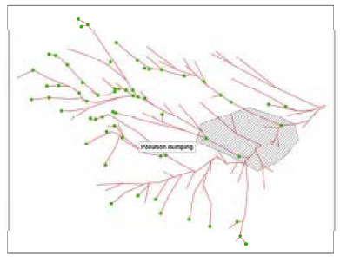
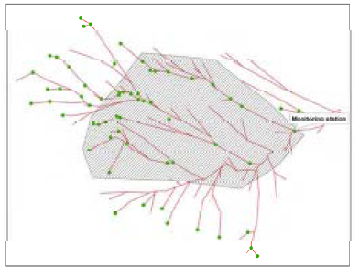
Illustration of tracing pollution sources

Slide 16
Use-case: Emergency Response

Slide 17
Thank you!

