Slide 1
Autonomous Water Sensors for FEW Systems
Alan Mickelson
Guided Wave Optics Laboratory (GWOL) of
Electrical, Computer and Energy Engineering (ECEE)
Mortenson Center for Engineering in Developing Communities (MC- EDC)
Interdisciplinary Telecommunications Program (ITP)

Slide 2
Outline
FEW Systems
Urban Water Supplies
Boulder
New York City
Wuhan
Some Previous Work
Present Work
A Sensor Pack

Slide 3
Food, Energy and Water Systems
Agricultural production affects water quality by nitrate and phosphate pollution (fertilizer) as well as organic pollution from livestock
Energy production also affects water quality thru
Organic and inorganic wastes from fuel production
Organic and inorganic waste from the burning of fuel
Waste heat from energy conversion
Water quality is sufficiently sensitive to the state of food and energy production to be a predictor

Slide 4
Urban Water Supply Systems
Boulder, Colorado
Glacier fed system by a distant (25 mile) glacier with multiple holding lakes and pipes down the mountain
New York City
Fed by tunnels from distant reservoirs with a minimal number of local holding ponds
Wuhan, Heibei, China
Primarily river fed from the Yangtze and Han rivers

Slide 5
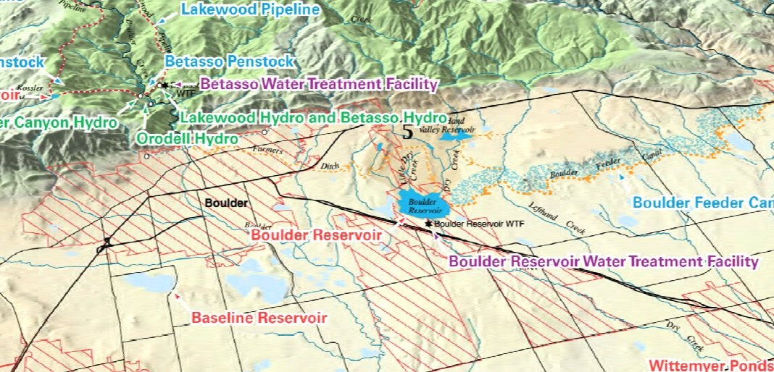
Boulder Colorado

Slide 6
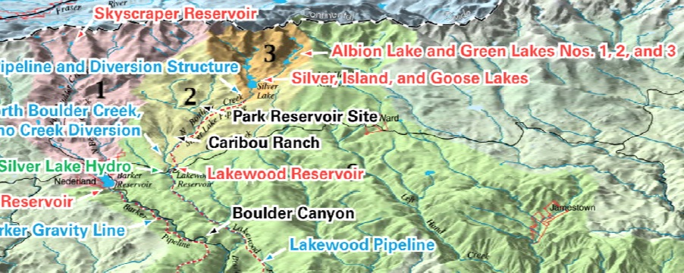
Boulder Colorado II

Slide 7
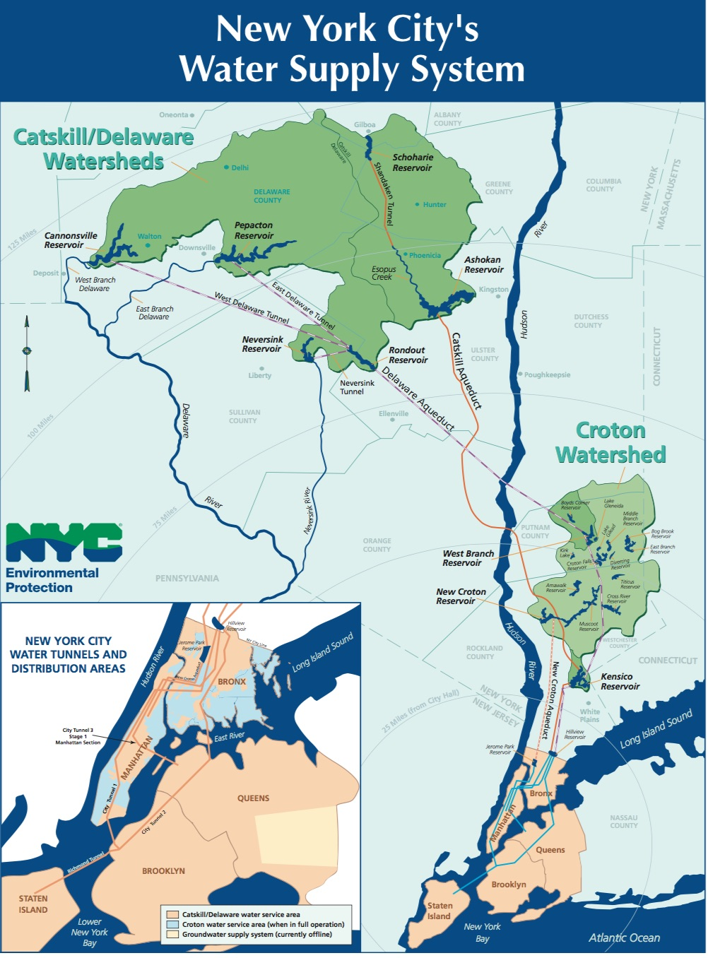
NYC New York
New York does not use river water but only piped reservior water from upstate
The system is well monitored by more than 900 water sensing units with multiple sensors

Slide 8
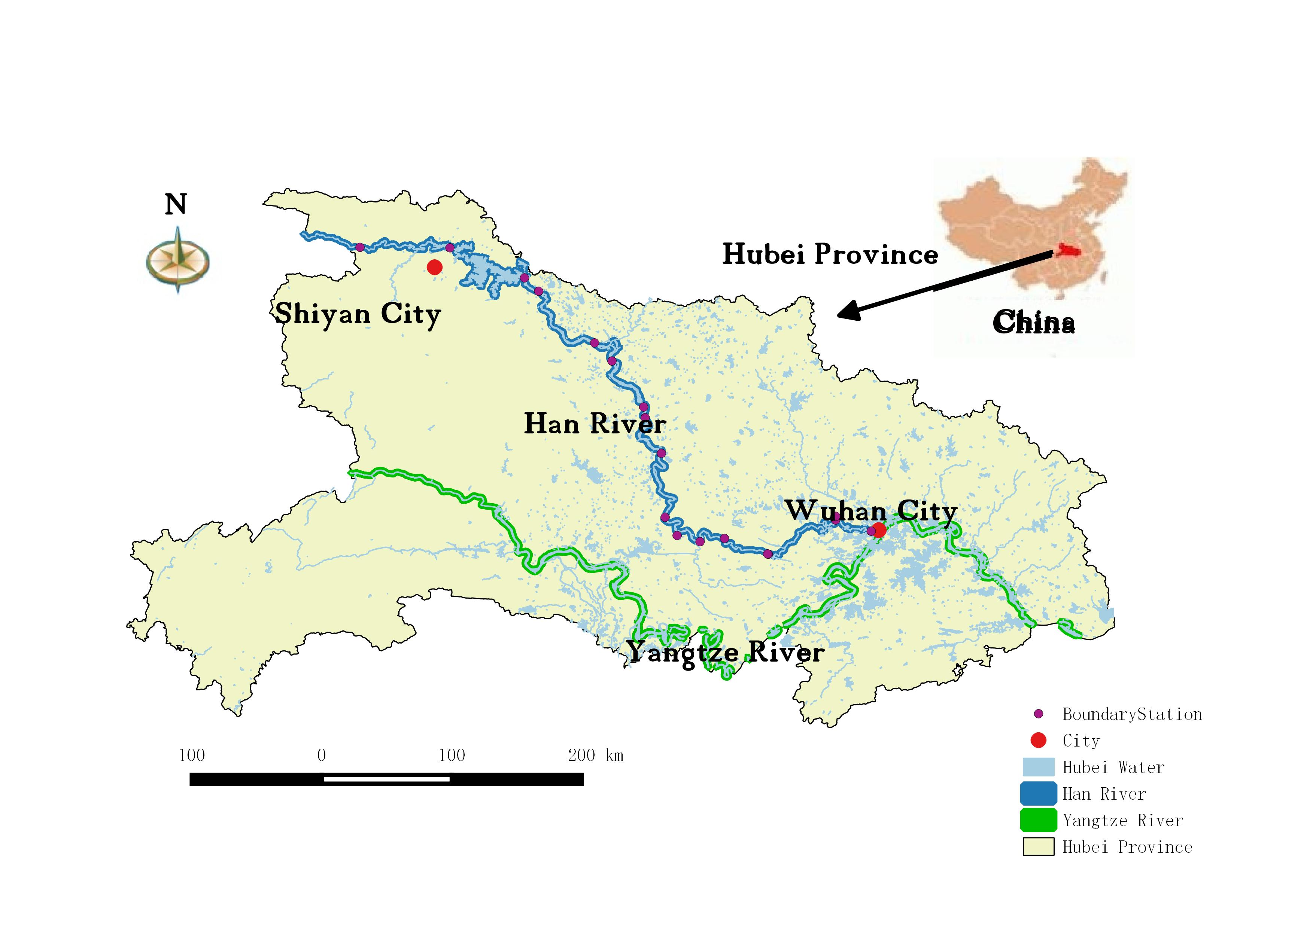
Wuhan, Hebei, China

Slide 9
Summary of Example Systems
In all cases, agricultural production and waste will affect water quality
In all cases, adverse weather may affect water quality
In Boulder and Wuhan, energy production will affect water temperature and quality

Slide 10
Some Previous Work
Water quality on the Napo of Peru
The Napo Network
Wireless network
Autonomous sensing
Water quality packs
Wireless networking
Rude Awakening

Slide 11
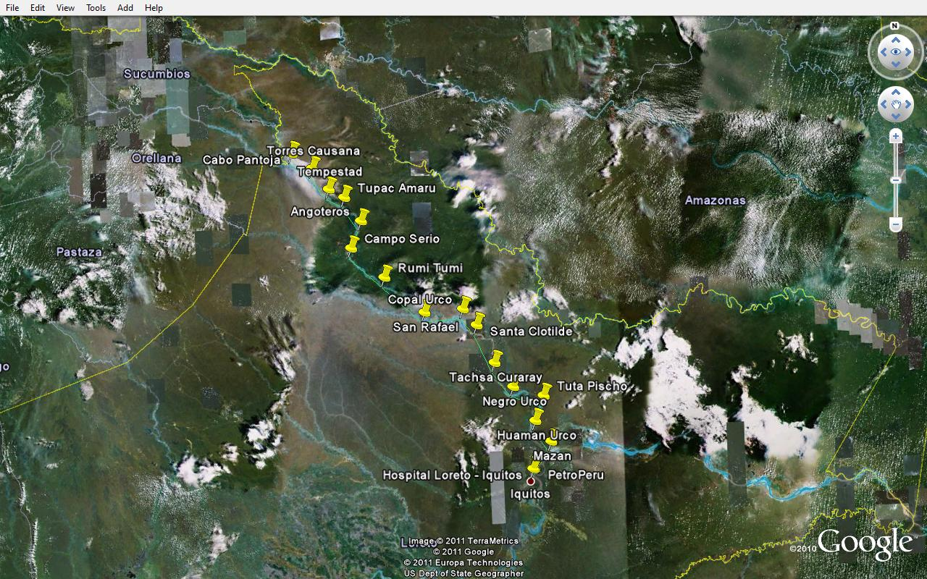
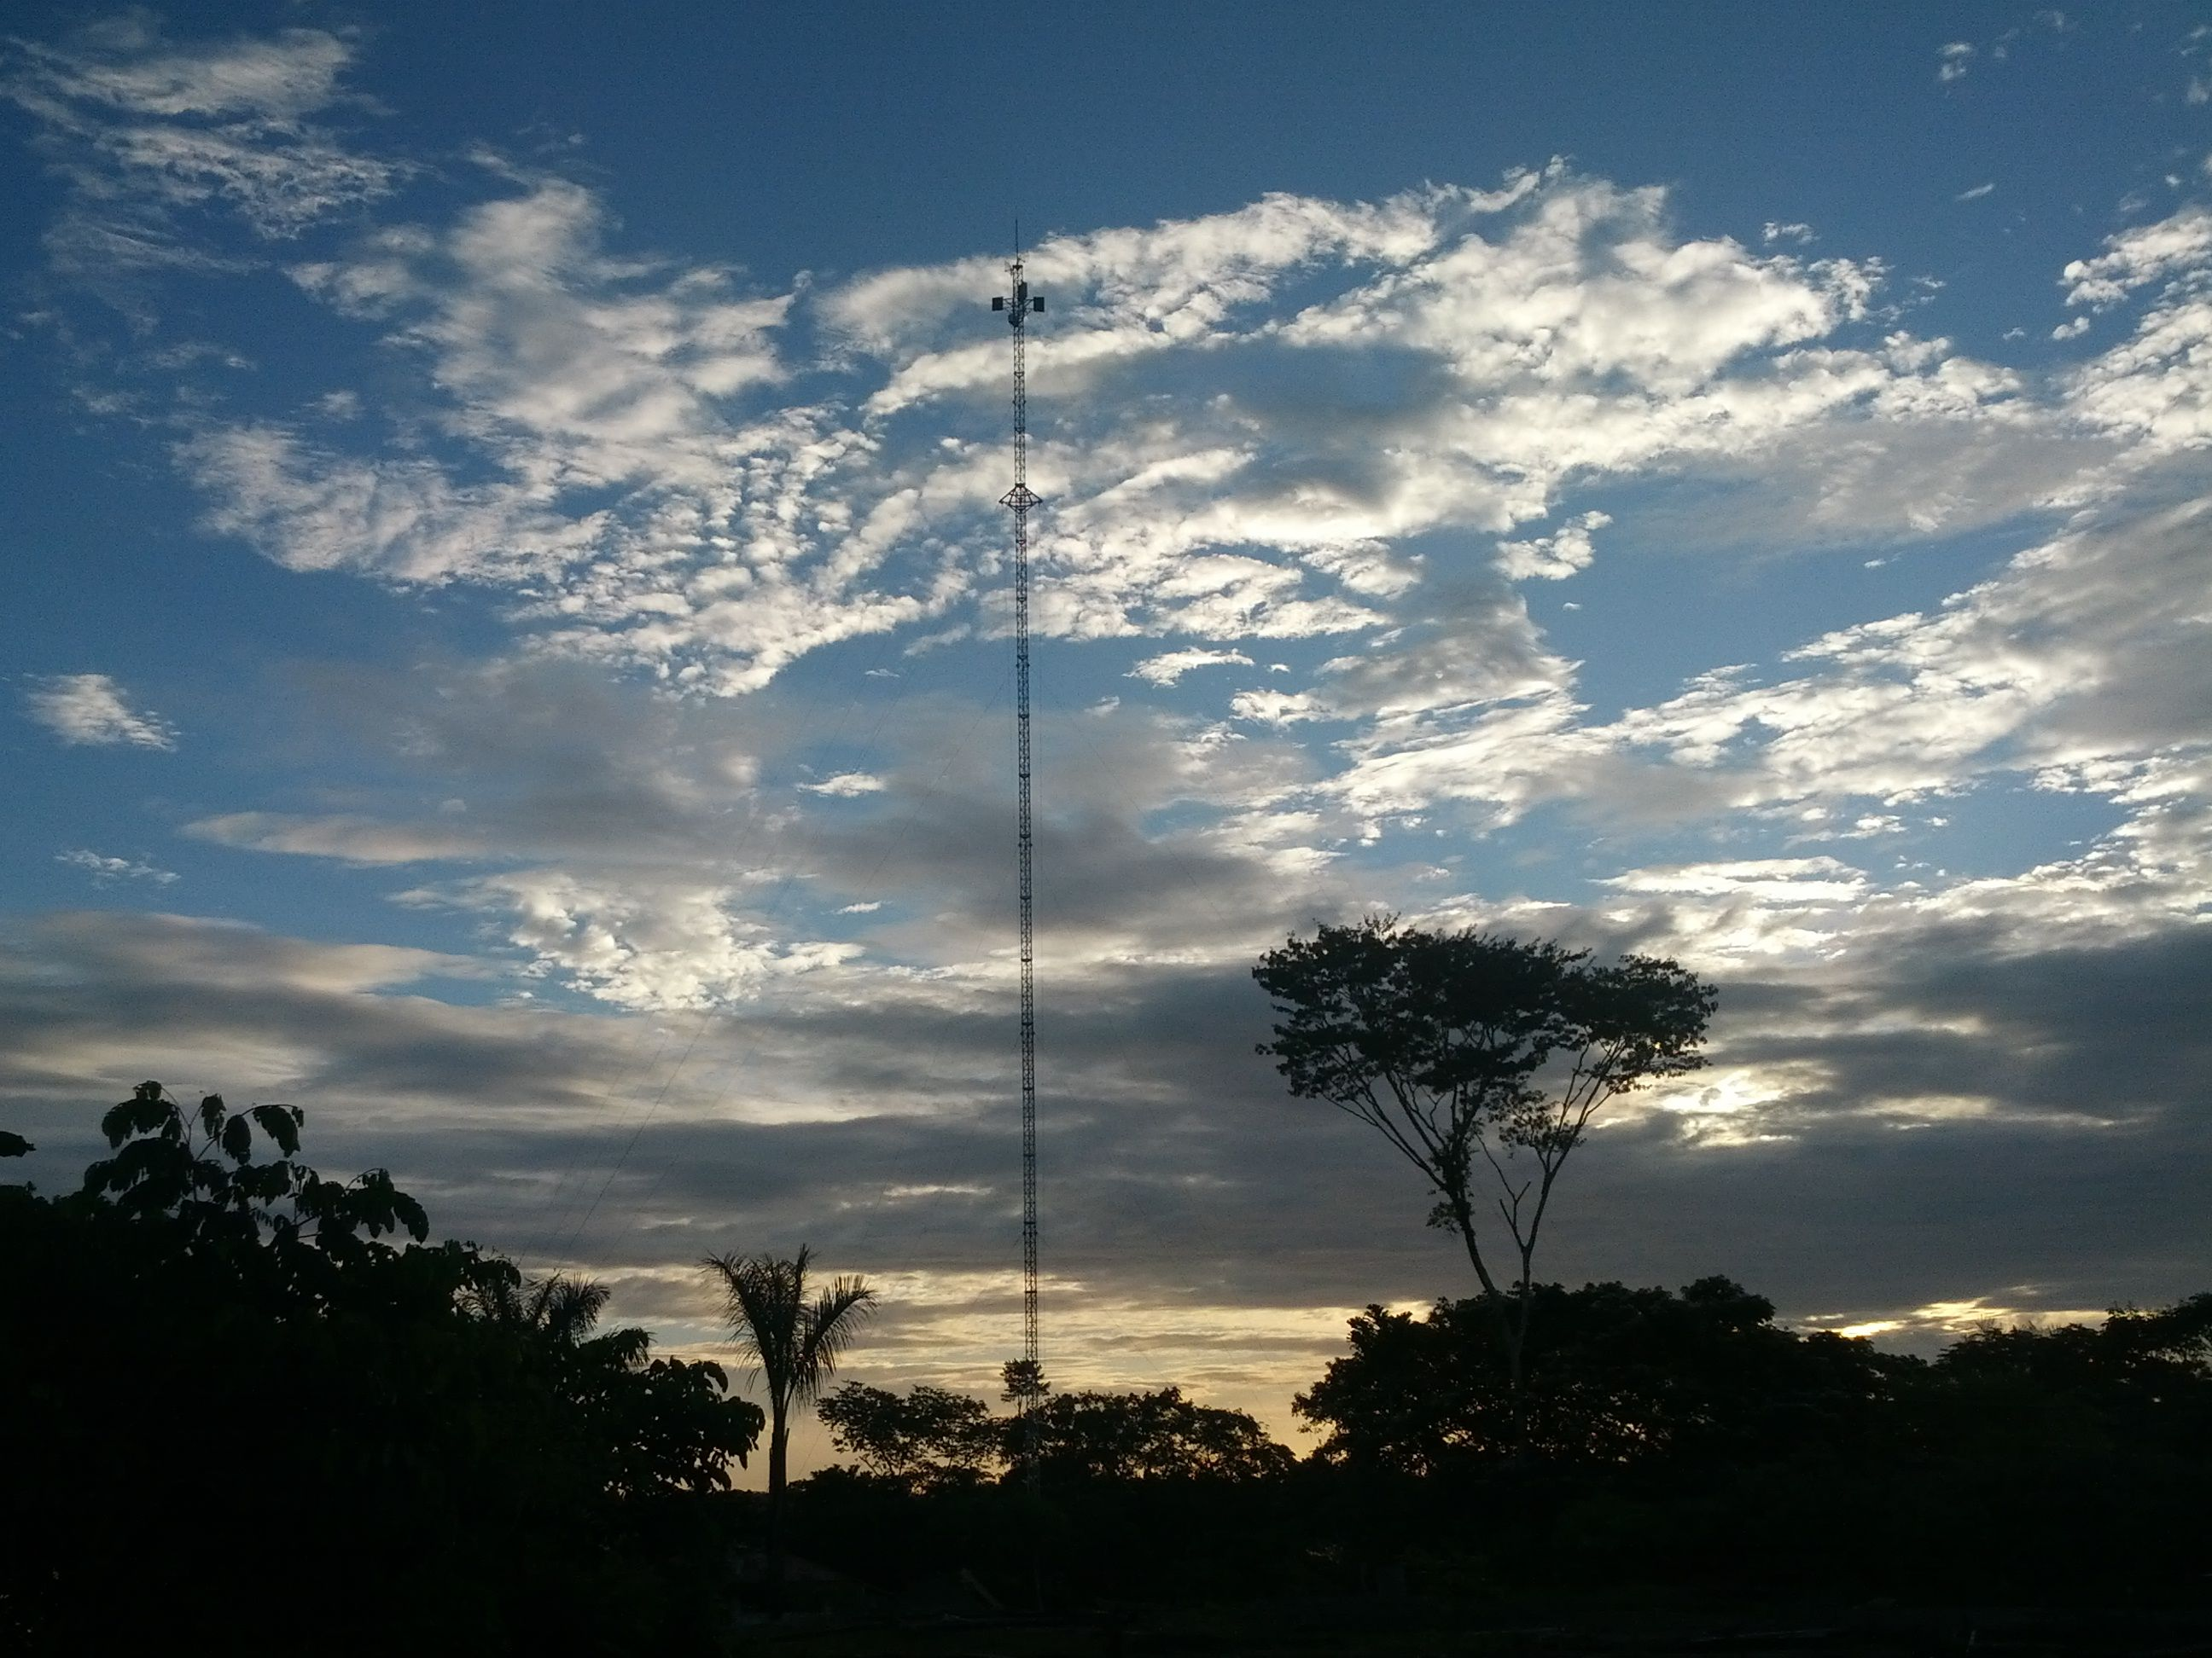
The Napo Network
Amazon Peru is without roads or communications
An established WiLDNet network runs 445 km linking jungle health posts
We have implemented (in concert with providers) a number of trial services on the network since 2009

Slide 12
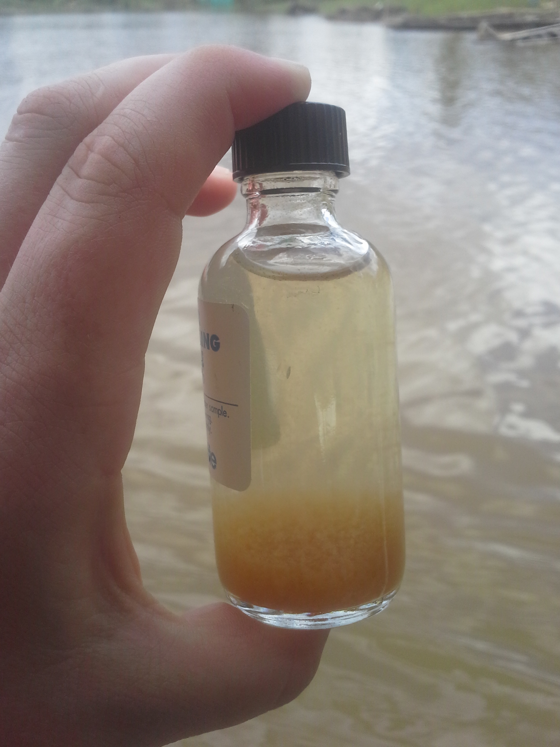
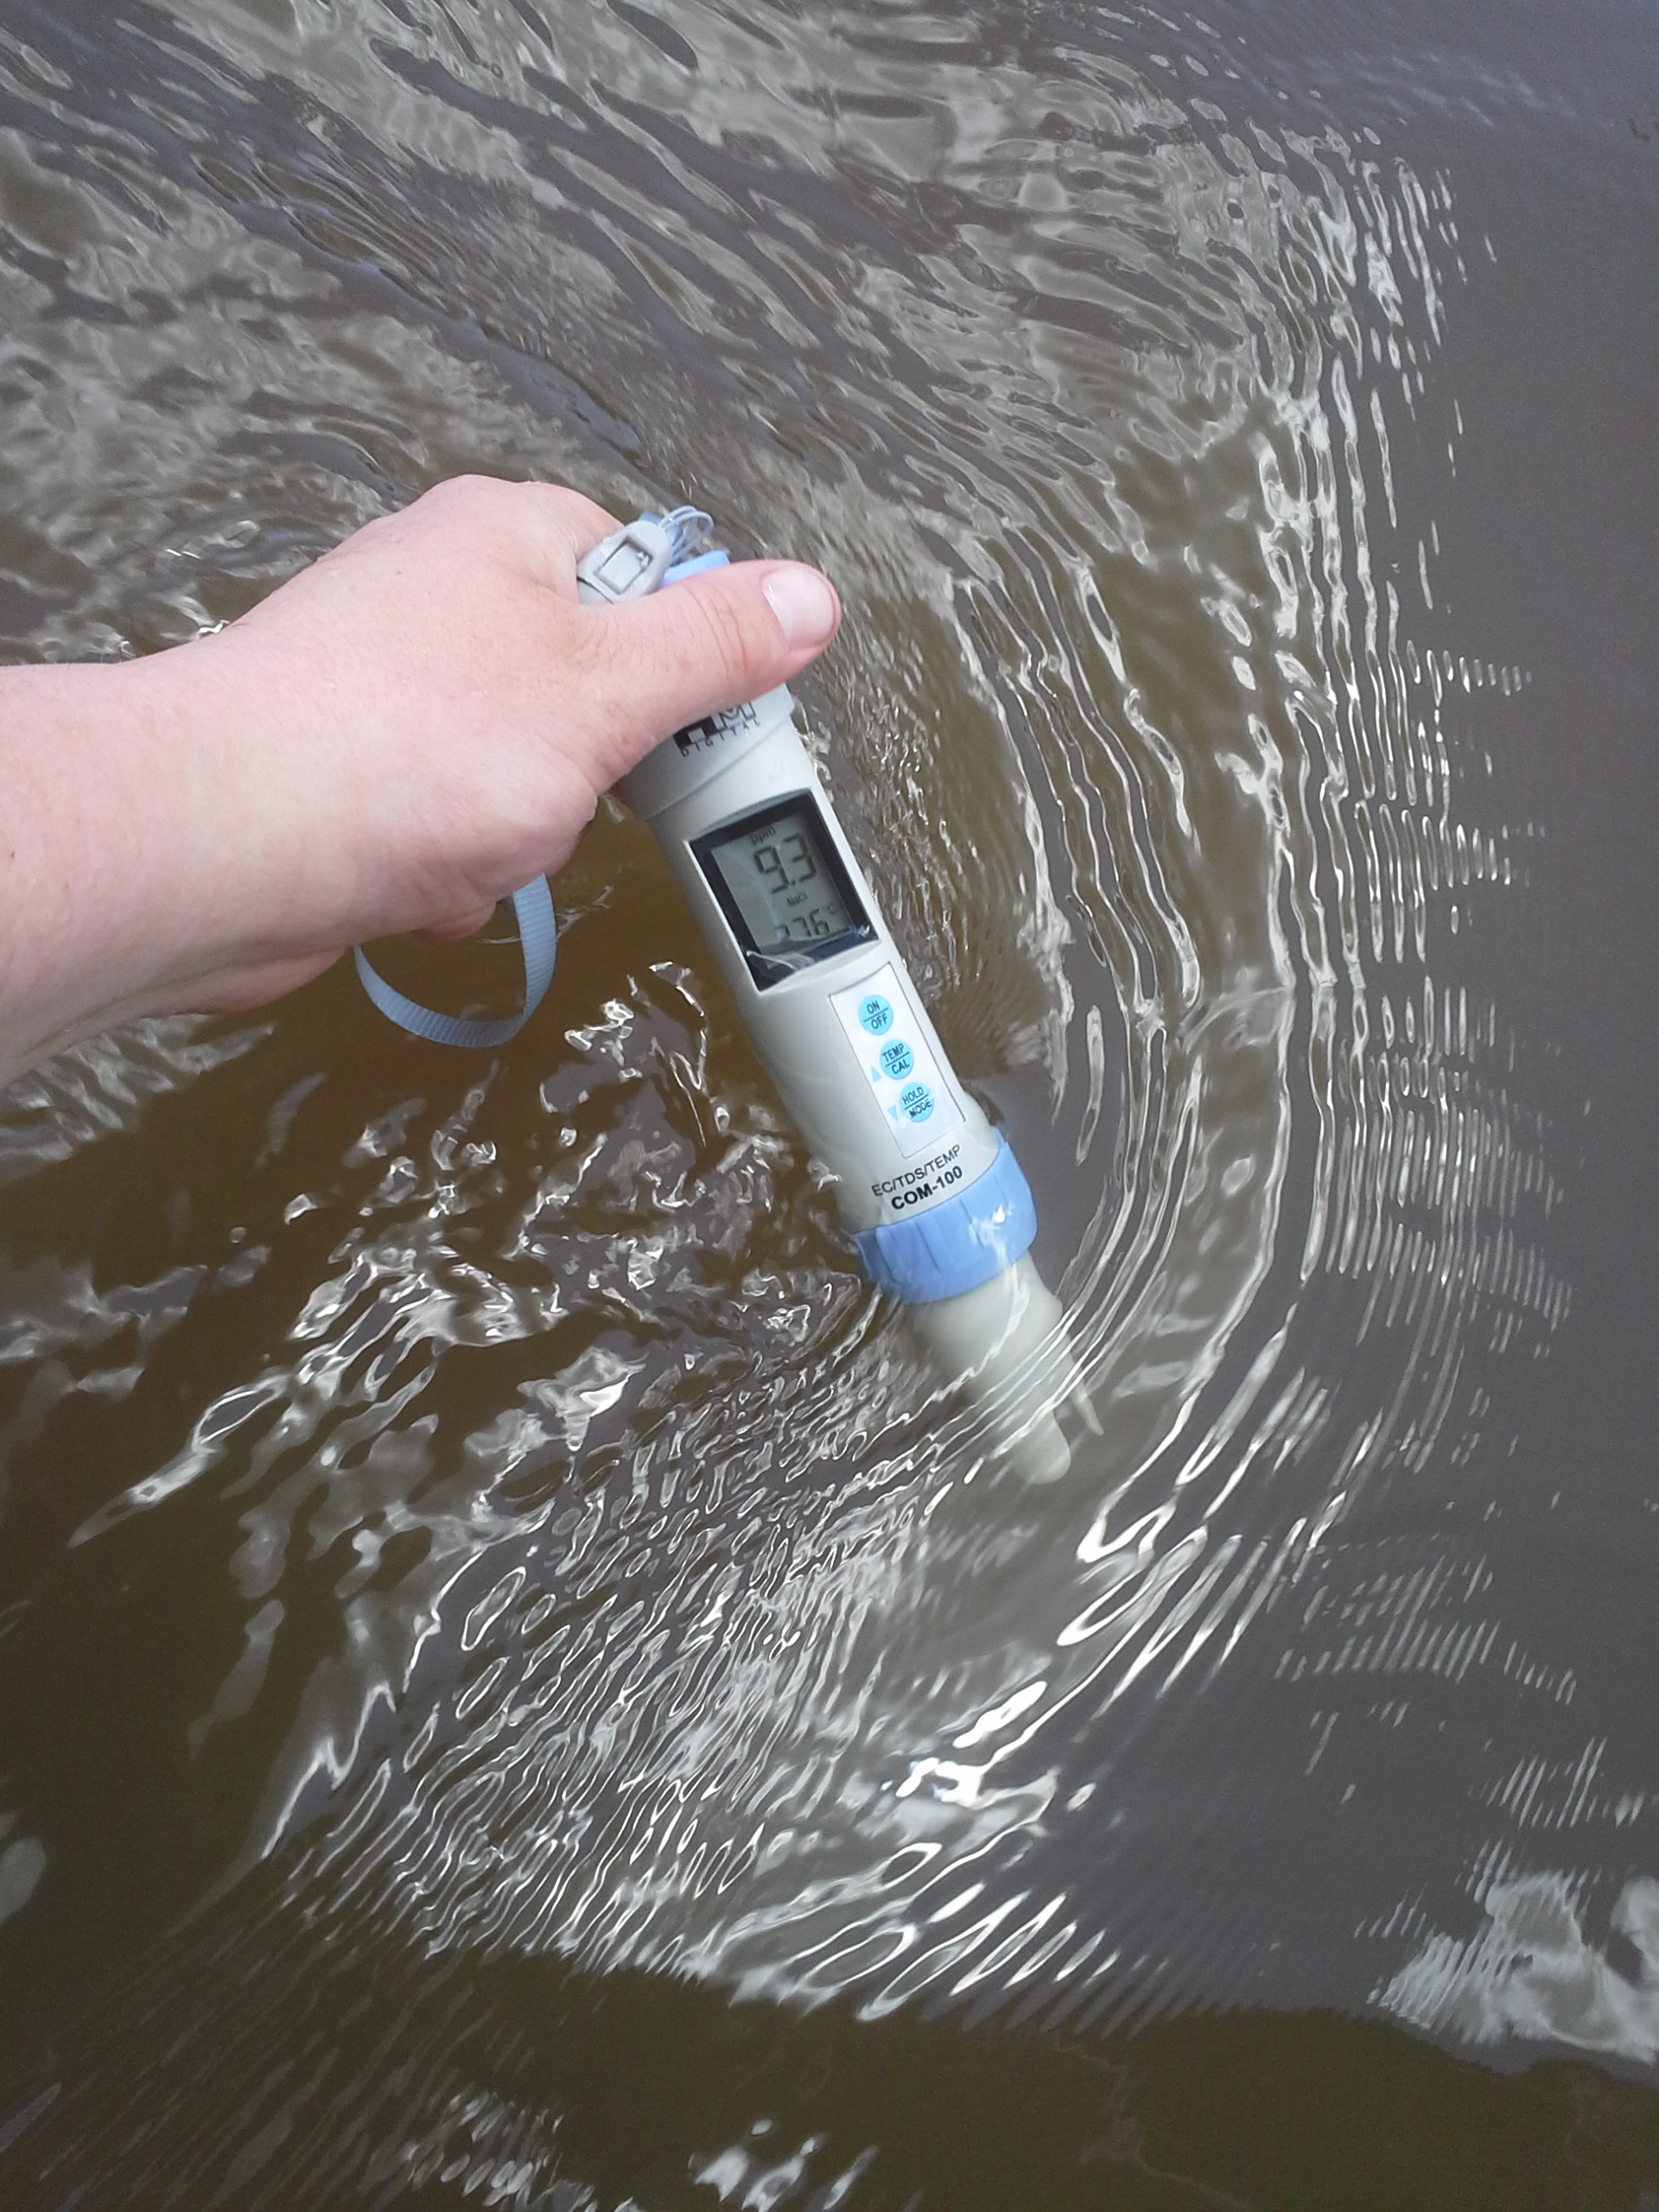
Water Quality Monitoring
Requires a suite of measurements including pH, dissolved oxygen, oxidation-reduction potential, conductivity and temperature
Manual measurement requires hours of testing, manual entrance of data into computers for data basing and further transmission

Slide 13
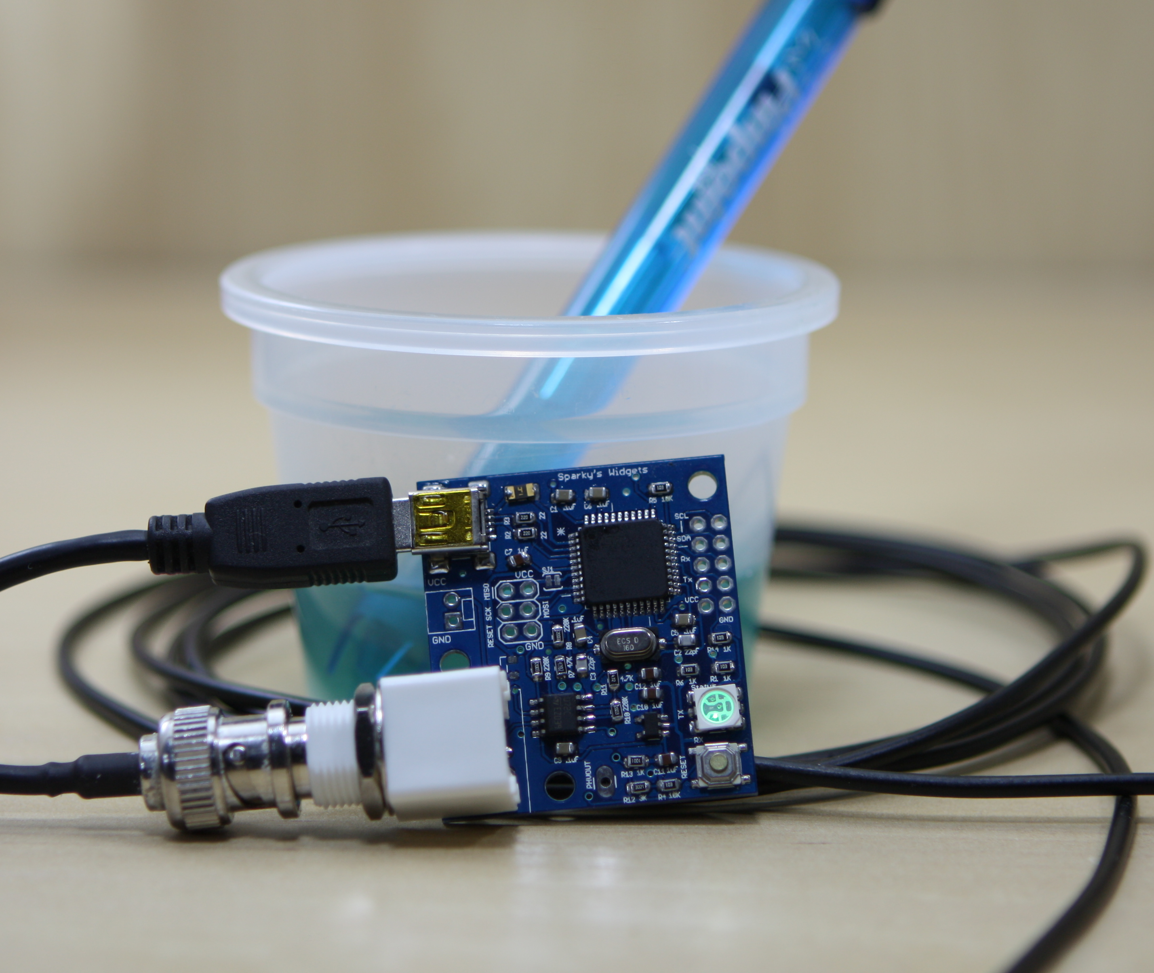
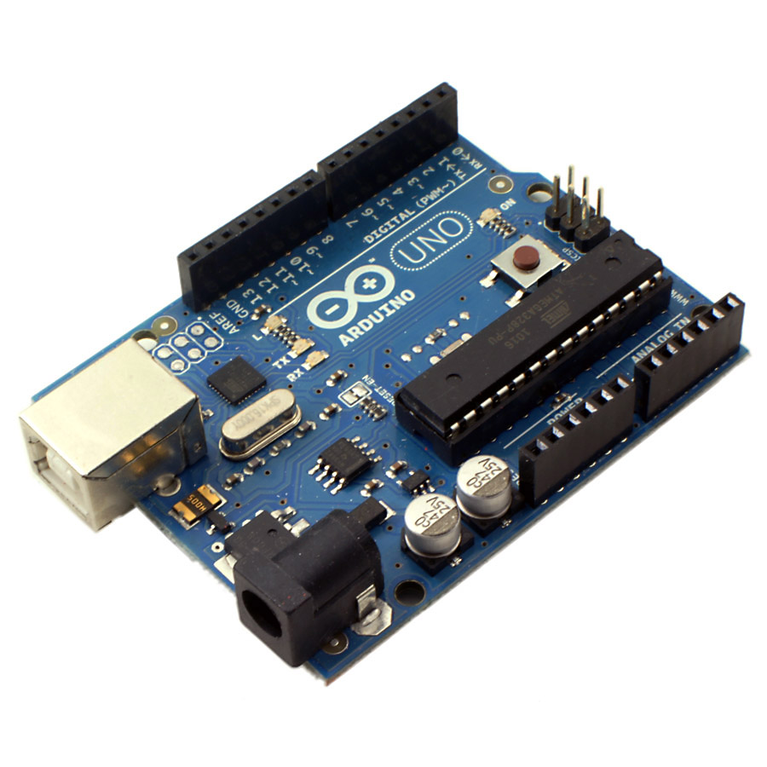
Micro-Controlled Sensors
Since the advent of the Arduino, numerous sensors have become commercial
Complete packages of the ‘5’ water quality sensors (Zennaro et al 2009) are available for <$600
Small packages with sensors, storage/read-out can be placed in treatment facilities

Slide 14
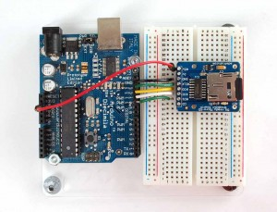
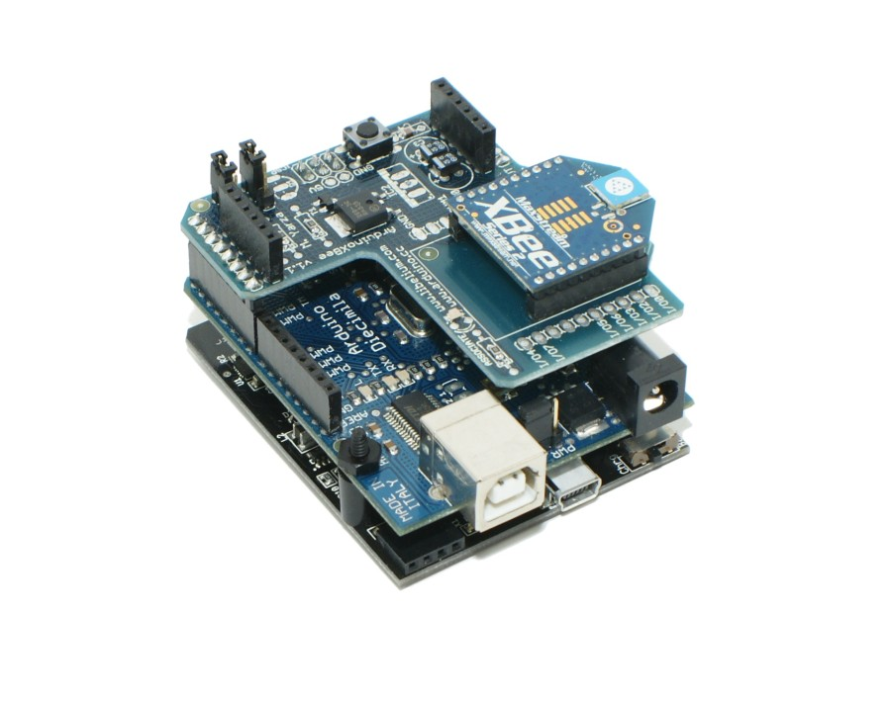
Storage and Transmission for WSN
Sensors can be attached to GByte storage through the controller that in turn connected to a wireless personal area networks (WPANs)
Storage allows for delay tolerance
Cell networks are generally nearby
Connecting networks to distant central processor through public network greatly lowers cost

Slide 15
Rude Awakening
After our original measurements, other data was made public and other measurements were made
Water quality is only problem within villages, population density is so low that the river cleans itself between villages
There may be better ways to detect catastrophic events (oil spills)
Heavy metal contamination (mining) is serious
There is no easy (non laboratory) method to measure heavy metal

Slide 16
Present Approach
State of the Art from USGS
More important than present water quality is future water quality as determined by FEW
The simplest FEW package would involve temperature, dissolved oxygen and nitrogen
Expanding to turbidity, Ph and phosporous as well would straightforward

Slide 17
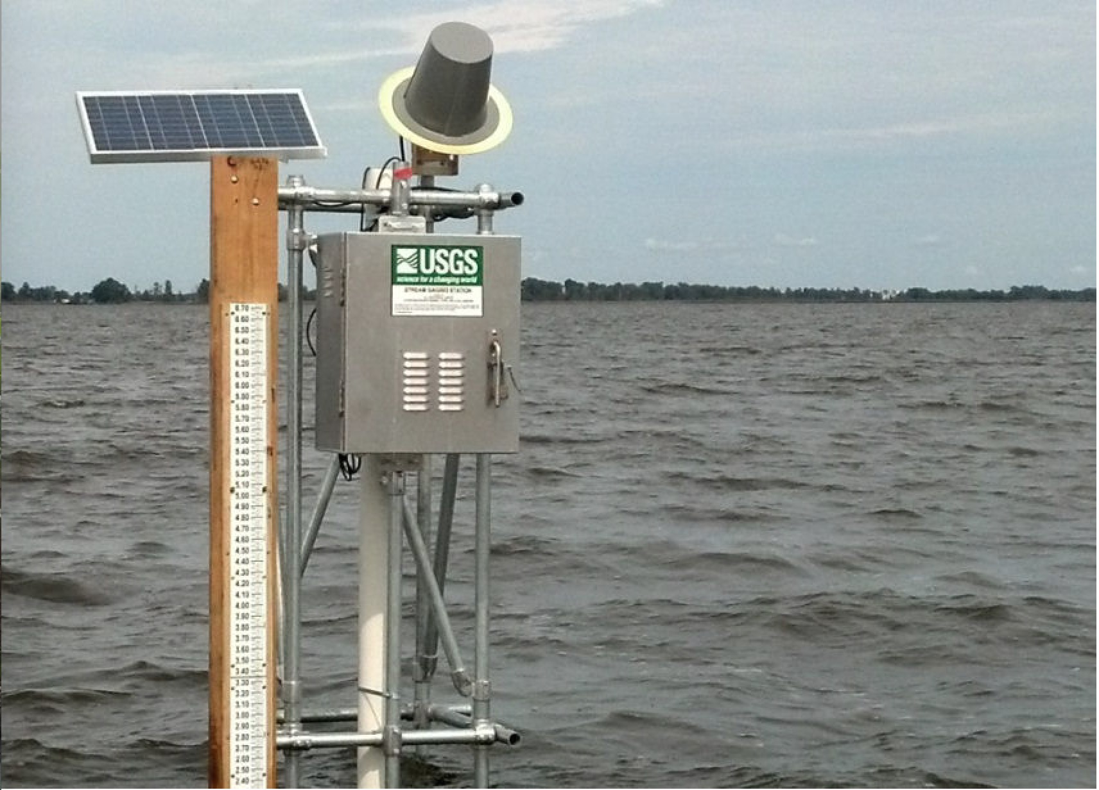
Lake Muttamuskeet NC
Almost autonomous but fixed location

Slide 18
A Sensor Pack for a FEW System
Turbidity senses the quantity of foreign substances in water
Dissolved oxygen is sensitive to algal blooms
Nitrate acts as a predictor of future water quality
Temperature is sensitive to waste heat from energy conversion

Slide 19
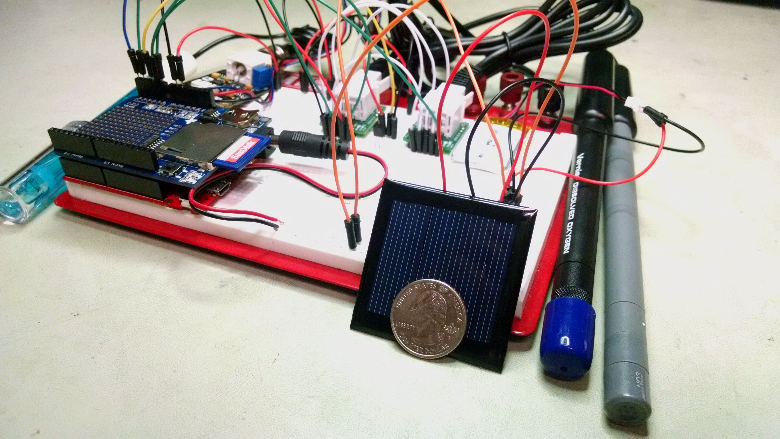
All the Components on a Board
Components are light, compact and self-contained (solar powered)

Slide 20
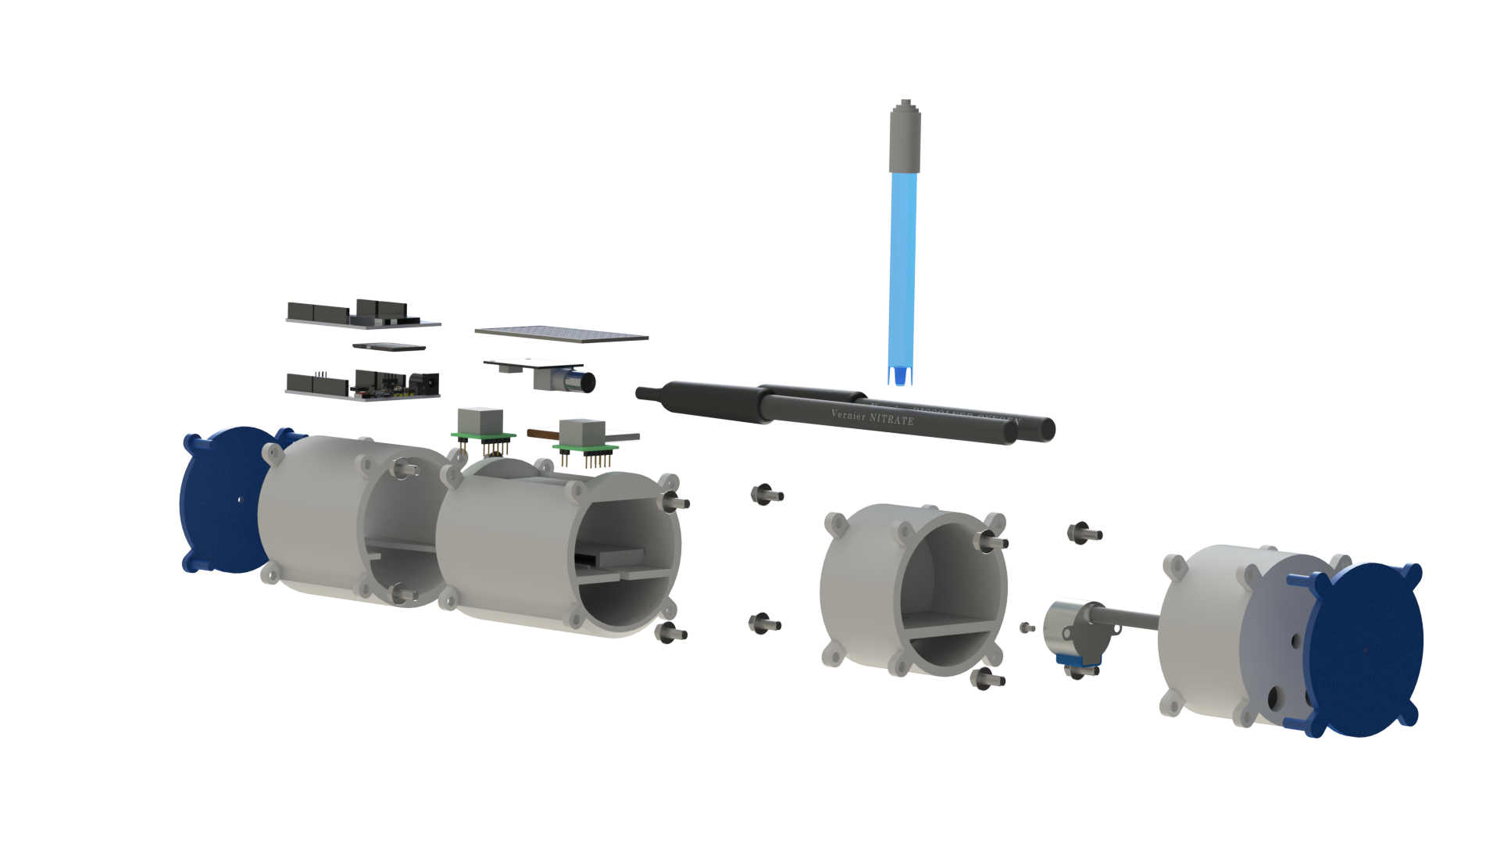
Rendering of the Package
Package will float with a loose tether
Can be read out (100 m) via bluetooth

Slide 21
Summary
Monitoring an urban water supply requires accurate spatial-temporal information
Arbitrary sensor placement will allow for optical topology of sensors
Autonomous water quality sensors can be used as elements of a water supply management system
Microprocessor based sensors can be small enough to fit in a small packet

