Slide 1
PAHs contamination in Beijing’s topsoil
A buried evidence of the megacity’s evolving environment and energy consumption
Yi Zheng
Department of Energy and Resources Engineering, College of Engineering, Peking University
October 21st, 2015

Slide 2
Presentation Outline
1. Study background
2. Data and methods
3. Results and discussion
4. Concluding remarks

Slide 3
Study background

Slide 4

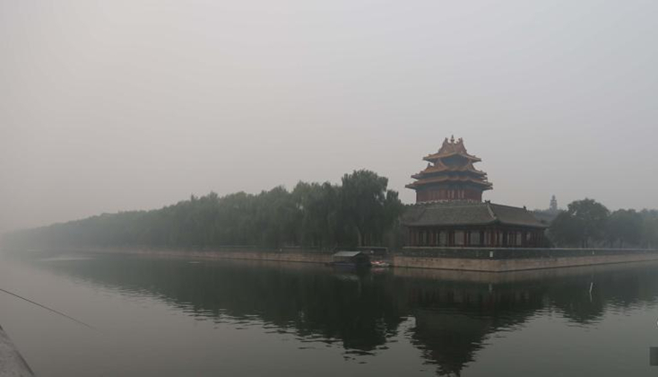
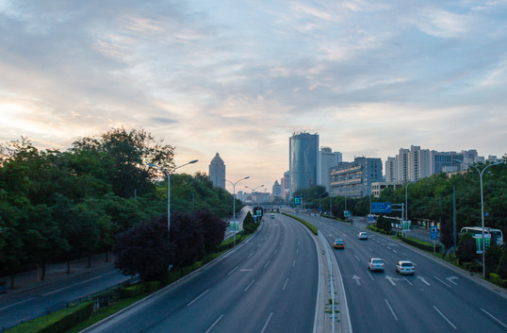
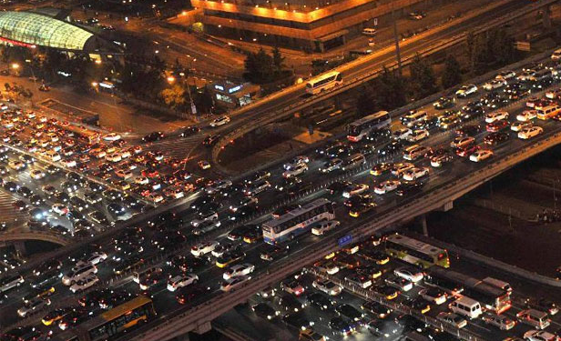

Beijing
Angel and Demon
Under the dome
An influential documentary (02/2015) about the haze problem, produced by Ms. Jing Chai, a famous journalist in China.

Slide 5
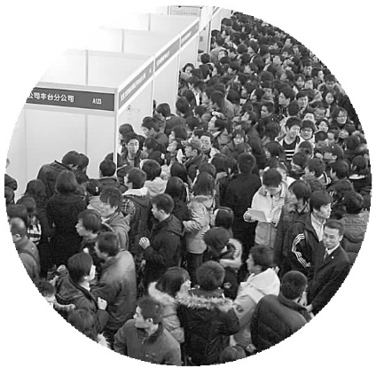
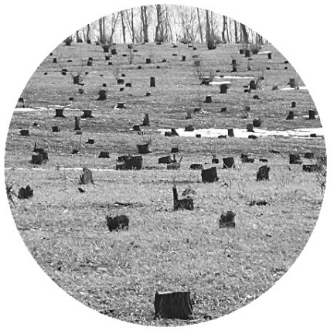
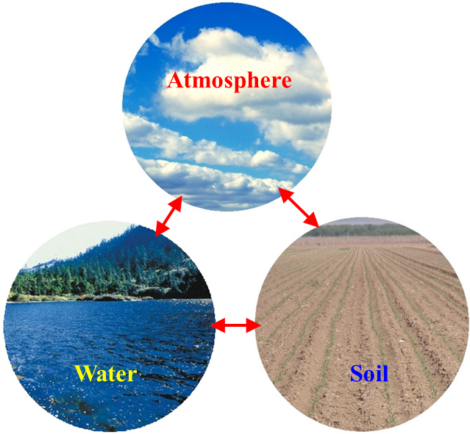

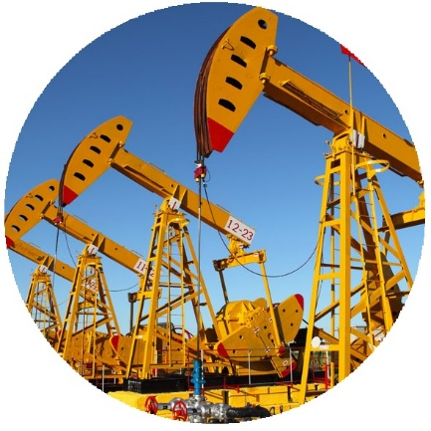
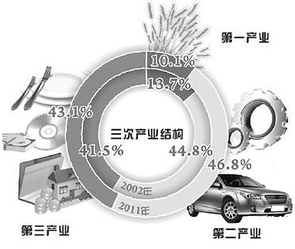

Megacity：complex human-nature nexuses！
Population
Land use
Economic development
Environmental quality
System approaches are desired to unravel and tackle megacities’ environmental problems.
Resources and energy
Economic structure
Climate change

Slide 6
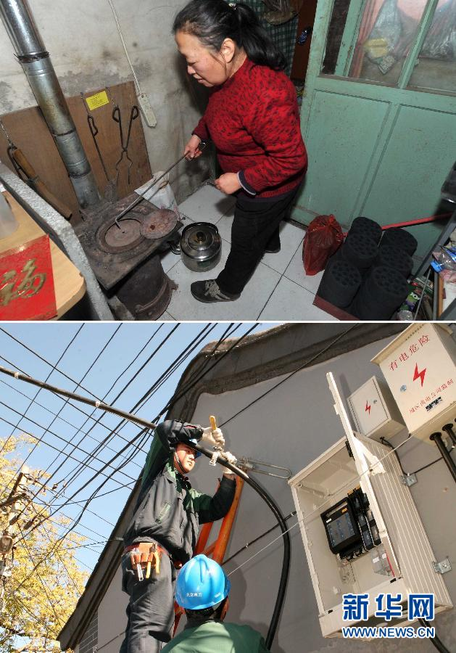
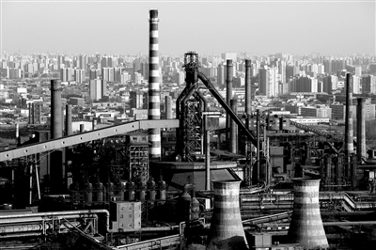
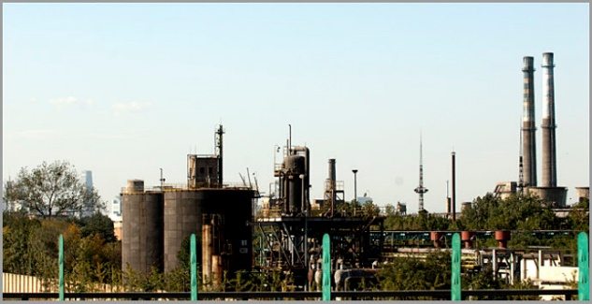
A ten-year battle against Beijing’s air pollution
Heating source conversion
The top motivation before 2008: to ensure a good air quality for the 2008 Olympic Games
Heating source conversion from coal to electricity in downtown Beijing (started from 2003).
Relocation or shutdown of major emission sources, such as the Capital Iron & Steel Company, Beijing Coking Plant, Beijing Chemical Plant (started from 2005).
The old site of Beijing Coking Plant
The old site of as the Capital Iron & Steel Company

Slide 7
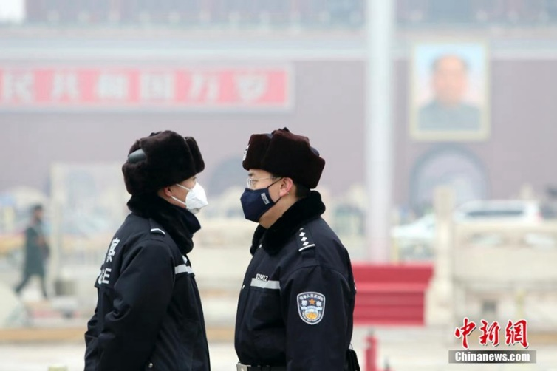
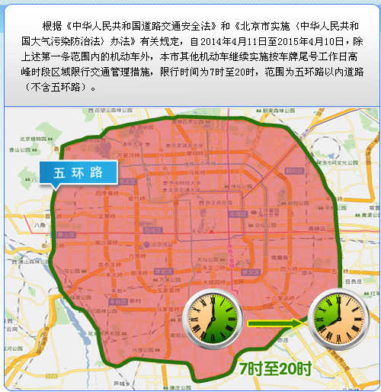
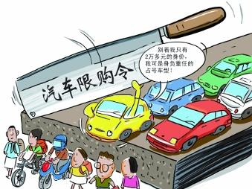
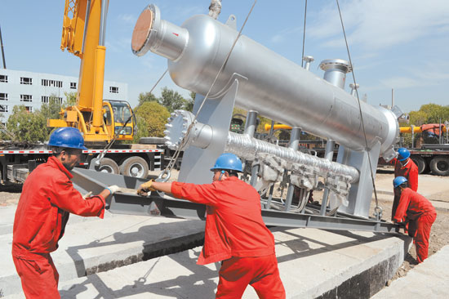
A ten-year battle against Beijing’s air pollution
After 2008, the haze problem has stimulated significant public awareness of the air pollution, which led to more policy measures
Regular traffic volume control（from 2008）
Restriction on car purchase (from 2010)
Substitution of natural gas for coal (from 2013)
Car purchase restriction
Coal to natural gas
Traffic volume control

Slide 8
Two critical questions of public concern
1. Has the environment quality in Beijing really been improved through all these years?
2. Are the existing policy measures appropriate?
It is challenging to answer these two questions.
Systematic studies are desired.
In this study, PAHs content in topsoil was considered as an indicator of the energy consumption-related pollution in megacities.

Slide 9
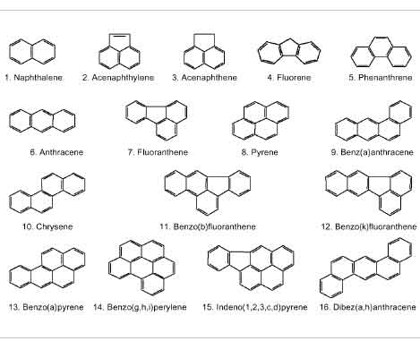
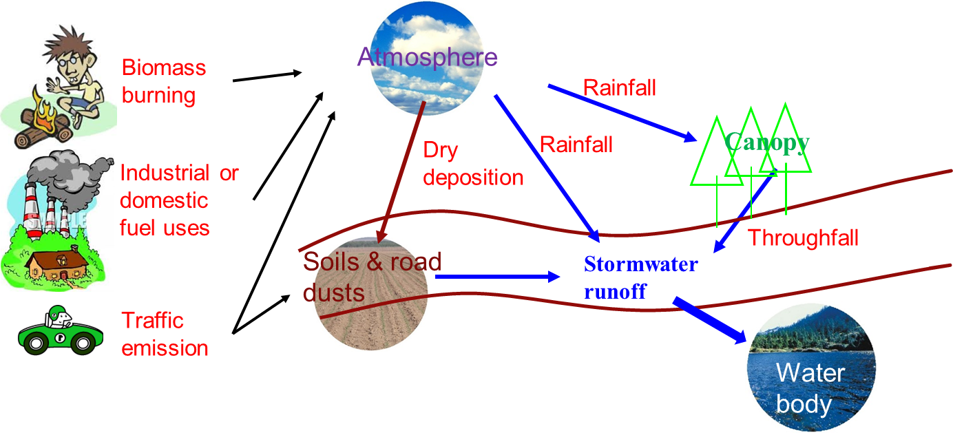
Polycyclic Aromatic Hydrocarbons (PAHs）
Persistent Organic Pollutants (POPs)
Mainly from Incomplete combustion (e.g., traffic emission, coal combustion, coking, biomass burning, etc.)
High toxicity and potential carcinogenicity
Ubiquitous in an urban environment
16 USEPA priority PAHs
BaP
Soil is a major sink of PAHs!

Slide 10
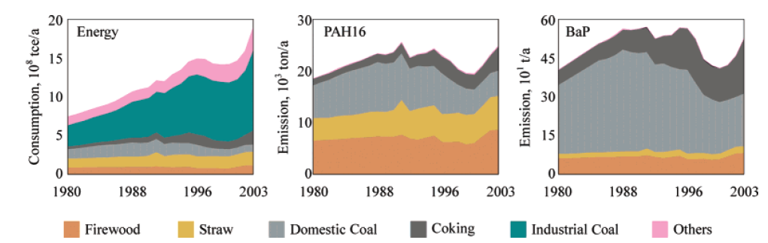
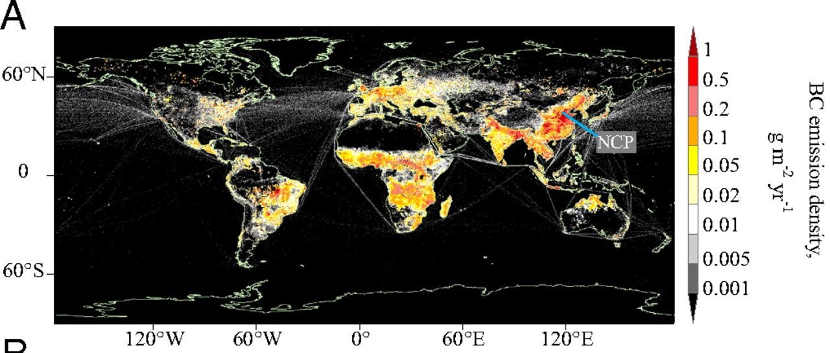
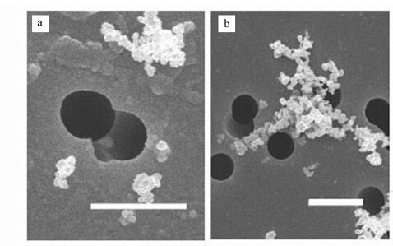
PAHs contamination in megacities
An environmental issue, as well as an energy issue!
Related with the PM2.5 issue
Energy consumption and PAHs emission in China (Xu et al., Environ. Sci. Tech., 2006)
e.g. soot particles
Global distribution of black carbon (BC) emissions (Wang et al., PNAS, 2014)
（杜德艳等，环境科学学报，2015）

Slide 11
Data and methods

Slide 12
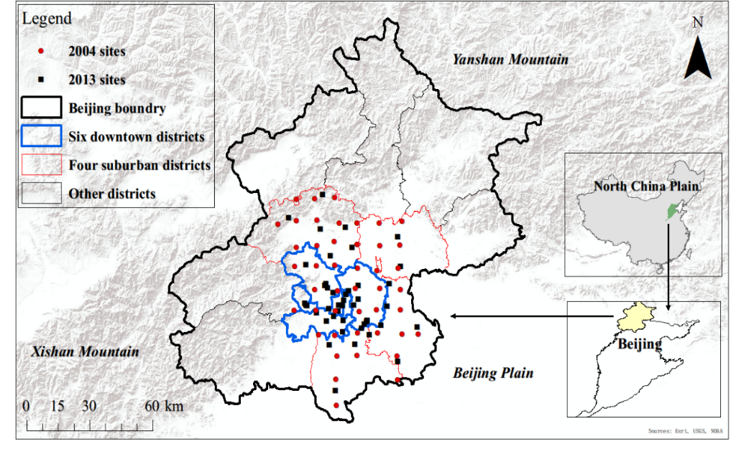
Soil samples
  Two large field campaigns to collect soil samples:
  1) A historical campaign in 2004 (data provided by Dr. Xuejun Wang’s group in the College of Urban and Environmental Sciences)
  2) A new campaign in 2013 organized by ourselves.
Number of soil samples
 | 2004 | 2013
6 Downtown districts | 20 | 28
4 Suburban districts | 25 | 17
Contents of 16 priority PAHs were measured

Slide 13
Positive Matrix Factorization （PMF）
  PMF is a Principal Component Analysis (PCA)-based receptor model to perform source apportionment analyses
PMF minimizes the objective function Q

Slide 14
Risk evaluation
  Carcinogenic equivalent concentration of BaP (denoted as BaP_{eq}) as a risk indicator
Five levels of risk:
BaP_{eq} ≤10 ng/g (no risk)
10 ng/g < BaP_{eq} ≤100 ng/g (low risk)
100 ng/g < BaP_{eq} ≤500 ng/g (medium risk)
500 ng/g < BaP_{eq} ≤1000 ng/g (high risk)
BaP_{eq} >1000 ng/g (extremely high risk)
¹ The limits are based on a new version of China’s Environmental Quality Standards for Soils (GB15618-2008) which is still under discussion and has not been officially released yet.

Slide 15
Results and discussion

Slide 16
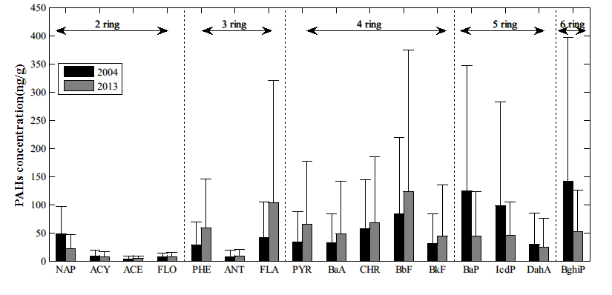
PAHs content and profile
  The overall content hasn’t significantly changed, but the profile has!
Year | Sample set | 2 to 4-ring PAHs | 5 to 6-ring PAHs | ∑16PAHs
 | All | 383.63 | 394.05 | 777.69
2004 | Downtown | 625.43 | 657.30 | 1282.73
 | Suburban | 190.19 | 183.45 | 373.65
 | All | 559.03 | 165.39 | 724.42
2013 | Downtown | 793.52 | 237.84 | 1031.36
 | Suburban | 172.81 | 46.06 | 218.87

Slide 17
Source appointment results
(preliminary results to be further refined)
not successfully separated
In Beijing, while the coal consumption was relatively stable or even slightly decreasing from 2003 (22.7 million tons) to 2012 (21.5 million tons), the number of motor vehicles in 2012 (5.2 million) was almost triple of that in 2003 (1.9 million)
  At present, vehicle emission > coal combustion, with regard to the soil PAHs contamination.
  The contribution of coal and coking sources decreased, while the contribution of vehicle sources increased.

Slide 18
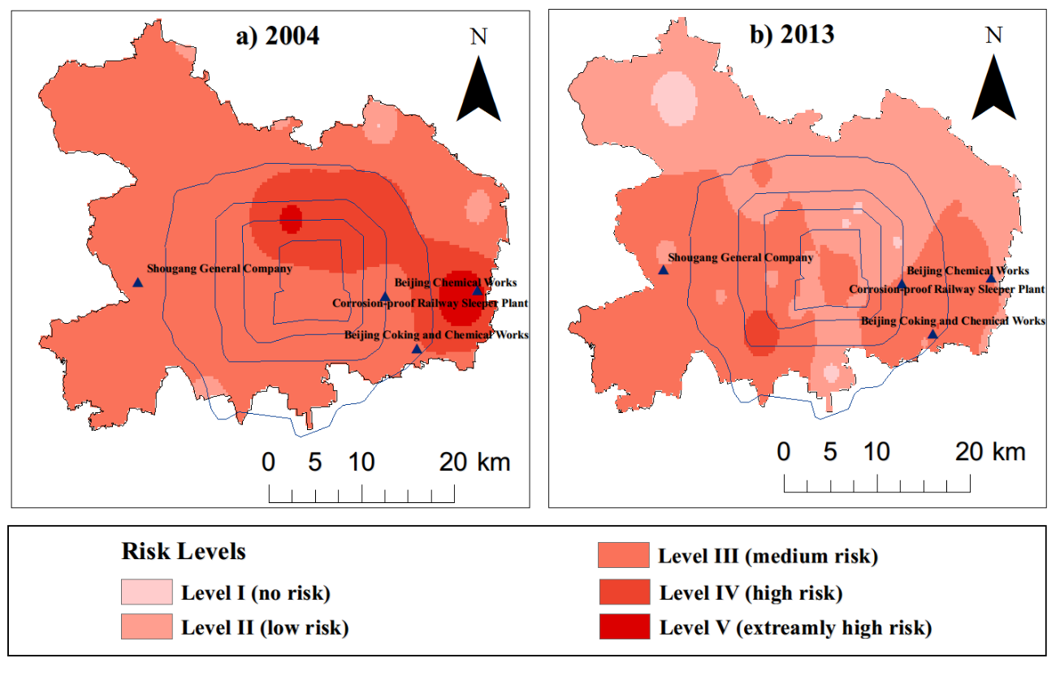
Change of the risk
  The average BaP_{eq} values of all samples are 139.48 ng/g and 310.42 ng/g for 2013 and 2004, respectively, indicating a significant reduction of the risk associated with the soil contamination by PAHs.
  A significant improvement of the soil environment quality, reflecting the impact of the policy measures.

Slide 19
Concluding remarks

Slide 20
The PAHs content and its associated environmental risk have been significantly reduced from 2004 to 2013, which reflects Beijing’s tremendous efforts of pollution prevention in the past decade.
The composition of soil PAHs had changed over time as well, which implies a notable increase of the contribution of vehicle emission. At present, vehicle emission appears to be a more important combustion source than coal burning.
PAHs contamination in topsoil is a good indicator of a megacity’s environmental quality and energy consumption status, and deserves continuous investigation.

Slide 21

Acknowledgments
Thank you!
Questions or comments?
Funding sources: National Natural Science Foundation of China (grant no. 41371473)
The 2004 dataset: Dr Xuejun Wang at the College of Urban and Environmental Sciences, Peking University

