Slide 1
PHL-TEDA EcoPartnership on Urban Clean Energy Infrastructure 中国天津-美国费城清洁技术转移合作平台及领军示范项目
Low-Carbon Buildings 低碳建筑
Clean Water 清洁的水
Smart Electricity 智能供电

Slide 2
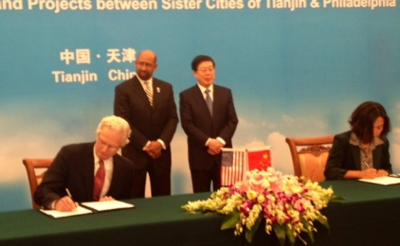
What PHL & TEDA Offer 费城-天津合作平台的价值
35 Year Old Sister City Relationship
基于35年之久“姐妹城市”关系
Designations from respective national governments as clean energy exemplars
双方分别被指定为国家级清洁能源领军示范样本
PHL as national EEB leader
费城作为国家级“超低能耗建筑”领军者
TEDA/Tianjin as clean energy testbed under current FYP
中国天津-美国费城平台作为中国第十二个五年计划下的清洁能源试点平台
3 Year PHL-TEDA EcoPartnership on Clean Energy Urban Infrastructure (2014-2017)
3年期 (2014-17) 的中国天津-美国费城清洁技术转移合作平台及领军示范项目
Focus on Commercial-scale Implementation tied to Entrepreneurial Innovation
重点在商业领域应用实施及开拓性创新

Slide 3
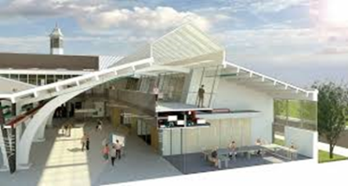
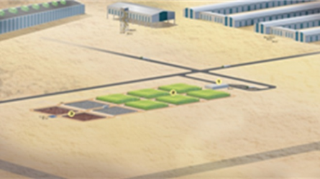
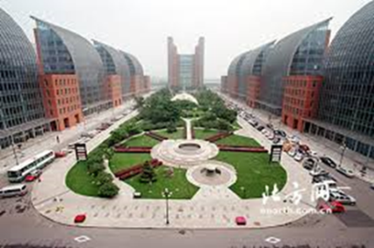
PHL-TEDA Pilot Projects 费城-天津试点工程项目
Low-Carbon Built Environment (LCBE)
绿色楼宇运行效率（建筑节能）
An EEB Lab partnership initiative with the World Business Council for Sustainable Development (WBSCD) to develop LCBE technology tools and collaborative models
一个与世界企业可持续发展委员会共同合作的、致力于开发建筑节能科技工具与合作模式的超 低能耗建筑实验室合作项目
Wetlands Urban Water Management (WUWM)
南港人工湿地减排项目（清洁水）
A pilot project to demonstrate commercially-viable, hybrid-wetland alternatives to traditional industrial waste-water treatment processes.
一项用于展示可代替传统工业废水处理流程的、具有广泛商业价值的多项组合人工湿地方法的 试点工程
Online Monitoring Systems (OMS)
楼宇在线能源监测（高效电力）
A pilot project involving 79 sensor-networked sites to demonstrate solutions for reducing peak electricity load and to reduce overall energy consumption
一项覆盖了79个传感器网络连接点、用于展示降低高峰期电量并减少总能源消耗的解决方案的 试点工程

Slide 4
Urban Clean Energy Infrastructure Cooperation & Transfer Center 中美清洁技术交流与转移中心
A permanent platform for leveraging pilot project experience and showcasing clean energy technology solutions for urban infrastructure in areas of low-carbon buildings, clean water and smart electricity
针对建筑能效、清洁的水和智能供电等主要领域，用于嫁接试点工
程经验、展示清洁能源科技方案的永久性平台
A program to amplify collaboration on urban clean energy infrastructure projects among stakeholder vendors and clients via trade missions, direct facilitation services and online services including virtual exhibitions
通过贸易代表团、直接合作促进、网上虚拟展示服务等，扩大主要供
应商和客户在城市清洁能源基础建设工程领域合作的项目

