Slide 1
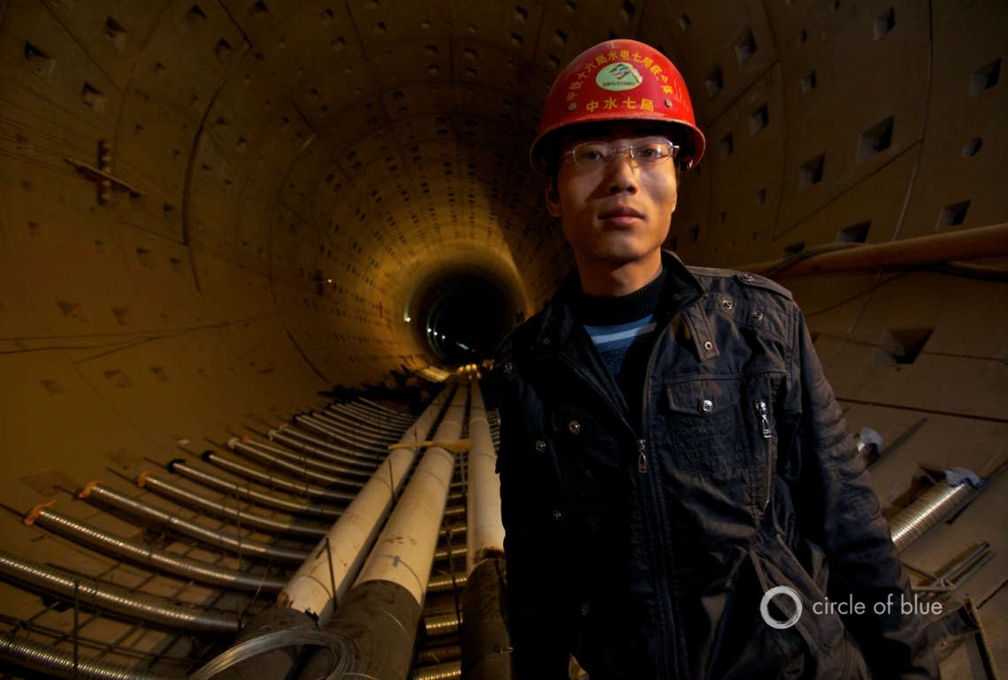
Water-Energy-Food Confrontations
in the World’s Fastest
Urbanizing Country
China
Notes:
5 years ago Circle of Blue & I started investigating how energy development was impacting water in China. It was a question that few were asking back in 2010 and we worked in raising its prominence in producing mulitmedia reports and creating dialogues and exchanges here in China. countless convenings in China and the US. Being at the conference today it is exciting to see it is now a recognized challenge.

Slide 2
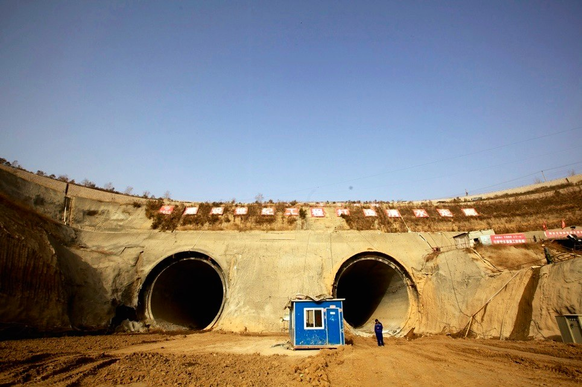
Water on the Move

Slide 3
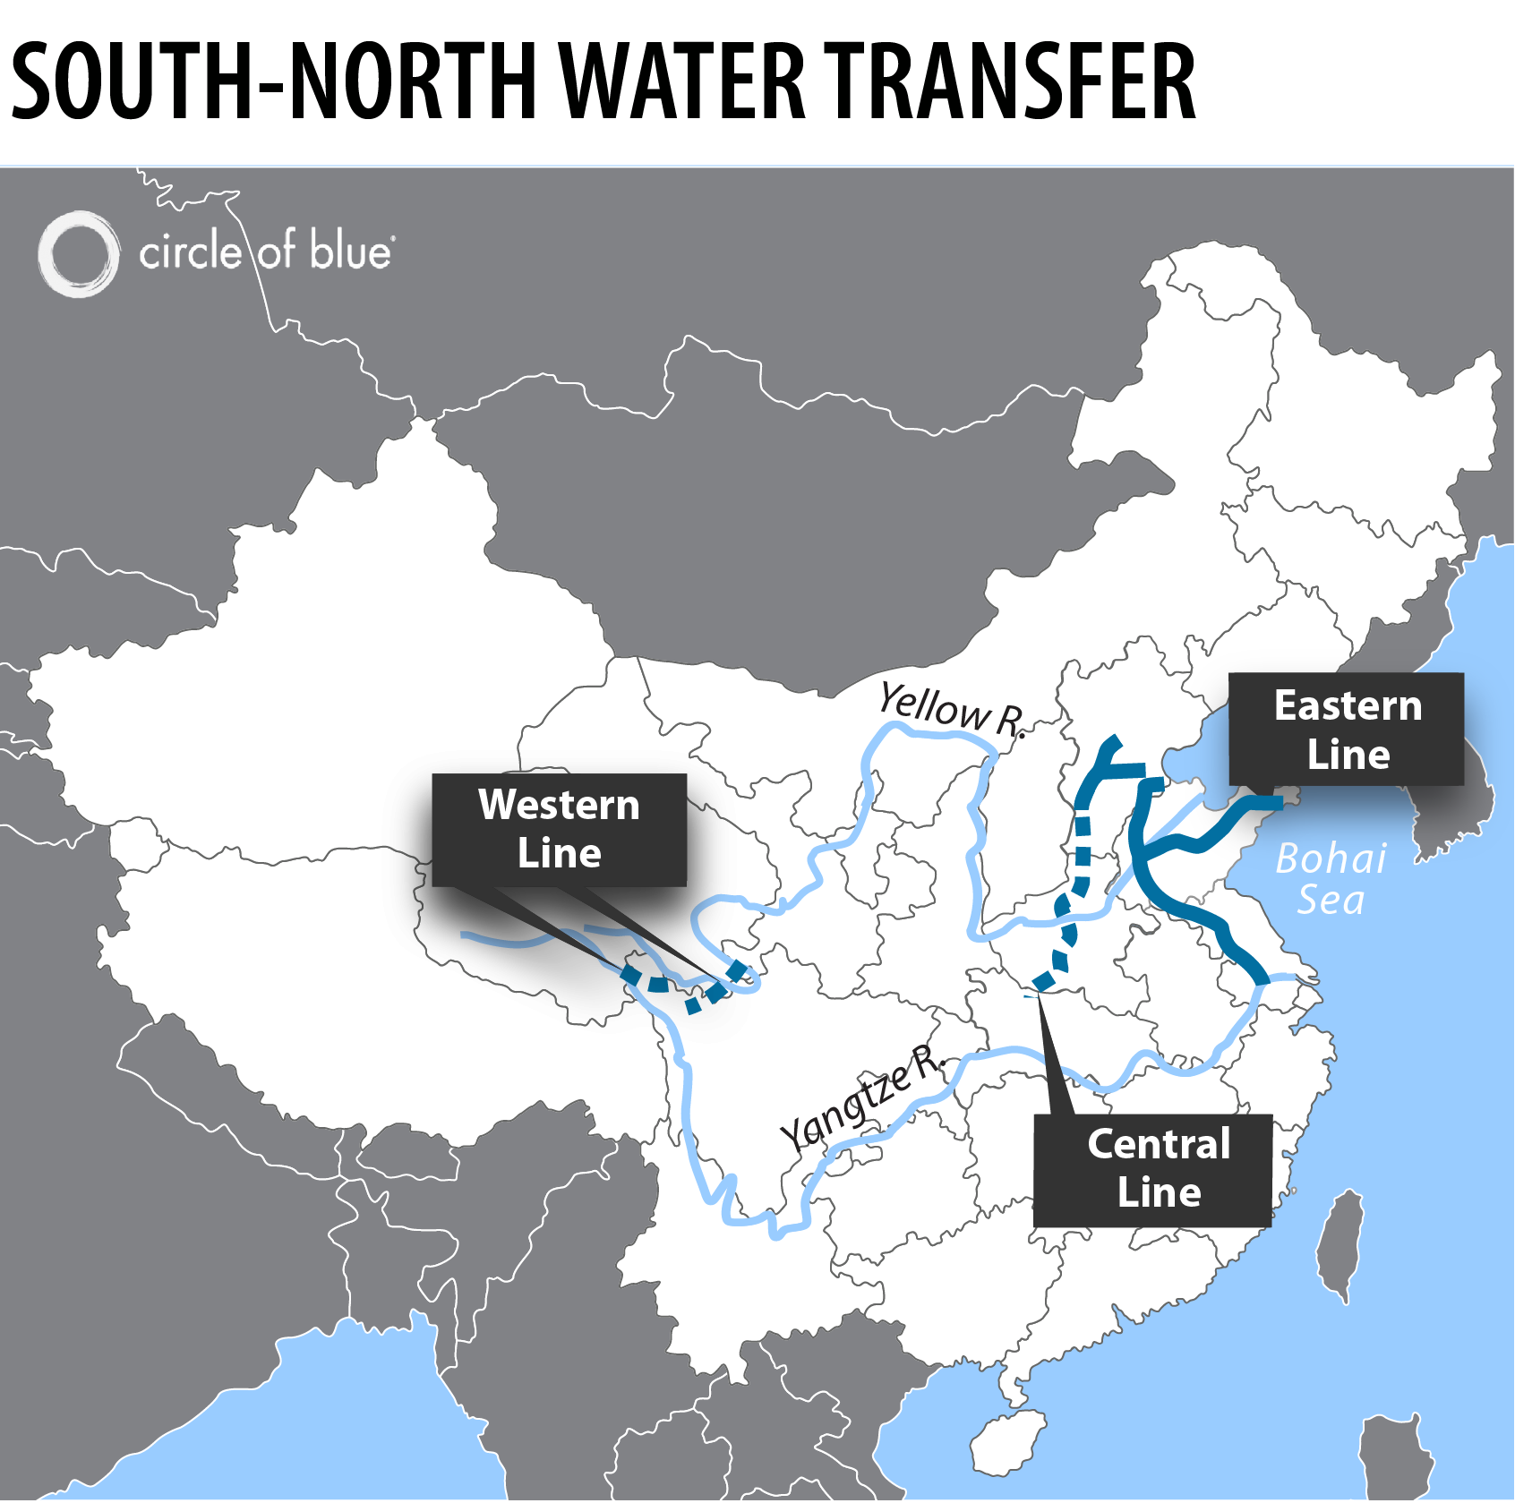

Slide 4
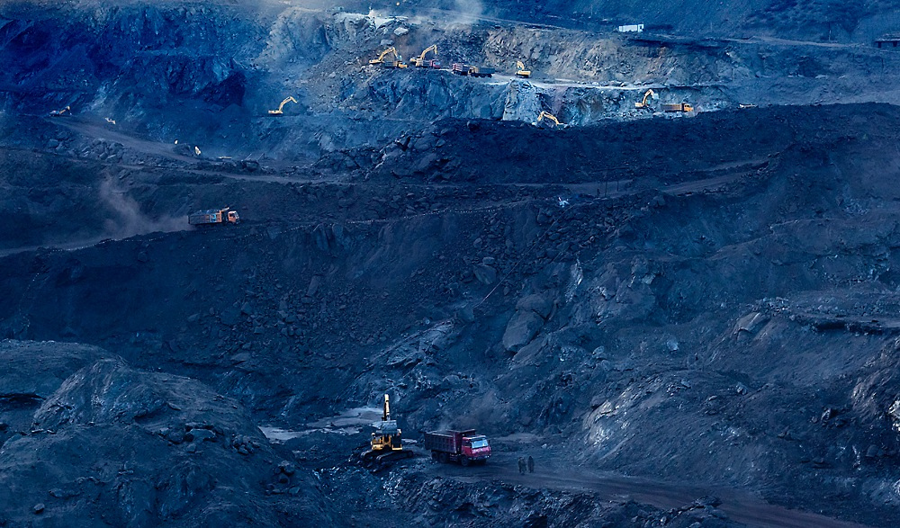
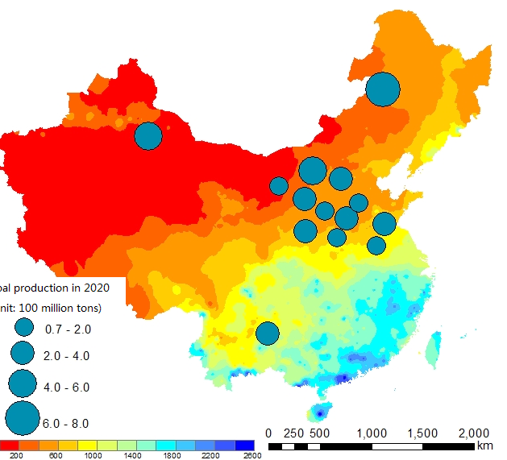
Notes:
Primary source of energy in China is coal….these dots show you some of the big coal bases that until recently were being expanded….coal mines, CFPP, CTL CTG, CTC and notice how this map shows you the rainfall amounts—red means very little. N china where most of the coal is receives 20% rain but that hasn’t stopped the development

Slide 5
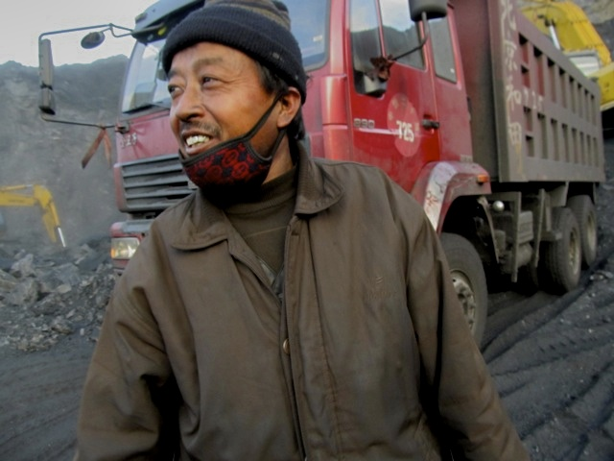
26%
~2%
Notes:
26% of all of China’s coal production but only about 2% of the country’s water supply

Slide 6
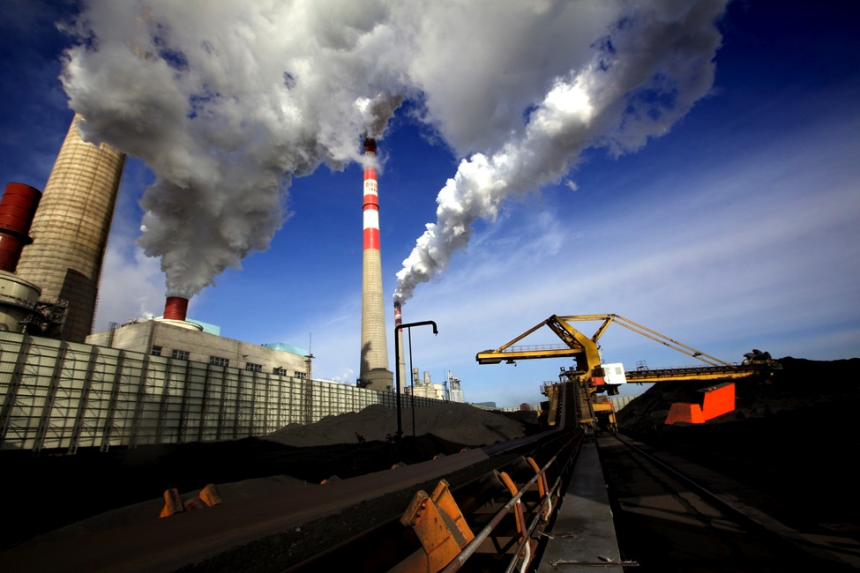
20% of Water Used in China Goes to Coal
Notes:
Big statistic that we uncovered in our Choke Point: China interviews with Ministry of Water Resources and Chinese energy researchers was that 20% China’s water is for coal production and consumption. 2020 possibly will rise to 28%.
Every step from coal extraction to use has a significant water footprint: mining, washing, ash pile control, air pollution control, cooling. 12th FYP regulating NOx will need water to run the equipment.
Surprisingly, no one had put these numbers together before.

Slide 7
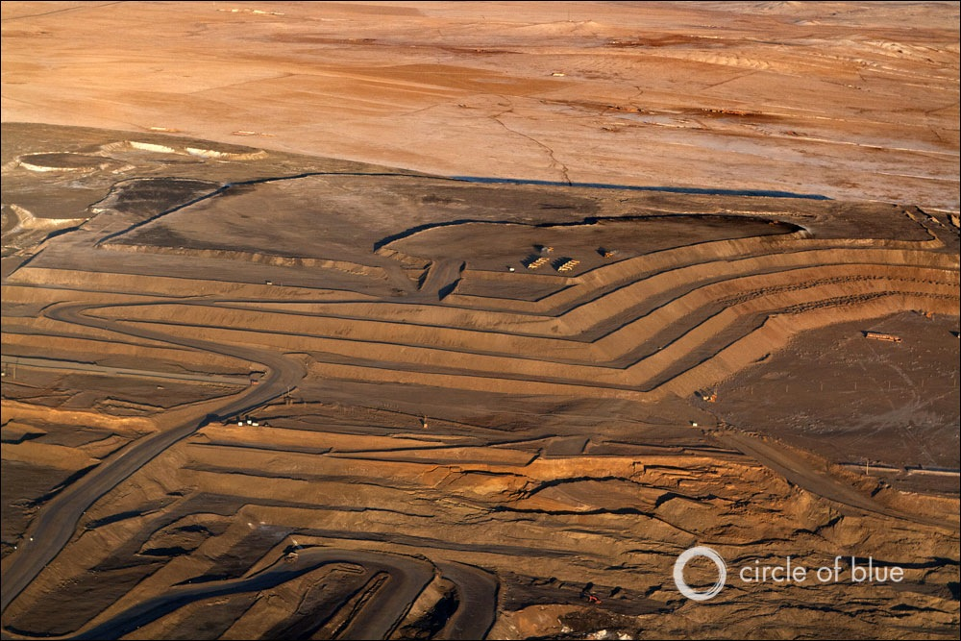
The King is Thirsty
China’s Demand for Energy is Outpacing its Freshwater Supply

Slide 8
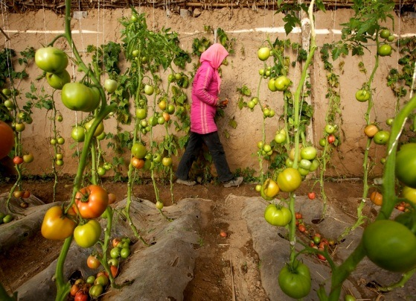
Agriculture on the Move
Notes:
Water to coal displaces agriculture

Slide 9
Agriculture on the Move
Notes:
Water to coal displaces agriculture

Slide 10
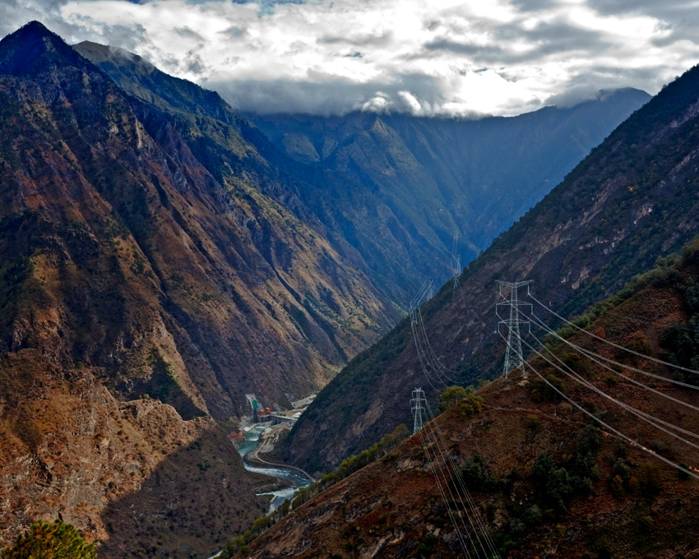
The Queen
400 GW by 2020
Notes:
China’s dam building goals face challenges due to increasing droughts in the south. Goal to increase hydro from 150GW today to 400 GW in 2020.
Southern China is facing a new round of power shortages due in part to insufficient water volumes at the largest hydropower station in Guizhou, the Goupitan Hydropower Station has dropped to ONE TENTH of its normal daily capacity b/c of the early droughts. Guizhou is the “leading province” in the “West to East Electricity Transmission Project” down south, so low water in Guizhou means less energy in Guangzhou.
Coal transport bottlenecks moving more coal to the south at times.
China’s 12th FYP for Reneweables includes target to add 60 more dams.

Slide 11
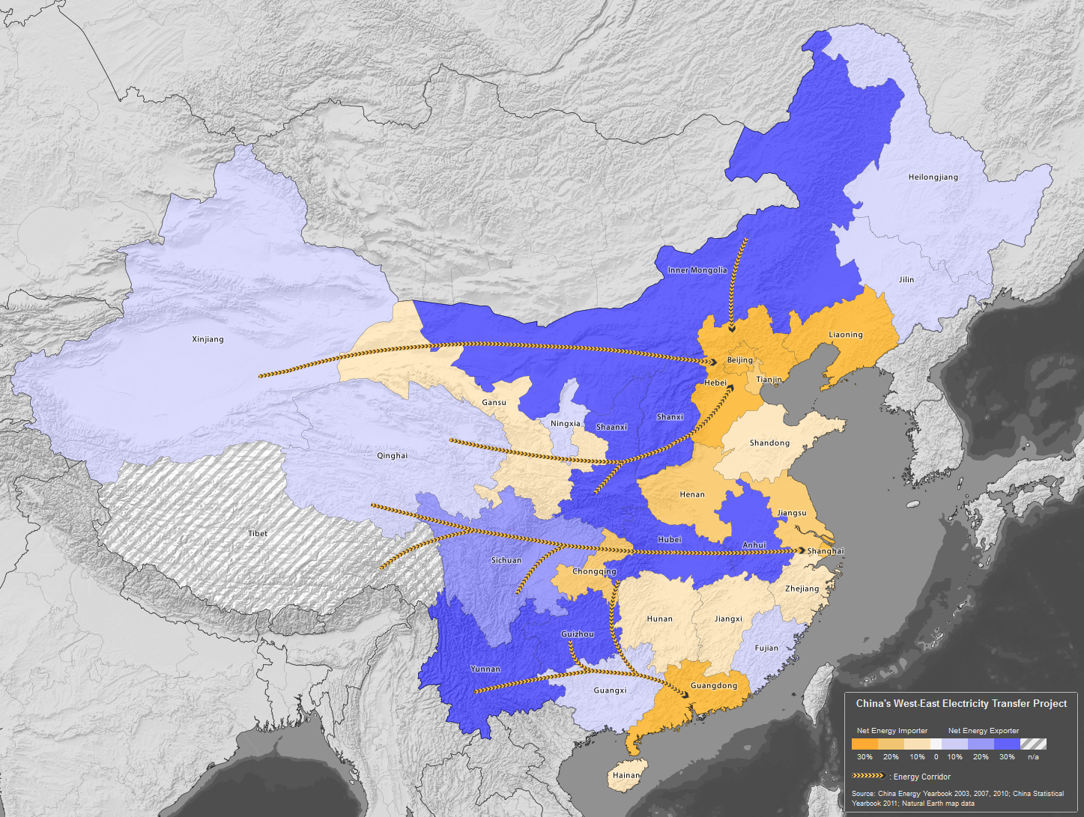
Electricity On the Move
Notes:
Mammoth infrastructure development is keeping China’s economic engine running at a fast clip. Nevertheless, China’s urban and industrial centers on the east coast still face energy shortages, in large part because most wind, coal, and hydro power plants are concentrated in the country’s inland provinces. China’s northern grain belt also faces water shortages as increasing coal production uses more and more water.
Construction started 2000
Each of the corridors is expected to exceed 40 gigawatts in capacity by 2020 – a combined capacity equivalent to 60 Hoover Dams. The seven recipient provinces – Beijing, Tianjin, Hebei, Shanghai, Zhejiang, Jiangsu, and Guangdong – together consume nearly 40 percent of China’s total electricity.

Slide 12
Illustration by Mikel Jaso http://www.bloomberg.com/news/2011-07-06/why-we-care-about-the-price-of-water-in-china-peter-orszag.html
Notes:
North China’s airpocolypse snatches headlines, but water pollution and shortages represent China’s biggest environmental burden threatening the country’s economic growth, agricultural production and human health

Slide 13
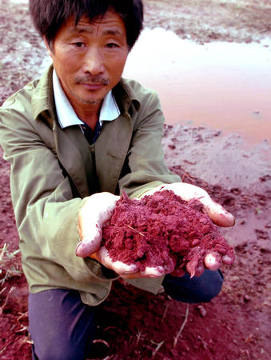
Rivers Run Red, Green, Denim Blue...
Reuters/China Daiily.. (March 31, 2013) : If you Think China’s Air is Bad you Should see the Water, Business Insider. http://www.businessinsider.com/china-water-pollution-2013-3?op=1

Slide 14
Solutions
Low-Energy Water
Wastewater to Energy
Renewable-Powered Treatment Enforcement of Water Pollution Prevention Laws
Water-Efficient Energy
Off-Grid Renewables
Energy Efficiency
Notes:
Bilateral water-energy program starting up and more US orgs working in China on this topic level playing field

Slide 15
Solutions
Baseline Data & Mapping
Water-Energy
Policies & Planning
Technologies
Subnational partnerships
Notes:
Bilateral water-energy program starting up and more US orgs working in China on this topic level playing field

Slide 16
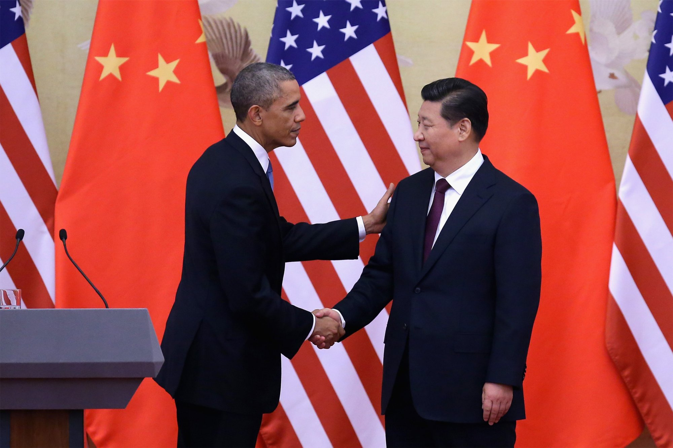
New U.S.-China Water-Energy Program
Photo Credit Daily BeastL:
http://cdn.thedailybeast.com/content/dailybeast/articles/2014/11/12/obama-and-xi-jinping-say-they-ll-work-together-to-save-environment/jcr:content/image.img.2000.jpg/1415810684415.cached.jpg
Notes:
Under the November 2014 US-China Clean energy and climate agreement the two countries agreed to create a new water-energy research program

Slide 17
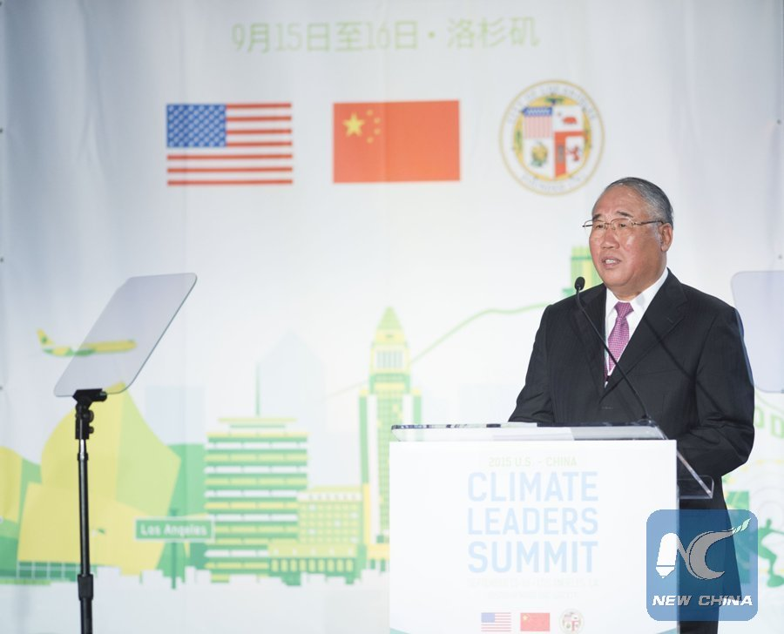
New Subnational Low-Carbon Cooperation
Photo Credit Xinhua: ttp://news.xinhuanet.com/english/2015-09/16/CnybnyE005043_20150915_NYMFN0A002_11n.jpg

