Slide 1
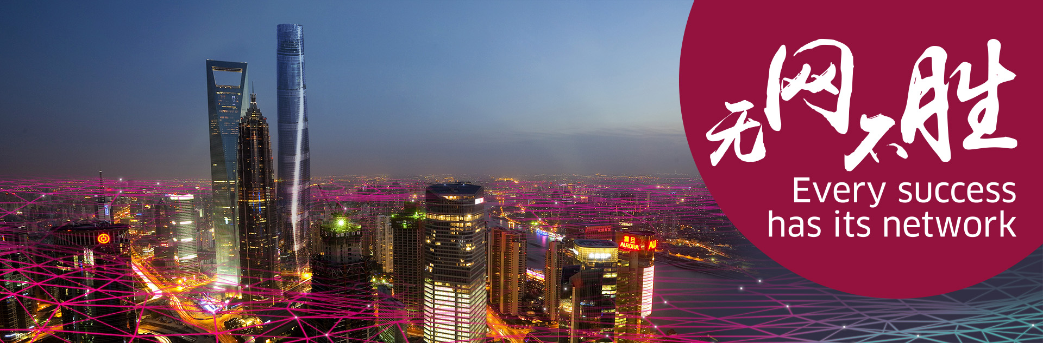
贝尔实验室及其未来数字通信研究
Bell Labs & Its Initiatives in Digital Communications
殷月明 Emile Yin
2015年10月20日，北京 Oct. 20, 2015, Beijing

Slide 2
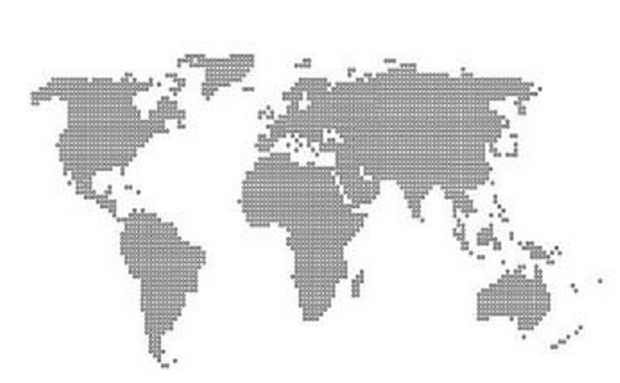
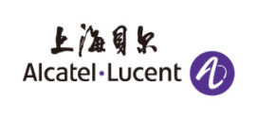

贝尔实验室与上海贝尔股份有限公司
Bell Labs and Alcatel-Lucent Shanghai Bell
俄罗斯Russia
加拿大Canada
爱尔兰Ireland
法国France
德国Germany
比利时Belgium
意大利Italy
西班牙Spain
美国USA
中国China
以色列Israel
创建于1925年
Founded in 1925
8个诺贝尔奖（物理和化学）
8 Nobel Prizes in Physics & Chemistry
印度India
创建于1984年
Founded in 1984
111家央企之一
One of 111 SOE’s in China
澳大利亚Australia
产品研发中心 Product & Solution Development Center
研创中心 Research Center
Family 阿尔卡特朗讯家族
Notes:
1937 Clinton J. Davisson shared the Nobel Prize in Physics for demonstrating the wave nature of matter.
1956 John Bardeen, Walter H. Brattain, and William Shockley received the Nobel Prize in Physics for inventing the first transistors.
1977 Philip W. Anderson shared the Nobel Prize in Physics for developing an improved understanding of the electronic structure of glass and magnetic materials.
1978 Arno A. Penzias and Robert W. Wilson shared the Nobel Prize in Physics for their discovery of cosmic microwave background radiation, - the Big Bang theory.
1997 Steven Chu shared the Nobel Prize in Physics for developing methods to cool and trap atoms with laser light.
1998 Horst Stormer, Robert Laughlin, and Daniel Tsui, were awarded the Nobel Prize in Physics for the discovery and explanation of the fractional quantum Hall effect.
2009 Willard S. Boyle, George E. Smith shared the Nobel Prize in Physics together with Charles K. Kao. Boyle and Smith were cited for the invention of the CCD sensor.
2014 Eric Betzig was awarded a nobel prize in Chemistry

Slide 3
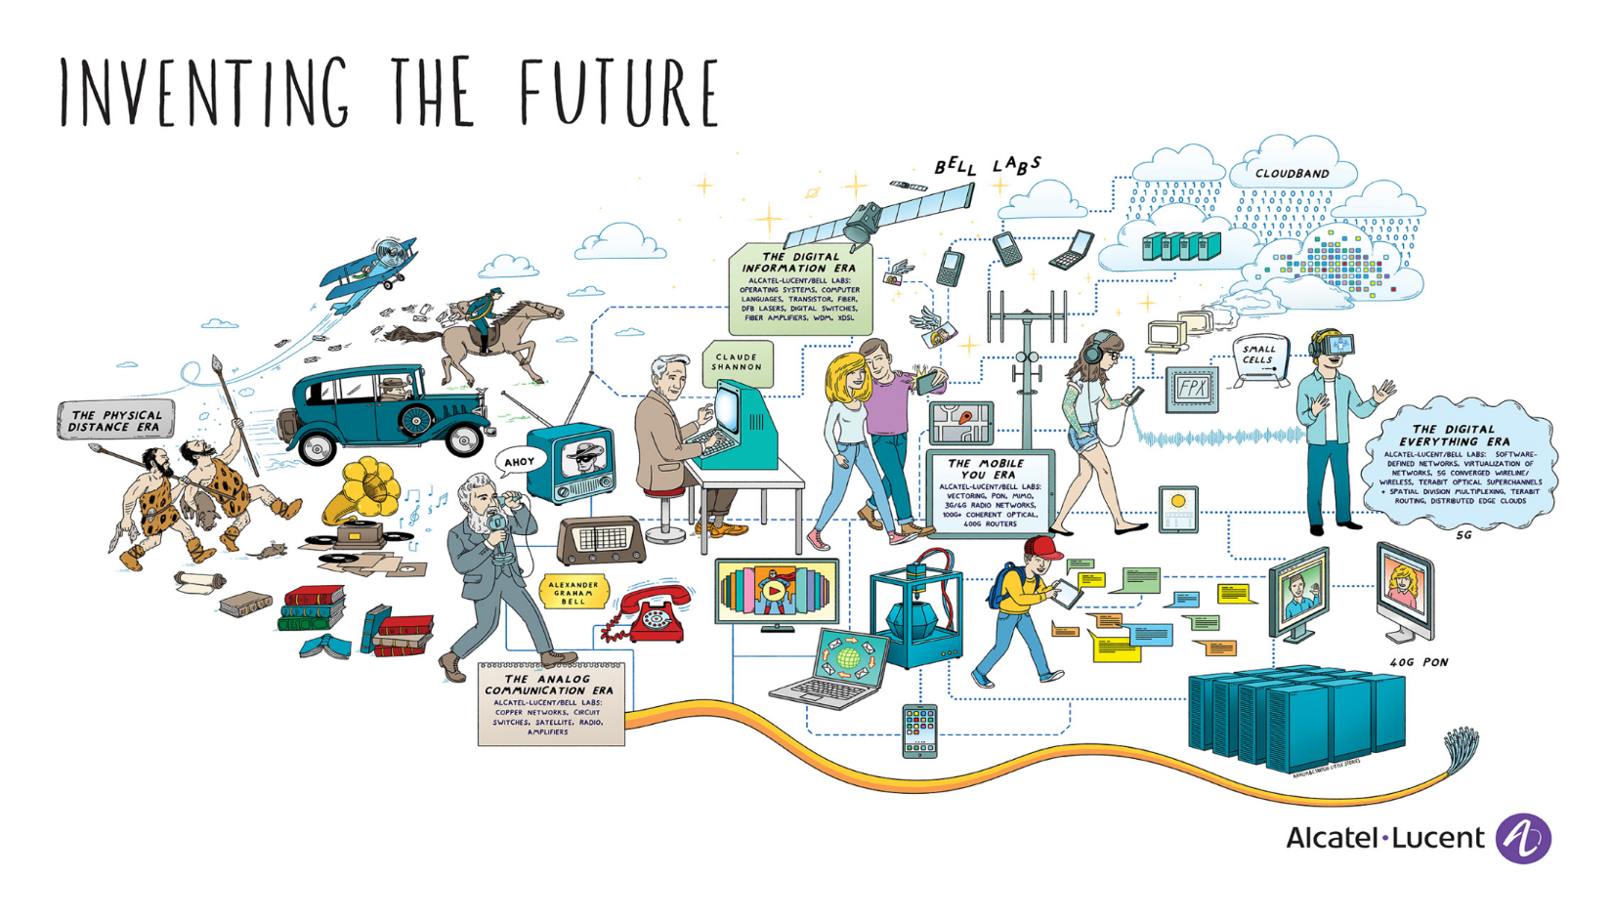
发现未来
数字通信的年代
数字一切的年代
远足的年代
模拟通信的年代
移动互联的年代
3

Slide 4
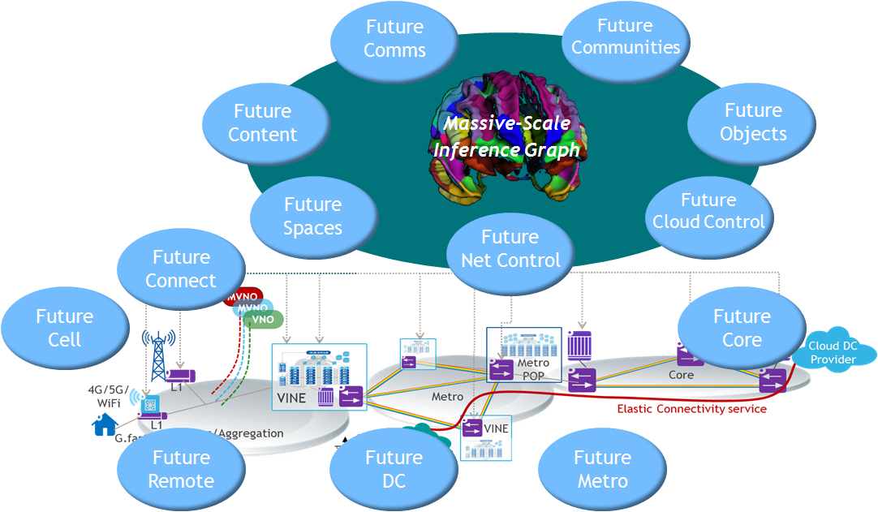
研究方向及协作
Research Initiatives & its Co-operations
贝尔实验室奖 Bell Labs Prize
每年一次的竞赛 A yearly competition program
面向突破性创新 Select winners focused on game-changing research
有机会与贝尔实验室的科学家合作 Opportunity to collaborate with Bell Labs researchers
三大奖项授予现金奖励 Three prize winners will receive a grant of cash
“Future X Network” a book of Bell Labs

Slide 5

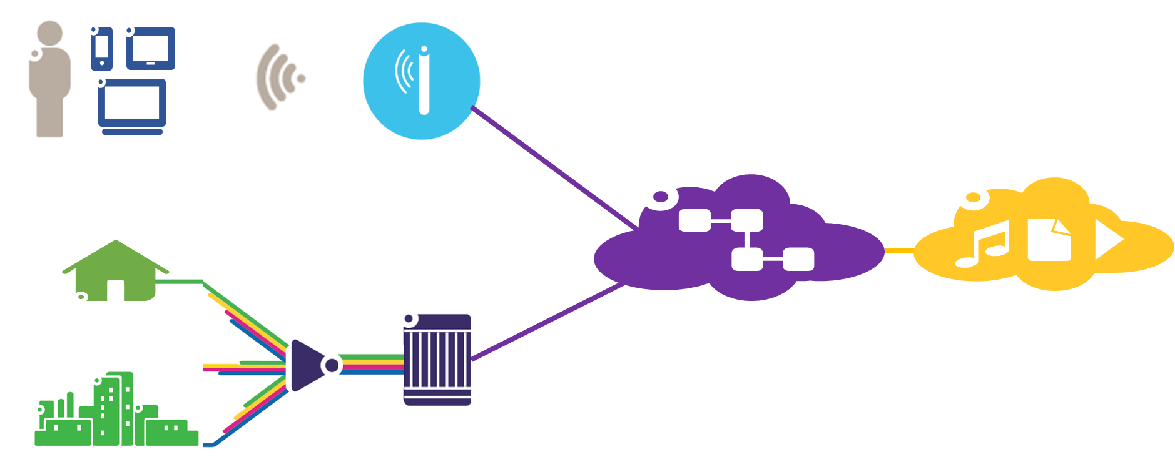
GreenTouch联盟及其成果
Overview of GreenTouch and its Results
由贝尔实验室领导，成立于2010年，旨在推动网络节能1000倍 Formed in 2010 under leadership of Bell Labs to improve energy efficiency in networks by factor 1000x
来自设备厂家、运营商和学术研究机构的48个全球组织参与 48 global organizations from equipment vendors, service providers, research institutes and academia
2015年6月18日，公布了研究成果 Final results were announced at event in New York on June 18th,2015 hosted by Bell Labs
移动无线接入 MOBILE ACCESS → 10,000x
核心网 CORE NETWORKS→ 316x
固定接入 FIXED ACCESS → 254x
2020年端到端网络净能耗降低98% （对比2010）
98% Reduction by 2020 in Net Energy Consumption in the End-to-End Network (vs. 2010)

Slide 6



