Slide 1
Water-Energy Nexus in Cities
城市中的水资源与能源
Sustainable Megacities: Food, Energy, Water and the Build Environment, 20th Oct 2015, Beijing
Dr.Lijin ZHONG, China Water Lead/Senior Associate, Water Program
钟丽锦博士，中国水项目主任/高级研究员
(图片来源: etiennems/Flickr)

Slide 2
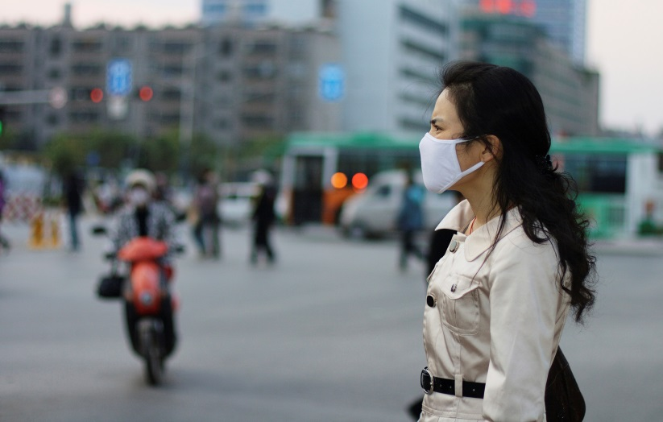
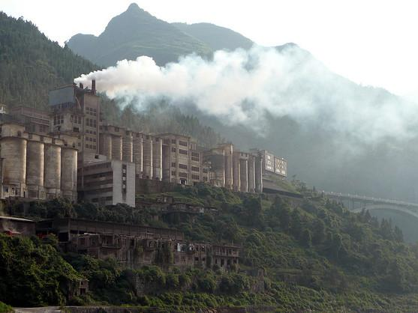
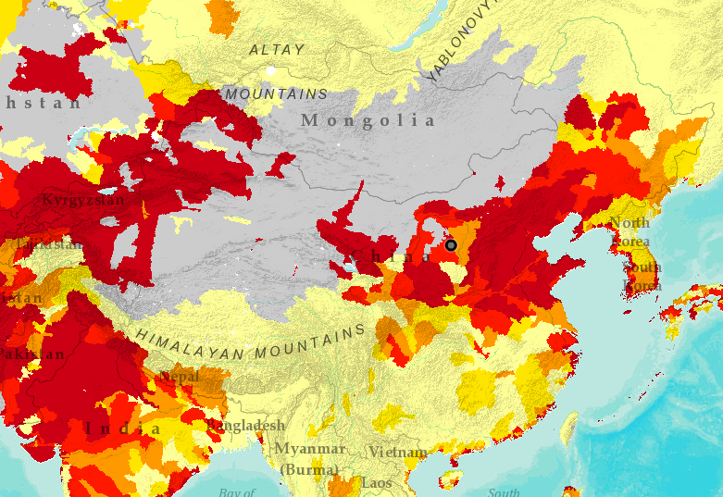
CHALLENGES IN CHINESE CITIES: Air pollution, congestion, water shortage, energy consumption, GHG emissions 中国城市的挑战：空气污染、交通拥堵、水资源短缺、能源消耗、温室气体排放
189
50%
Days of high pollution in Beijing in 2013
Global coal consumed by China
30%
32%
High and extreme high water stress in China
PM 2.5 Emissions from Transport

Slide 3
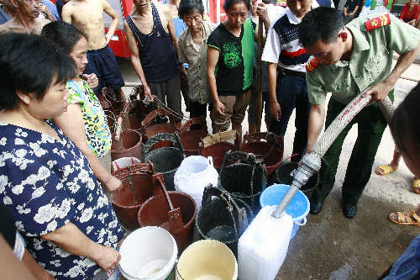
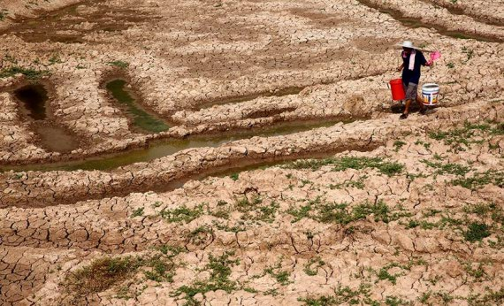
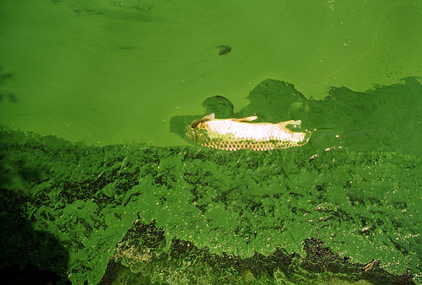
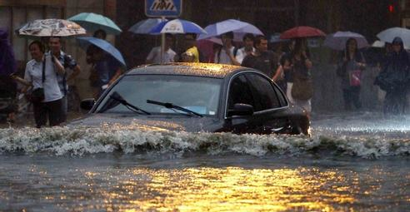
WATER CHALLENGES IN CITIES: Too Much, Too Little, Too Dirty
城市中的水挑战：水太多、水太少、水太脏

Slide 4
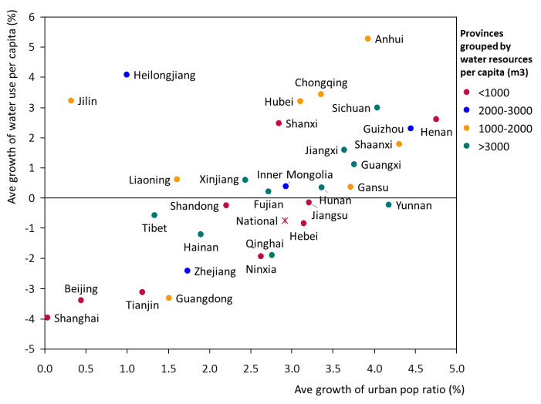
URBANIZATION SPEED UP THE INCREASE IN WATER DEMAND
城镇化加速用水需求的增长
(Source: WRI, Draft Not for Distribution)

Slide 5
Energy in Urban Water System : Energy Consumption & GHG Emission
城市水系统中的能源：能源消耗与温室气体排放
随着用水需求和水质要求的提高，城市水系统 的能源密集属性愈发强烈，随之而来的温室气体排放的增加对气候变化带来直接影响
With the increasing demand on water resources and water quality, urban water system b becomes more energy intensive, with higher GHG emission contributing directly to the climate change

Slide 6
WRI SUSTAINABLE AND LIVABLE CITIES PROJECT: WEN IN CITIES
WRI可持续宜居城市项目：城市中的水资源-能源研究
Qingdao Case: WEN in water supply
青岛：供水中的水资源-能源问题
Xiangyang Case: Sludge to energy
襄阳：污泥能源化
Chengdu: WEN in wastewater
成都：污水处理设施的能效

Slide 7
Qingdao Case: Increased energy intensity with the use of non traditional water resources
青岛案例：非传统水资源开发需要更多的能耗
Energy
Consumption
（kWh/m³）
4.0
The energy consumption of per unit water production is 10 and 2.7 times for desalination and long distance transfer in Qingdao.
青岛海水淡化和远距离调水的制水能耗分别是传统地表水的10倍和2.7倍
3.5
3.0
2.5
2.0
1.5
1.0
0.5
0.0
0
20,000
40,000
60,000
80,000
100,000
120,000
140,000
160,000
180,000
200,000
220,000
240,000
260,000
Surface
Y to QD
Ground
Reclaimed
S to N
Desalination
Blackish
(Sources: WRI, 2014)
Water Supply Potential (10 thousand m3 per year)

Slide 8
WEN IN URBAN WATER: Increased energy intensity with higher water discharge standards
污水处理：随之水质要求提高，能耗强度增加
(Draft, Not for Distribution; Source: WRI estimate)
Energy Consumption of Municipal Wastewater Treatment
With the higher requirements on water quality and reclaimed water reuse, the energy consumption of urban wastewater system increased 80% compared with 2007. The energy intensity of per unit wastewater treated increased 11%.
Notes:
污水处理量增加的同时，国家对水质要求的标准也在不断升高，再加上对污水再生循环利用的需求，污水处理能源强度出现激增。

Slide 9
Chengdu Case: Potential Energy Efficiency Improvement
成都案例：污水处理设施有提高能效的潜力
全国
成都
Over half WWTPs are below the average energy efficiency per unit wastewater treatment. Estimate suggests that over 6 billion kilowatt-hours can be potentially saved compared to the most energy efficient plant.
超过一半的污水处理厂能效低于平均水平，假设所有厂可以达到能效最优厂的水平，可以节约60亿千万时

Slide 10
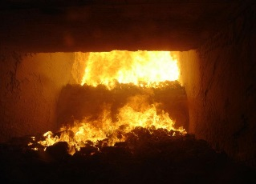
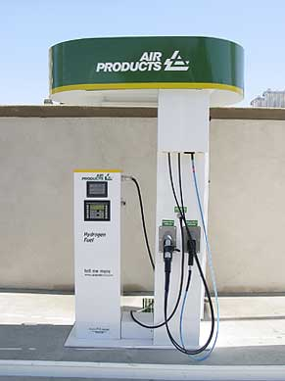
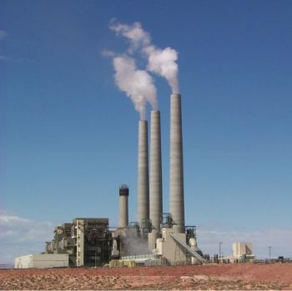
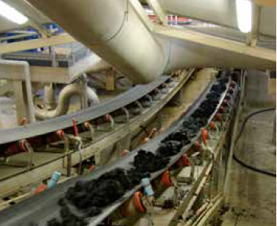
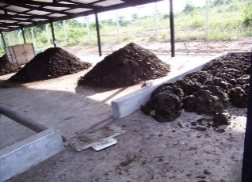
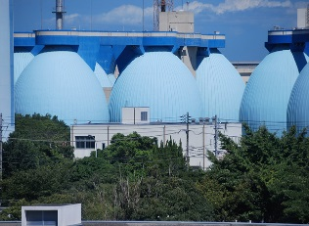
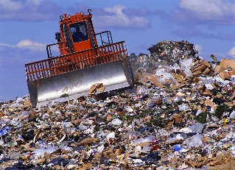
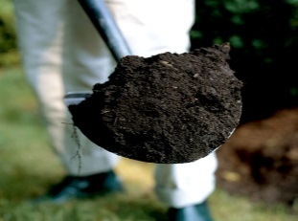
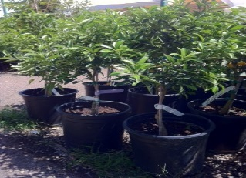
Xiangyang Case: Changing Sludge from Waste to Resources
襄阳案例：污泥资源化、能源化
Waste or Resource?
Electricity
Incineration
CNG
$$$
Composting
$$$
$$$
$$$
Anaerobic Digestion
$$$
Landfill
$$$
Biochar
Planting trees
Selection of disposal methods decides if sludge exists as waste or resource.
污泥处理方式的选择可以将污泥从废物转变为资源

Slide 11
WEN IN URBAN WATER: Some issues
城市水系统的水资源-能源问题：一些思考
Considering water, energy and climate change as separate issues 水资源、能源、气候变化问题被割裂看待
Lacking consideration of energy as a factor in water resource selection and wastewater treatment 水源选择或污水处理决策中没有考虑能源问题
Insufficiency in R&D and infrastructure investment (e.g. pipes construction) 基础设施以及研发投入不足
Lacking statistics on the energy consumption of water supply and wastewater treatment 缺乏相关的数据统计
Ignorance of the impacts of urban water system on climate change 忽略了城市水系统对气候变化的影响

Slide 12
Contact 联系人
Dr.Lijin Zhong
China Water Lead/Senior Associate
Water Program
World Resources Institute
China Office
(86)10-6416 5697-55
lijin.zhong@wri.org
www.wri.org
www.wri.org.cn
Xiaotian Fu
Associate
Water Program
World Resources Institute
China Office
(86)10-6416 5697-59
xiaotian.fu@wri.org
www.wri.org
www.wri.org.cn
Supporters

