Slide 1
Michael Singer Studio

Slide 2
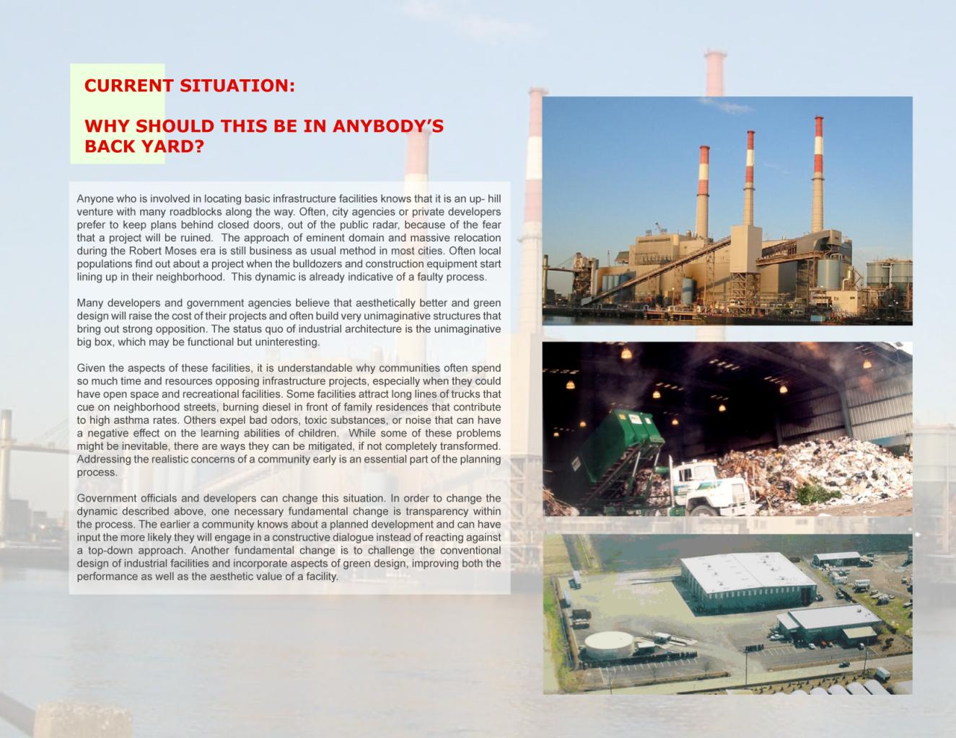

Slide 4
