Slide 1
Peña Station NEXT – Modeling a new Zero Energy Urban District
Andrew Parker, NREL Commercial Buildings Research Group
12/1/2017

Slide 2
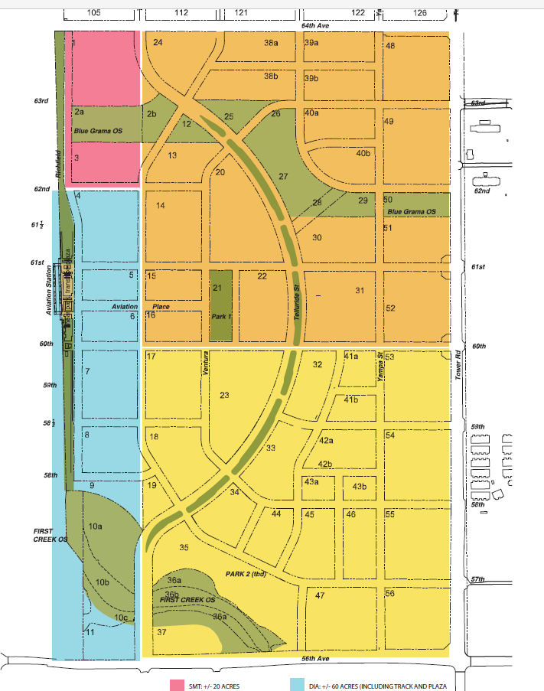
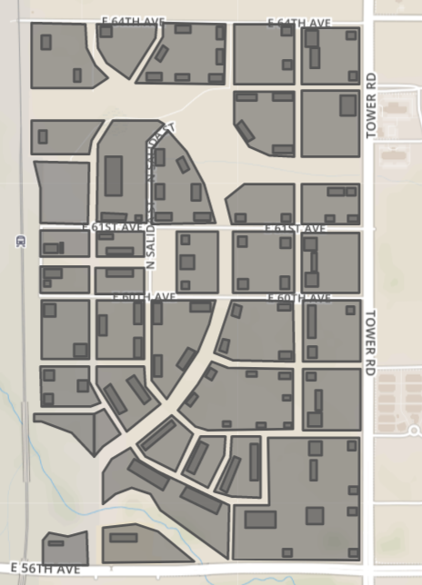
Peña Station NEXT
400 acres with a mix of 103 residential, hotel, office, restaurant, and retail buildings

Slide 3

Project Team
Electric & Gas Utility
Developer
Anchor Tenant & District Tech Company
Developer
National Lab
Working with key project stakeholders from the outset ensures that solutions meet the practical limitations and concerns that are sometimes ignored in research.

Slide 4
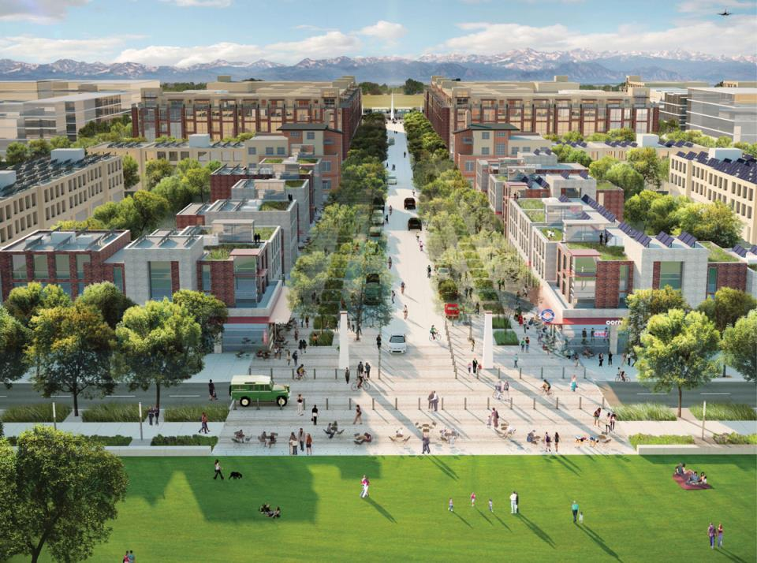
Peña Station NEXT

Slide 5
Building Modeling Scenarios
Scenario | Characteristics
90.1-2013 Code Baseline | Lots of gas for heating
NREL ZNE Ready 2017 (Standard Efficiency) | Higher effectiveness ERVs All-LED lighting Higher insulation Reduced infiltration Plug load reduction Smart exterior/street lighting controls
NREL ZNE Ready 2017 + District Heat Pumps | Electrify heating and with heat pumps Investigate district vs. individual building loops
High Efficiency Scenario + Renewable Maximization | Maximize On-site PV direct consumption Maximize use of Grid-Scale PV and Wind

Slide 6
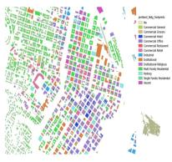

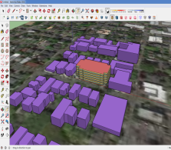
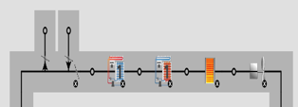
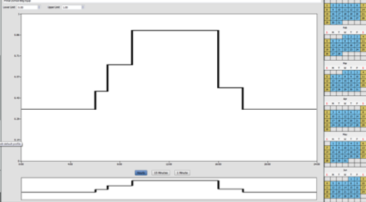
Urban Renewable Building And Neighborhood optimization
NREL’s URBANopt platform, and its underlying physics-based analytics engine, supports the design and optimization of high-efficiency urban districts with sustainable energy technologies integrated community-wide.
Geometry Creation Measure
Building geometry
Footprint and Height
Building Type Measure
OpenStudio Standards Library
Detailed Building
Energy Models and Load Profiles
Primary Fuel, Building Type, Vintage, and Template
+

Slide 7
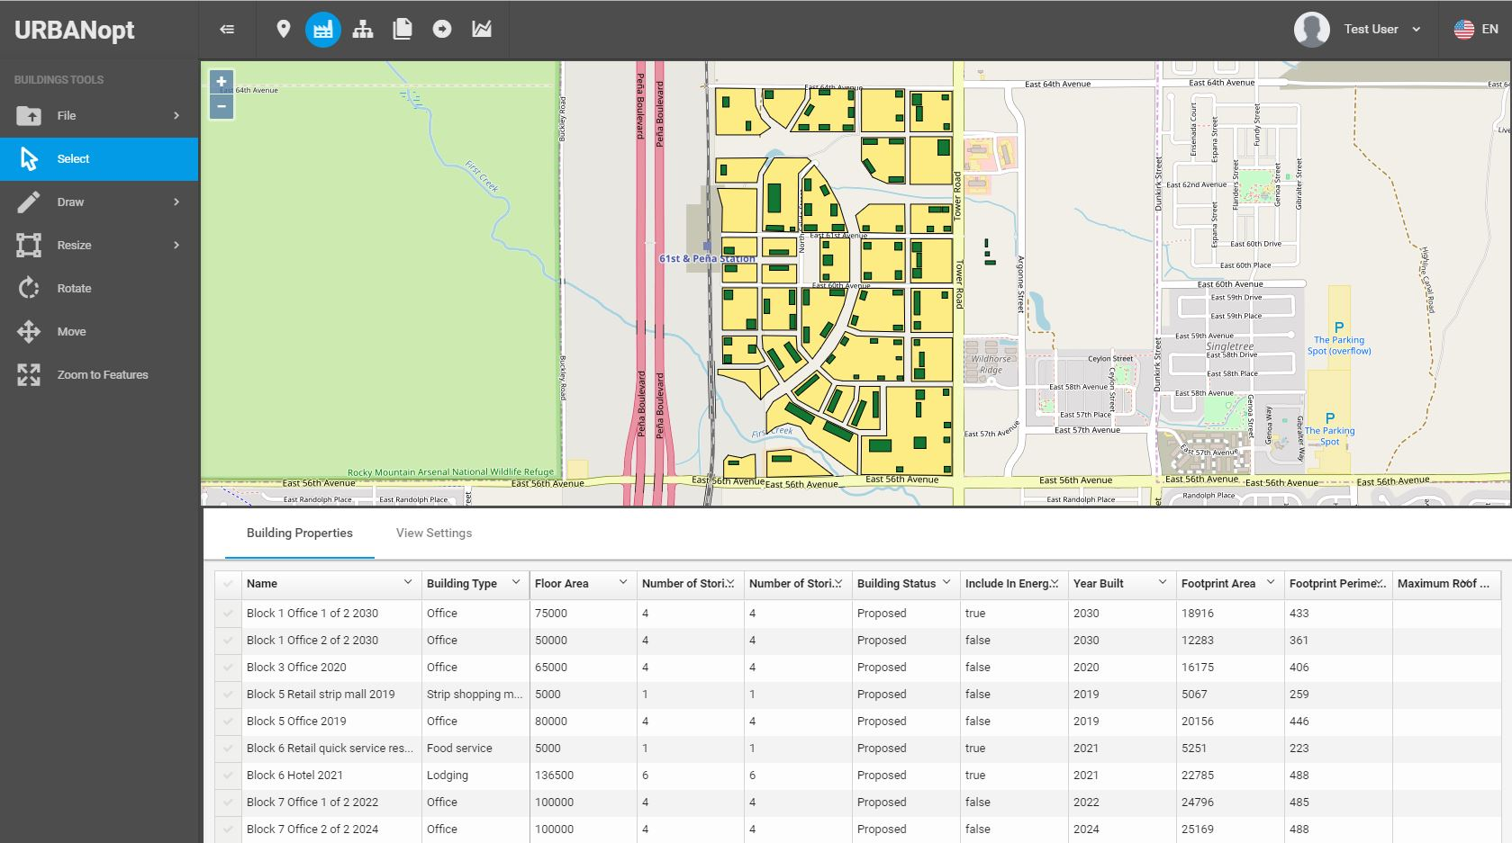
URBANopt Pena Station

Slide 8
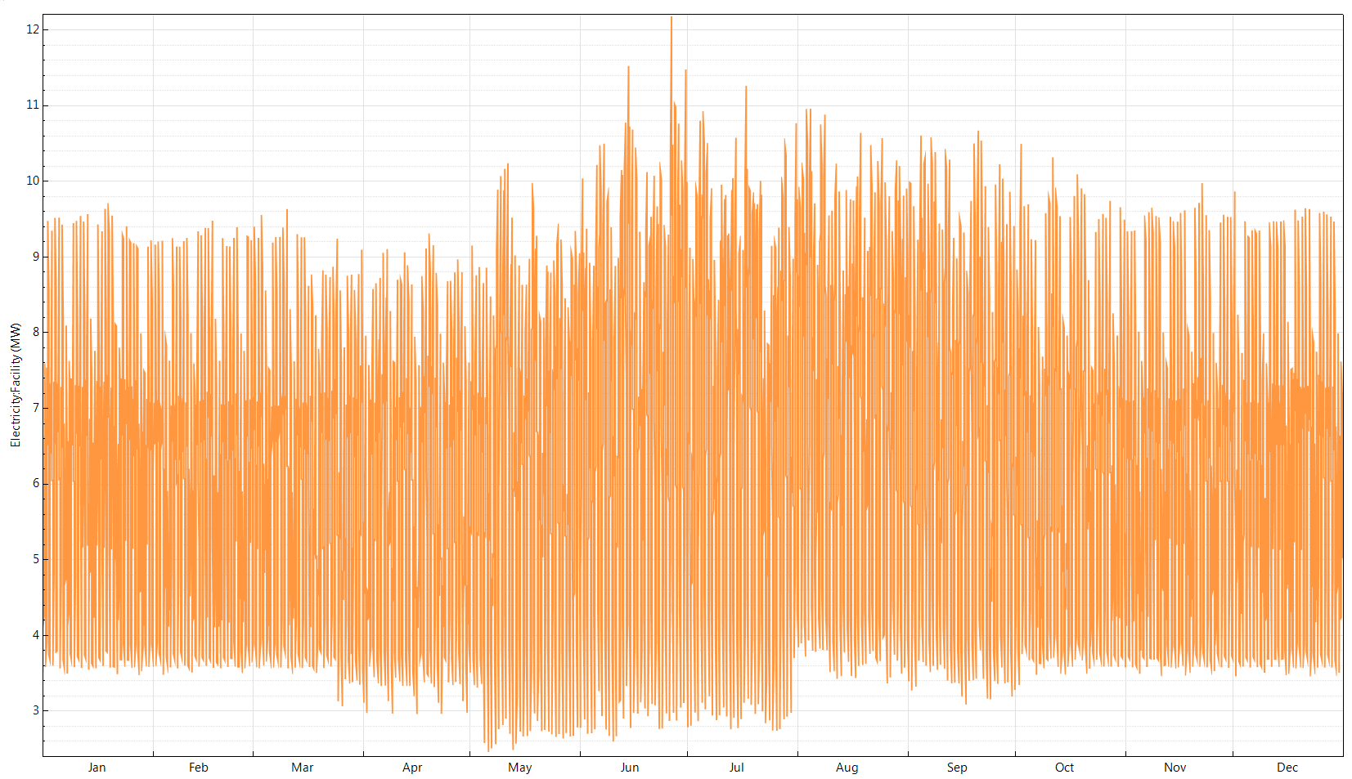
Baseline Site Total Electricity (MW)

Slide 9
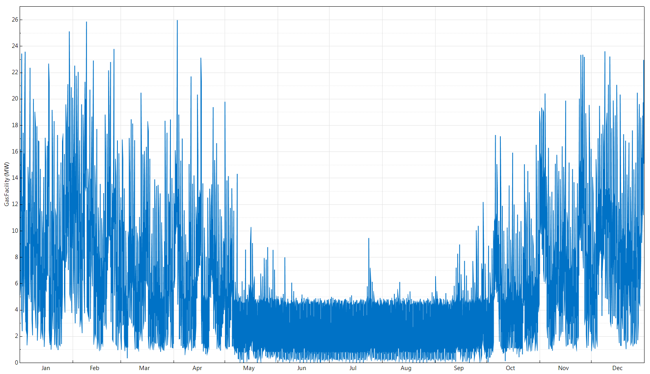
Baseline Site Total Gas (MW)

Slide 10
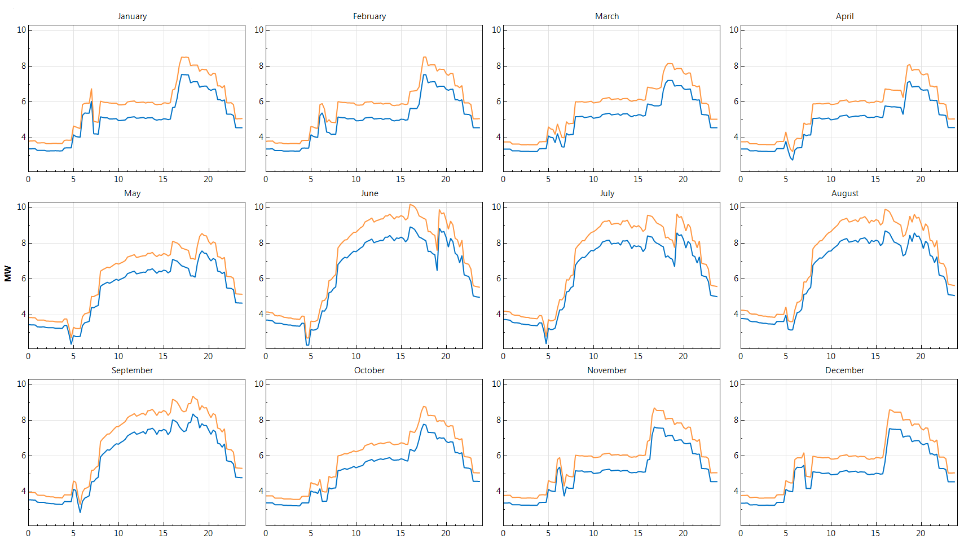
Avg. Daily Site Total Electricity (MW) – Baseline vs Efficient

Slide 11
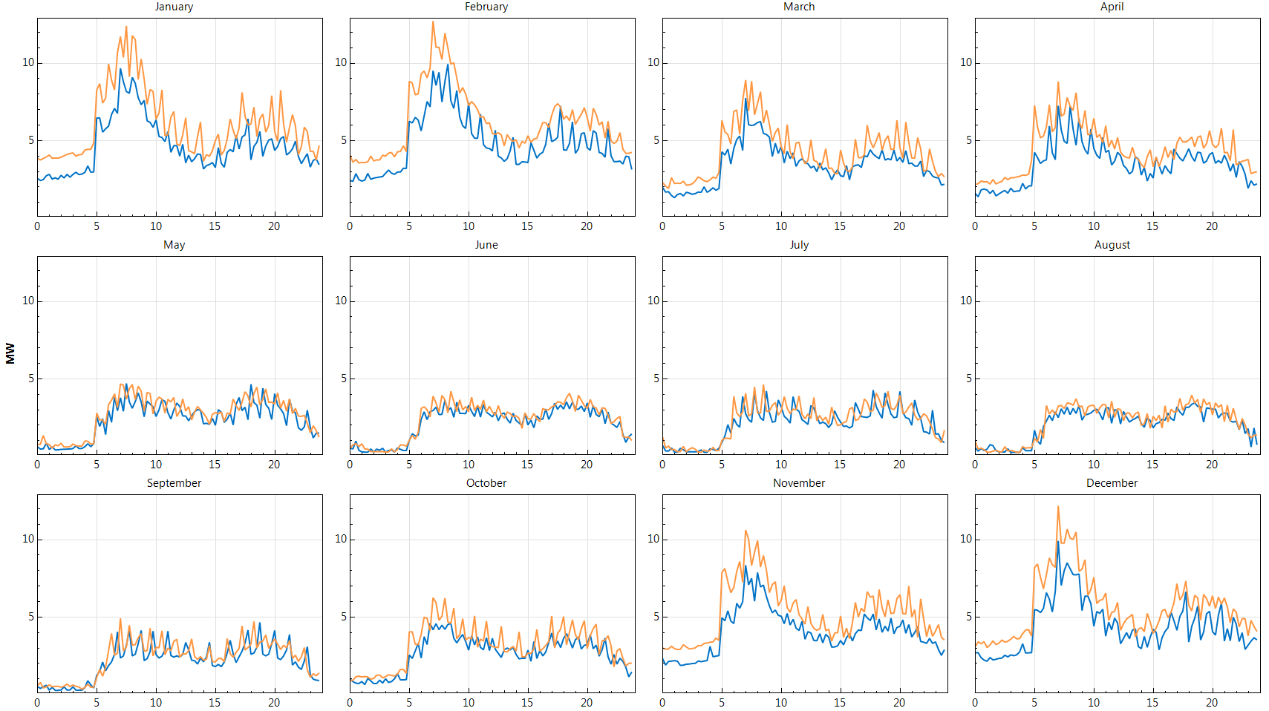
Avg. Daily Site Total Gas (MW) – Baseline vs. Efficient

Slide 12
Power System Modeling Scenarios
Scenario | Characteristics
Baseline | Typical
PV Everywhere | 19.8 MW roof-mounted PV 18.4 MW canopy or ground-mounted PV
PV + Battery Storage | With and without smart inverters PV and battery capacity optimization
Renewable Maximization with PV + Storage + Control Strategies + … | Maximize On-site PV direct consumption Maximize use of Grid-Scale PV and Wind

Slide 13
URBANopt-OpenDSS Integration
Existing distribution feeder
New development
SynerGEE
(proprietary)
URBANopt
Building loads, PV
OpenDSS
(open source)
Desired topology
Geojson
Lines, switches
Xcel catalogue of hardware options
Python-based genetic algorithm
Power flow
Realistic feeder designs

Slide 14
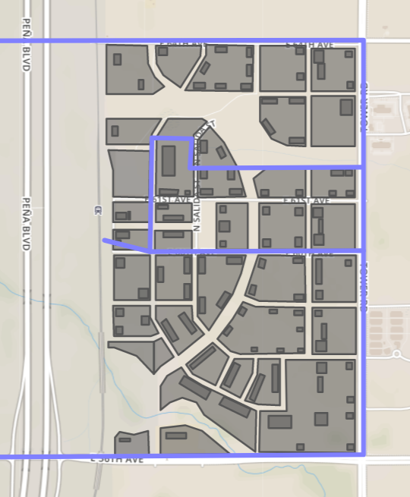
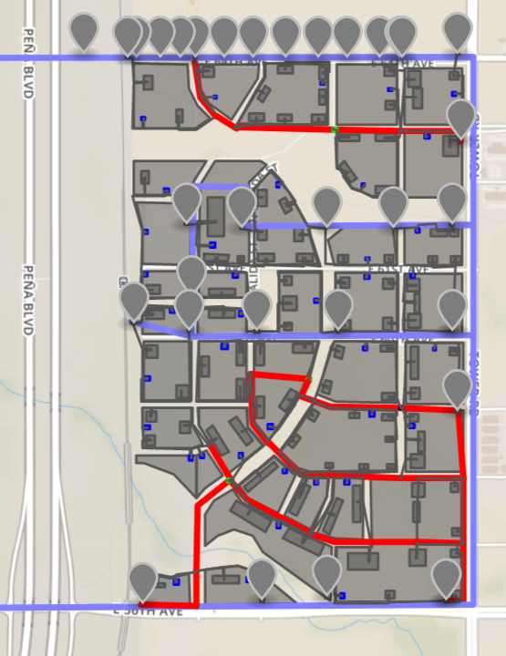
PSN Distribution Feeder Topology
Existing distribution feeder

Slide 15
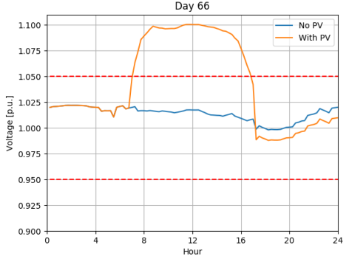
Clear Day Feeder Performance
PV Everywhere scenario
  Over-voltage violations with high PV penetration
  Red lines indicate ANSI voltage limits

Slide 16
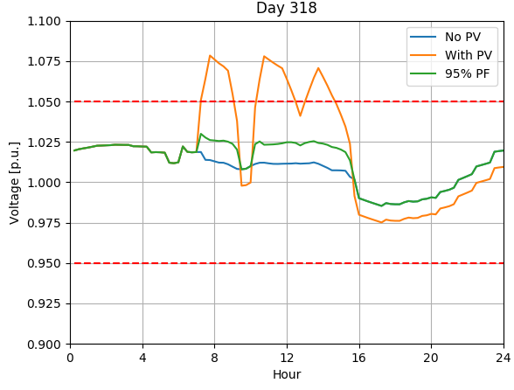
Cloudy Day Feeder Performance
PV Everywhere scenario
  Over-voltage violations with high PV penetration
  Red lines indicate ANSI voltage limits
  Constant power factor limits voltage violations
  More advanced inverter control strategies to be tested to limit curtailment

Slide 17
Partner Perspective
What impact do you expect for this project to have on your organization?
XCEL ENERGY | “Xcel Energy views this study as the first step to providing an additional way we could supply clean energy options that will delight our customers.”
What impact do you expect this to have nationally on the industry/market?
PANASONIC | “We seek a replicable model for development that open traditional utility distribution planning to all stakeholders.”
What’s the most important part of the project for your organization?
DIA | “DEN is entering a period of unprecedented growth...Sustainable energy will be a key focus of these efforts, and the study provides the first example of what may be possible in the future.”

Slide 18
Partner Perspective
PARTNERSHIP QUOTE
“The carbon-neutral district study at Pena Station NEXT centers on three key elements: customer choice, economic development, and technological energy innovations. Across these categories, the company is hearing what our customers are asking for and working to create new programs to address their energy needs and desires. Xcel Energy has a rich history of stepping up to the challenges of new energy technologies and Pena Station NEXT is no exception. We look forward to continuing our work with NREL, Panasonic, L.C. Fulenwider and Denver International Airport on this dynamic and engaging project.” –
Alice Jackson, VP Strategic Revenue Initiatives | Xcel Energy

Slide 19
Thank you!
Andrew.Parker@nrel.gov
303-275-4568

