Slide 1
Success in a Remote Workplace
Managing Remote Workers and Teams
Katherine Zuliani & Jean Finnerty
Office of Human Resources
2021

Slide 2
Agenda:
Remote Work Arrangements:
Policy & Expectations
Managing Remote Workers:
Hybrid & Full Remote
Effective Performance Management:
Setting Expectations & Goals for Remote Workers
Building Trust & Tracking Progress
Creating a Well-Functioning Team
Leading at a Distance and by Example
Providing Constructive Feedback
Having constructive “difficult” conversations
Technology Resources to be an Effective Leader

Slide 3
Remote Work Arrangements:
Policy & Expectations
Remote work for certain employee positions may be advantageous for both New York Tech and its employees.
Benefits Include:
Increased productivity
Increased performance
Reduced commuting time
Enhanced employee recruitment and retention
Relief of on-campus space constraints
Greater work-life balance
Remote work is a viable alternative work arrangement in cases where the individual employee, the job and the supervisor are well suited to such an arrangement.
Not all employees and positions are suitable for remote work.

Slide 4
Evaluating the suitability of a Remote Work Arrangement:
Factors to be considered by supervisor, Vice President and Dean, if applicable.
Does the position require in person interaction and coordination with other employees, students, or others?
Does the employee need to have immediate access to documents or other information located only on campus?
Will the remote work arrangement impact service quality or operations, and/or will it increase the workload for other employees?
Will the needs of the department be met when the requested remote work arrangement is implemented?
Will the remote work arrangement continue to serve the successful performance of the employee? Assess the performance of the employee to ensure that the employee is in good standing and to determine if the employee’s work habits display the traits customarily recognized as appropriate for successful remote workers, such as reliability, responsiveness, and the ability to work independently.
Will the supervisor be able to successfully manage the remote worker?
Will the employee be working remotely five days a week, or only part of the week?

Slide 5
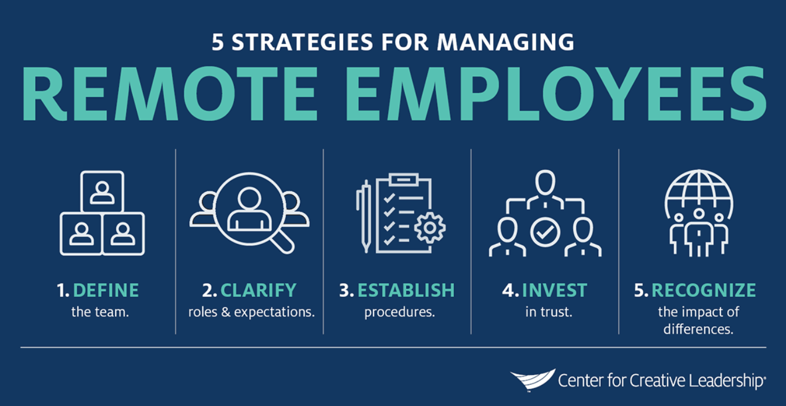
Managing Remote Workers:
Hybrid & Full Remote
Determine what your team will look like:
Hybrid Remote – regularly scheduled days each week or month
Fully Remote – five days a week.
Blend of In-person, hybrid and fully remote
Ensure your team is clear on organizational/ departmental goals & job expectations.
Set goals, provide and receive feedback
Create a consistent process for how you interacting with your team:
Outline expectations for meeting formats:
For ex: ensuring all meetings have a physical location and a digital location (Zoom invite).
Consistent Weekly or Bi-weekly 1:1 meetings
Managing Remote Employees: How to Lead From a Distance

Slide 6
Effective Performance Management
Setting Expectations & Goals for Remote Workers:
Clearly communicate department goals across all team members whether remote, hybrid remote or in-person.
The key to accountability is to ensure your team is on the same page about department goals and how their job duties align with those goals. Intentional consistent communication with remote workers will ensure your team, whether in person or remotely is on the same page.
Get familiar and comfortable with digital communication for check-in’s: meet regularly with employees via virtual platforms like Zoom or Microsoft Teams. Keeping webcams on during check-in’s allows for “face to face” communication.
Be cognizant of virtual distance - make an effort to break down the walls of virtual distance. Establish a framework for employees to connect with one another and with their supervisors. Frequent department meetings or check-in’s, consistent expectations, and holding employees accountable to their work keeps employees motivated and engaged.
Be mindful that before all communication moved virtual, you might not have realized that your messages were being conveyed mostly by non-verbal cues. As video calls become the default, you need to make a conscious effort to think about what message you are sending with your on-screen body language

Slide 7
Refer to New York Tech’s Performance Management System B.E.A.R for a Manager Guide on creating SMART Goals, set expectations and goals using the GROW model and how to provide continuous real time feedback.

Slide 8
Building Trust & Tracking Progress
Dispersed teams often struggle to build and maintain trust. Not only do they lack the physical proximity that encourages feelings of cohesiveness, but often members are unsure how to address cultural differences.
To build team trust:
Provide employees tasks they are expected to complete in a given time frame.
Track progress on work and projects. Remember, just because you can’t see them doesn’t mean work isn’t getting done.
Periodically hold virtual “face-to-face” meetings to build rapport.
Keep the team informed of long-term organizational changes.
Ask for team input on critical organizational or departmental issues.
Delegate work and allow team members who are experts in their field to lead in their fields of expertise; assigning project leads demonstrates trust of the employees and promotes professional development and mentoring opportunities.
Celebrate short-term wins, reinforcing the team’s shared effort.
Trust that if they're communicating clearly and meeting goals and deadlines, your employees are being productive and doing their jobs effectively.

Slide 9
Creating a well-functioning team:
In person, Remote & Hybrid Remote Workers
Trust: As a leader, be transparent about organizational and departmental goals
Competence: People’s jobs compliment strengths resulting in good performance
Communication: Team members, whether remote, in-person or hybrid are given consistent and clear information so they can succeed
Support: Leaders provide support and resources and identify when team members are struggling.
Respect: Everyone contributes in important ways. All contributions are valued

Slide 10
Leading at a Distance and by Example
Leaders have the responsibility to make sure their employees have everything they need to complete their jobs and for monitoring overall team performance, both remote and in-person.
The most successful managers are:
Good listeners
Communicate trust and respect
Inquire about workload and progress without micromanaging
Share positive feedback, motivate and celebrate successes
Provide constructive feedback when necessary.
Recognize over-communicating isn’t a bad thing
Inspire employees to do great things.
Balancing the needs of in-person workers and remote workers can be challenging. Remember to treat in-person and remote workers as equally as possible. Parity and consistency in communications is important. Whether in person or remote, workers deserve the same level of trust, respect and guidance.

Slide 11
Constructive Feedback & Coaching
Feedback:
Provide Real-Time Feedback:
Real-time feedback is a process in which managers and employees communicate in real-time in a semi-structured, ongoing manner regarding successes and opportunities for improvement
Feedback is specific to their work and progress on projects
Feedback can be given in two ways: Constructive feedback is intended to provide your employee with ways to improve. Positive feedback is to provide your employee with positive recognition for a job well done.
Feedback sessions via zoom should be followed up via email to ensure your employee understands and is on the same page.
Coaching:
Focuses on learning and opportunities for growth and improvement
Supportive process:
motivates and engages workers
builds confidence & increases engagement
Build a culture of feedback:
Be open to not only giving but also receiving feedback
Provide specific, genuine growth directed feedback
Keep communication lines open:
Keeping lines of communication open among remote workers can be a challenge. Outreach to remote team members must be intentional.
Maintain regular contact with all team members. Hold consistent weekly or bi-weekly virtual team meetings
Develop a schedule for 1:1 meetings with all employees those remote, hybrid remote or in-person
Make meetings with staff a priority, of course things happen and sometimes meetings need to be canceled. Just remember that making time for your team is important.

Slide 12
Constructive “Difficult” Conversations:
Providing feedback to remote workers must be intentional. Outreach and consistent communication is an intentional act with remote workers.
What communication tool is the best?
Difficult feedback or conversations ideally should be done during regular weekly 1:1 meetings. Remember, real-time feedback is a process in which managers and employees communicate in a semi-structured, ongoing manner regarding successes and opportunities for improvement in real-time.
Video calls should be the preferred method to offer “face to face” connections with remote workers.
Describe the problem and ask the remote worker for their perspective and suggestions for fixing the problem. Allowing the employee to dig deeper into identifying a solution holds them accountable.
Provide clear and specific feedback for ways to improve and expectations going forward.
Leaders who navigate difficult conversations successfully can build stronger relationships with their employees and provide needed guidance and correction on workplace performance or behavior—which fosters employee engagement

Slide 13
Technology Resources to be an Effective Remote Leader
Use technology tools effectively
Become familiar with the technology required to manage a remote team
Lead by example - your team must see you using technology so they will follow
Technology Resources
New York Tech Zoom Resources
Zoom Updates
Desktop Support
Microsoft Teams
Software Updates

Slide 14
THANK YOU!
The New York Tech Office of Human Resources is available to provide additional information, resources and support in managing remote teams.
hr@nyit.edu
516-686-7667

Slide 15
References/Resources:
Building a Culture of Feedback
Leading at a Distance
How to Handle Difficult Conversations at Work
Building and Leading High-Performing Remote Teams
Managing Virtual Teams
Academic Impressions
How to Lead from a Distance
Leading both In-person & at a Distance
Giving Feedback for Employees: A Managers Guide

